Slide 1
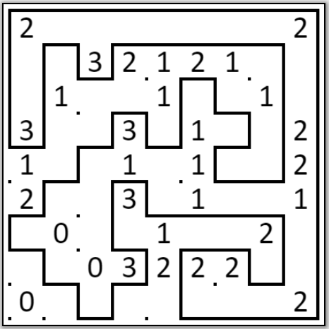
Solution
Created using https://www.kakuro-online.com/slitherlink/

