Slide 1
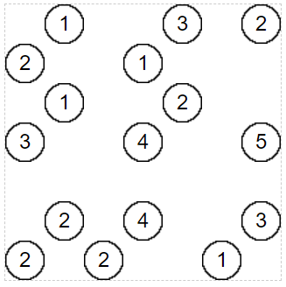
Solve the following Hashiwokakero

