Slide 1
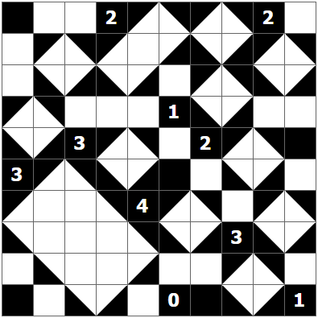
Solution
Created using https://www.puzzle-shakashaka.com/

