Slide 1
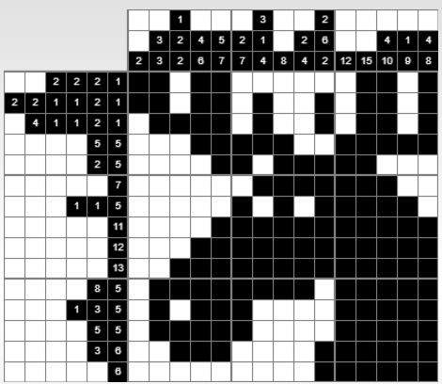
Solution
Created using https://nonograms.relaxpuzzles.com/nonogram/99749

