Slide 1
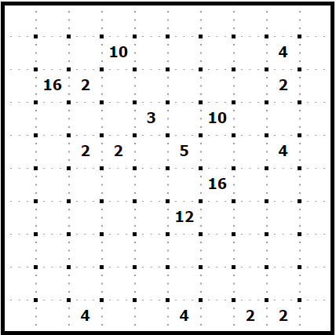
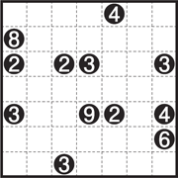
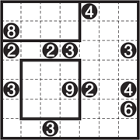
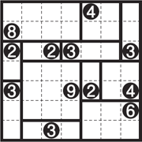
Solve the Following Shikaku
Rules (https://www.nikoli.co.jp/en/puzzles/shikaku/ )
Divide the grid into rectangles with the numbers in the cells.
Each rectangle is to contain only one number showing the number of cells in the rectangle.
Sample
Progressing
Solution

