Slide 1
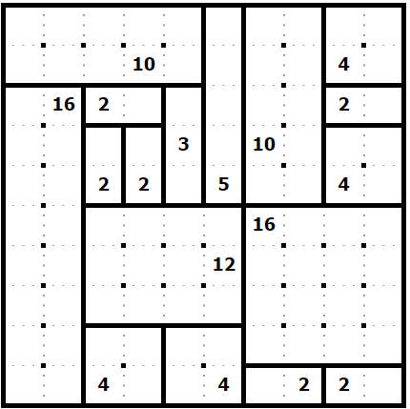
Solution
Created using https://www.puzzle-shikaku.com/

