Slide 1
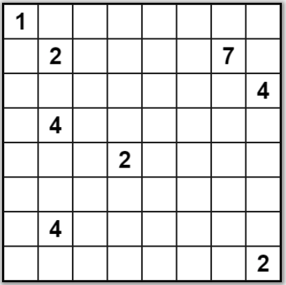
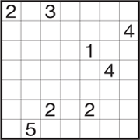
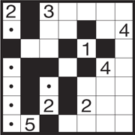
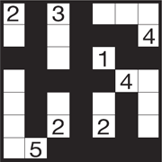
Solve the Following Nurikabe
(https://www.nikoli.co.jp/en/puzzles/nurikabe/)
Rules
Fill in the cells under the following rules.
You cannot fill in cells containing numbers.
A number tells the number of continuous white cells. Each area of white cells contains only one number in it and they are separated by black cells.
The black cells are linked to be a continuous wall.
Black cells cannot be linked to be 2×2 square or larger.
Sample
Progressing
Solution

