Slide 1
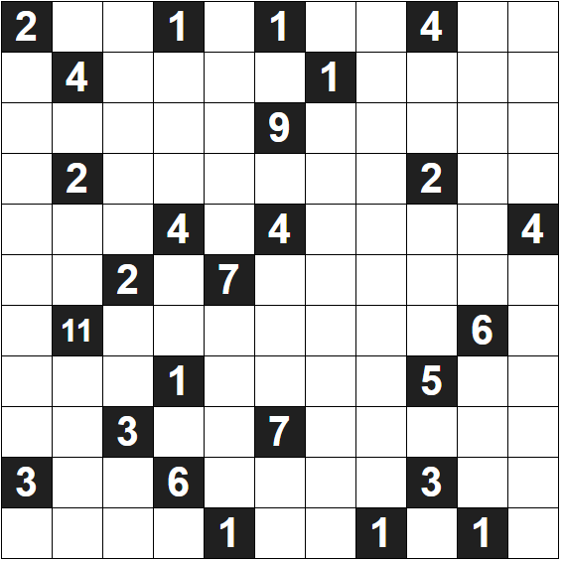
Solve the Following Vector Puzzles
Rules
Your task is to draw arrows starting from each of these black squares in such a way so that the total number of white squares covered by arrows emanating from any black square equals exactly the number displayed.
Arrows can go up, down, left or right, but can never cross another arrow.
You must also fill every empty square on the grid with one arrow segment.

