Slide 1
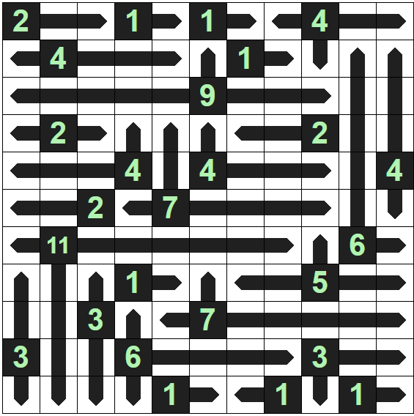
Solution
Created using https://vectors.puzzlebaron.com/

