Slide 1
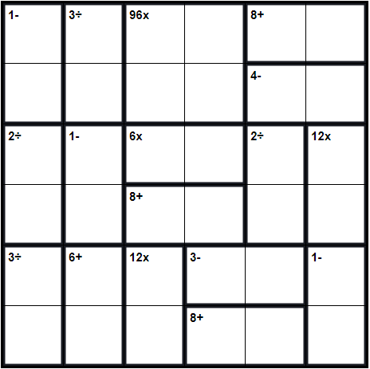
Solve the Following Calcudoku
Rules of Play
You can use only the numbers 1 through 6 in this puzzle.
Each number must be used exactly once in each row and column.
The numbers in each outlined group must arithmetically equal its given formula.

