Slide 1
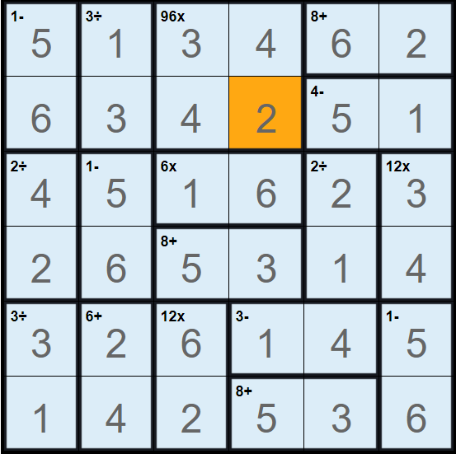
Solution
Created using https://calcudoku.puzzlebaron.com/play.php

