Slide 1
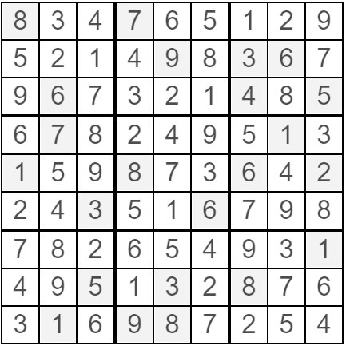
Solution
Created using http://sudoku.becher-sundstroem.de/

