Slide 1
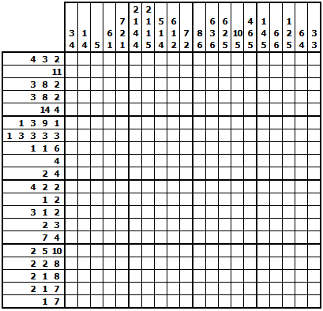
Solve the Following Nonogram

