Slide 1
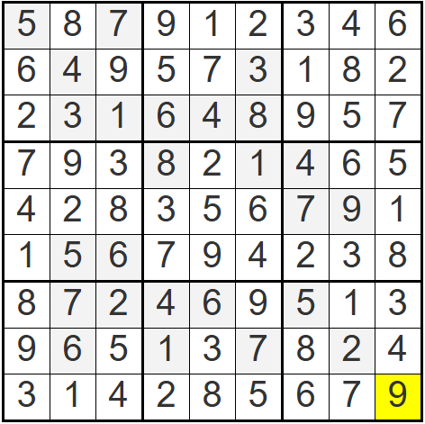
Solution
Created using https://sudoku.puzzlebaron.com/init.php?d=d

