Slide 1
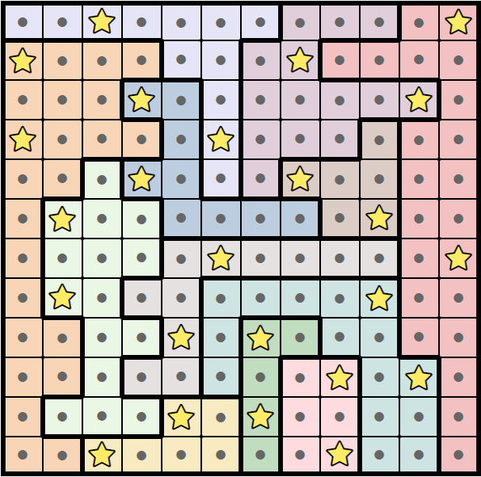
Solution
Created using https://starbattle.puzzlebaron.com/

