Slide 1
Problem

Slide 2
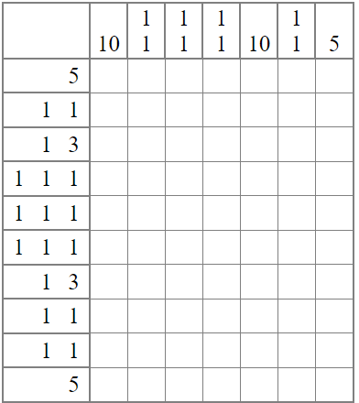
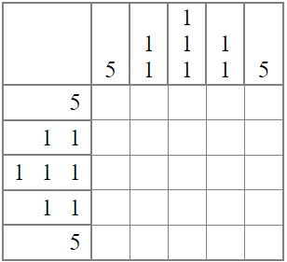
Nonogram

Slide 3
Solution

Slide 4
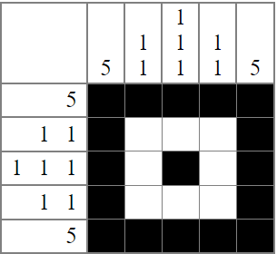
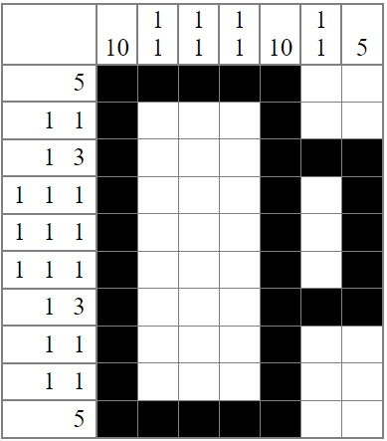
Created using http://www.landofcrispy.com/nonogrammer/nonogram.html?mode=build

