Slide 1
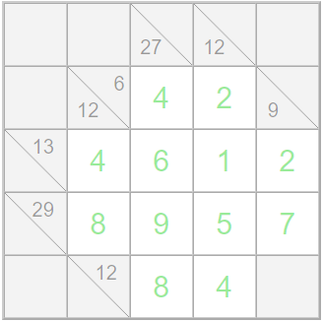
Solution
Created using https://www.kakuros.com/

