Slide 1
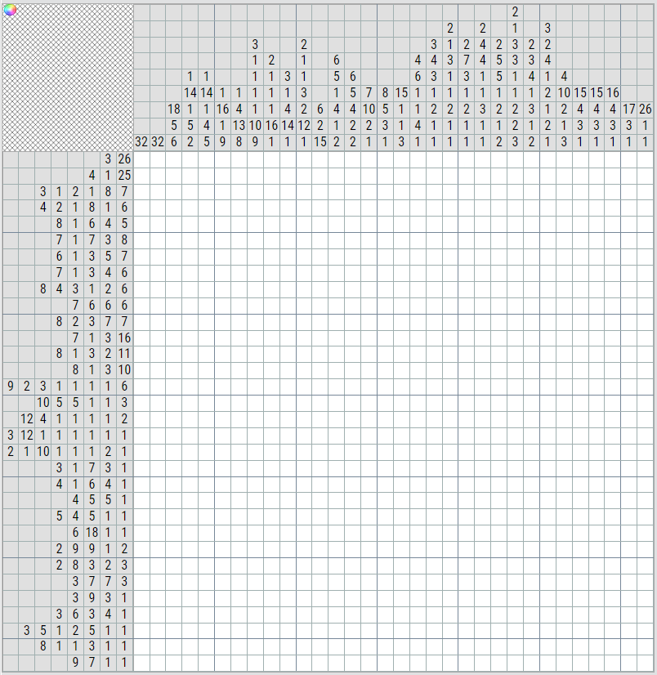
Solve the following nonogram

