Slide 1
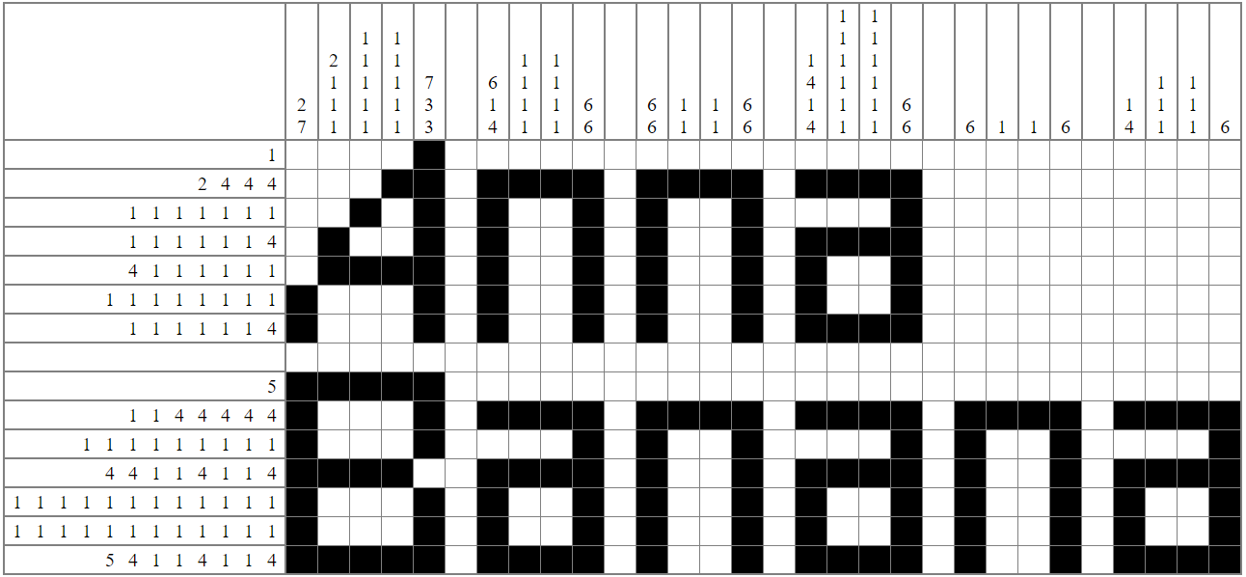
Solution
Created using http://www.landofcrispy.com/nonogrammer/nonogram.html?mode=build

