Slide 1
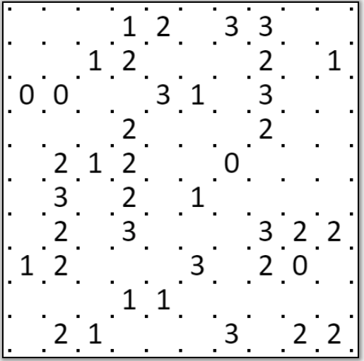
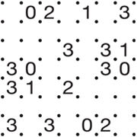
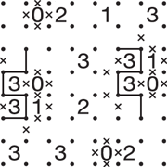
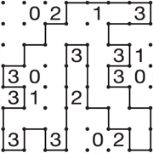
Solve the Following Slitherlink
Rules ( https://www.nikoli.co.jp/en/puzzles/slitherlink/ )
Connect adjacent dots with vertical or horizontal lines to make a single loop.
The numbers indicate how many lines surround it, while empty cells may be surrounded by any number of lines.
The loop never crosses itself and never branches off.
Sample
Progressing
Solution

