Slide 1
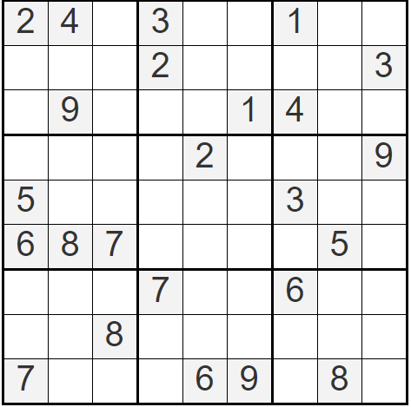
Solve the Following Sudoku

