Slide 1
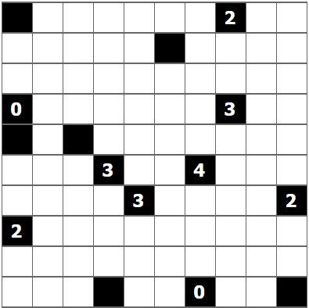
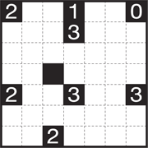
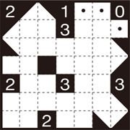
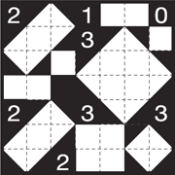
Solve the Following Shakashaka
(https://www.nikoli.co.jp/en/puzzles/shakashaka/)
Rules
Place black “triangles in squares” (see 2) in the grid under the following rules.
There are four kinds of black triangles you can put in the squares: . You cannot place black triangles in the black squares.
The parts of the grid that remain white (uncovered by black triangles) always form a rectangle or a square.
The numbers indicate how many black triangles are around it, vertically and horizontally.
Sample
Progressing
Solution

