Slide 1
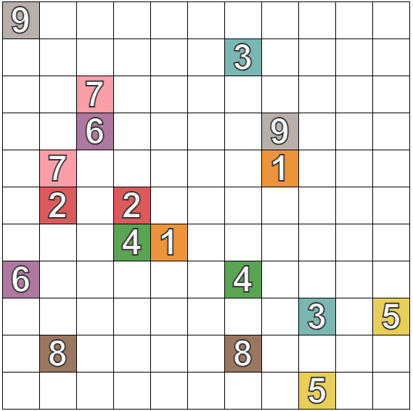
Solve the Following Numberlinks

