Slide 1
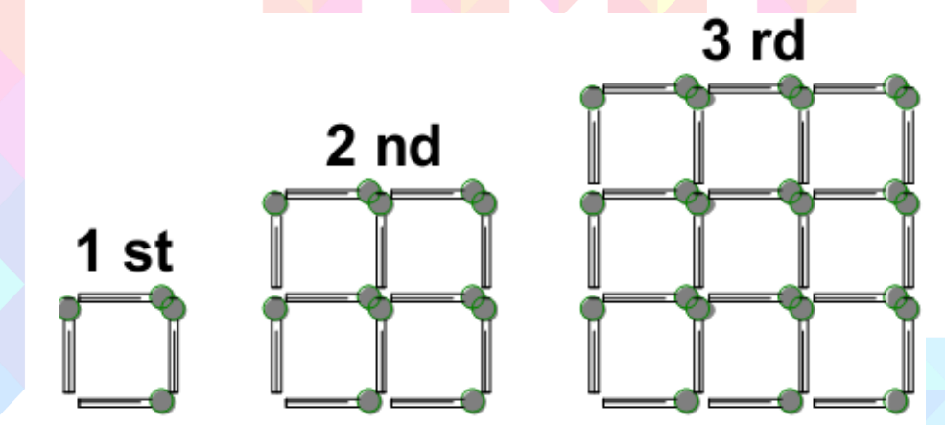
Problem
Ali is making squares using matches. He made the next square by adding more matches to the previous square as shown in the picture below. How many matches does he have to add to the 5th square to build the 6th square?

