Slide 1
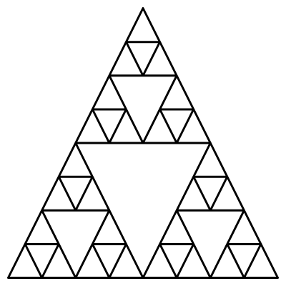
Problem
How many triangles are there in the following picture?

