Slide 1
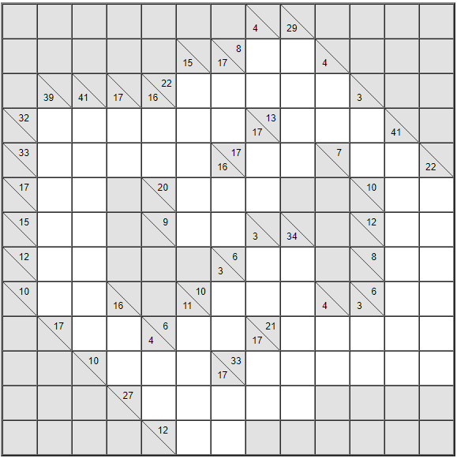
Solve the Following Kakuros

