Slide 1
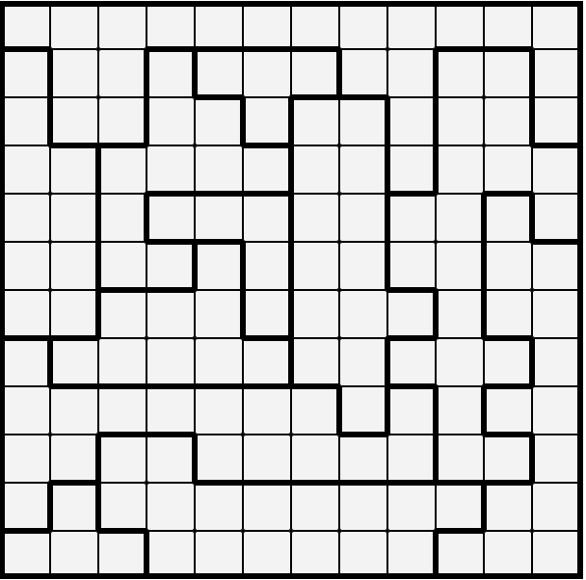
Solve the Following Star Battles
Rules
This puzzle requires two stars in every row, column and outlined shape.
No two stars can touch each other, even diagonally.

