Slide 1
Auto-Keras An efficient Neural Architecture Search System
Frank Wei
Data Scientist

Slide 2
Outline
Purpose of the Auto-Keras
Background
Bayesian Optimization
Kernel transformation
Experiment and result
Conclusion

Slide 3
Purpose of the Auto-Keras
Two primary purposes for training a neural network on a dataset
Defining a neural network architecture that learn the nature of the dataset
Tuning a set of hyperparameters over many experiments to lead model with high accuracy
These experiments can add up to hundreds to thousands of hours in GPU compute time
Auto-Keras is used to let non-deep learning experts to train their own models with minimal domain knowledge of either deep learning or their actual data.
Notes:
Defining a neural network architecture that lends itself to the nature of the dataset
Tuning a set of hyperparameters over many experiments that will lead to a model with high accuracy and ability to generalize to data outside the training and testing sets. Typical hyperparameters that need to be tuned include the optimizer algorithm (SGD, Adam, etc.), learning rate and learning rate scheduling, and regularization, to name a few

Slide 4
Background
A lot of efforts are made before in neural architecture search (NAS)
Deep reinforcement learning
Evolutionary algorithm
They are too time consuming! Bayesian Optimization approach is adopted to further improve the computational efficiency
Challenges:
Discrete hyper-parameter space
Usual acquisition function does not work

Slide 5
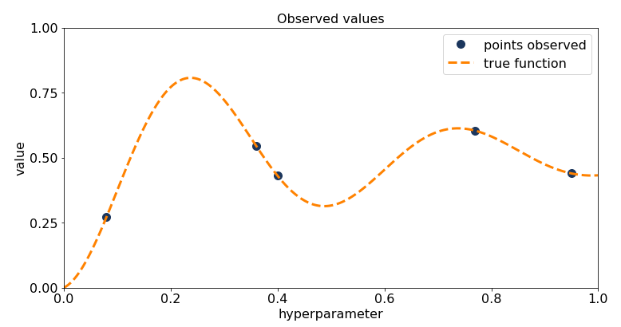

Bayesian Optimization
$x^{∗}$ is a hyper-parameter set and is searched such that
$$x^{∗}=\begin{matrix}argmax \\ x∈X\end{matrix}f(x)$$
Step 1:

Slide 6
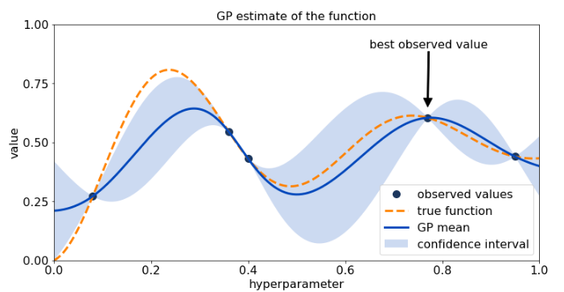
Bayesian Optimization
Step 2:

Slide 7
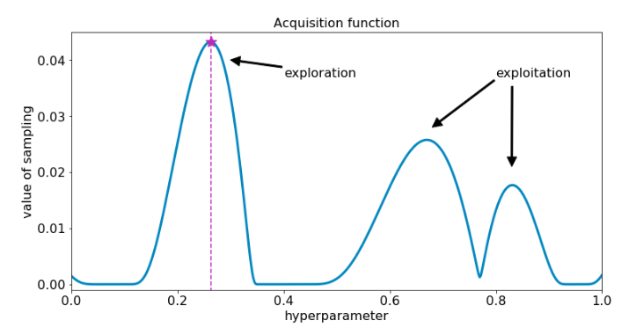
Bayesian Optimization
Step 3:

Slide 8
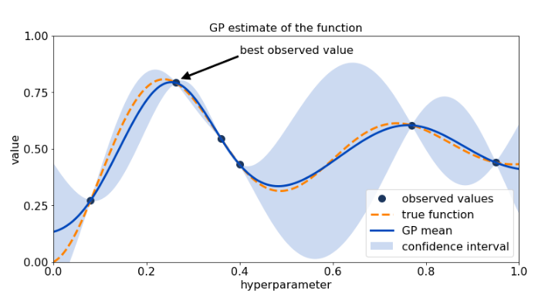
Bayesian Optimization
Step 4:

Slide 9
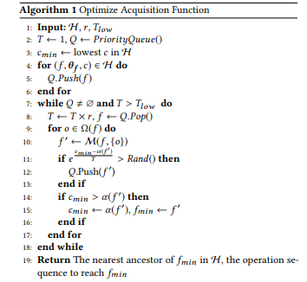
Kernel matrix and acquisition function
A kernel function is used to map the original discrete hyper-parameter space to a space with distance that can be used for Gaussian process

Slide 10
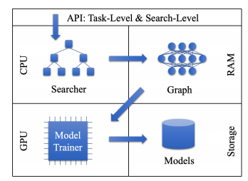
Auto-Keras structure

Slide 11
Experiment and result

Slide 12
Conclusion

