Slide 1
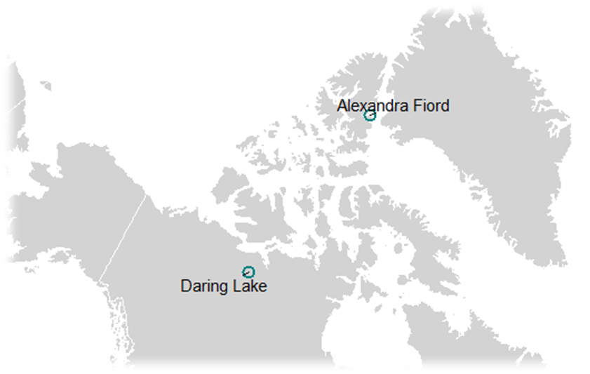
a)
Flowering
DOY
b)
R²=0.57
Flowering
DOY
R²=0.87
-0.35 OTC
-0.41 Temp_{t}
Climate
Climate
-0.15 - 0.01²
-0.26 + 0.06²
-0.05 OTC
0.12 Temp_{t}
Flower #
R²=0.13
Flower #
R²=0.34
N=930, 5 spp
N=1584, 7 spp
Flowering
DOY
Flowering
DOY
-0.42 OTC
R²=0.66
-0.75 Temp_{t}
R²=0.86
-0.08 Temp_{t-1}
Climate
Climate
-0.13 + 0.06²
-0.20 - 0.02²
-0.11 OTC
0.07 Temp_{t-1}
c)
Fruit #
d)
Fruit #
R²=0.17
R²= 0.57
N=1013, 3 spp
N=510, 3 spp

