Slide 1
Image-Text Classifier
Objective:
Predict the relationship between textual and visual inputs
Input images and their corresponding text descriptions
Transform text into text embeddings, and images into image embeddings. Then, define the loss function and train the classifier with the joint embeddings.

Slide 2
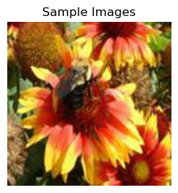
'this flower has petals that are red with yellow tips the petals of this flower are orange and red with a long stigma this flower is orange and yellow in color, with petals that are yellow on the tips. this is a yellow flower with orange on the petals and red stamen. the flower has many petals that are red with yellow tips and red stamen. bright yellow and orange make up the colors of the petals. this flower has petals that are orange and has yellow tips this flower is pink and yellow in color, and has petals that are multi colored. red stigma flowing into a reddish orange petals that are tipped in yellow the petals of this flower are orange with yellow tips and the pedicel is green '

Slide 3
Image-Text Classifier
Procedure:
Resize all the images to a size of 128x128 pixels.
Split the data into training, validation, and test sets.
Convert images to tensors and stack them into one tensor.
Set up a pre-trained BERT model and tokenizer, to convert text descriptions to tensors.
Define the text model, image models, loss function, training, evaluation and testing processes.
Execute the training and testing processes. Output the running losses (diagrams), classification accuracy, and the testing accuracy.

Slide 4
Image-Text Classifier
Text Model: BERT-ARCH
Pretrained BERT model
FC layer (768, 512)
ReLU activation function
Drop-out layer (rate = 0.1)
FC layer (512, 1000)
BERT is a deep learning model for NLP tasks, pre-trained on large amounts of unlabelled texts. It consists of multiple Transformer encoder layers and performs two tasks: masked language modelling and next sentence prediction. It is first used to extract features from the input text, and then these features are fed into a task-specific output layer.

Slide 5
Image-Text Classifier
Image Model: GoogleNet with a modified final fully connected layer
pre-trained deep convolutional neural network for image classification and object detection tasks
Inception modules are designed to capture information at different spatial scales. Each module contains parallel convolutional layers of different sizes, and the outputs are concatenated to produce the final output of the module.

Slide 6
Image-Text Classifier
Loss Function:
Ratio of the average L2 distances between matching text-image pairs to that of non-matching pairs
Optimization algorithm: AdamW (Adam with Weight Decay regularization)
Penalize large weight values
Weight decay added to the weight update step, to ensure that the weight decay does not interfere with the momentum-based updates performed by the Adam optimizer
Uses a modified learning rate schedule adjusting for the weight decay parameter, to prevent the learning rate from decaying too quickly

Slide 7
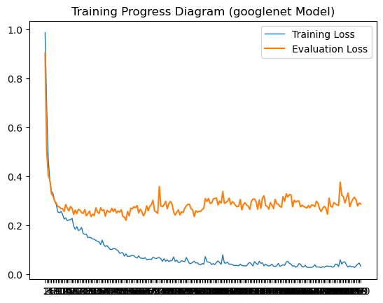
Image-Text Classifier
Training:
Sample ➔ loss ➔ backpropagate
Return the average loss over all batches and the list of samepairdist (for calculating the running mean)
Evaluation:
Choose the best model with smallest validation loss

Slide 8
Image-Text Classifier
Testing:
Generate image and text embeddings.
For each text embedding, calculate the distance to all image embeddings.
Select the top k distances and compare with the distance to the true image embedding.
Return the image tensors, the check tensor, which contains a boolean value for each input indicating whether the correct image embedding was included in the top k predictions, and the outindex tensor.
（结果图）

Slide 9
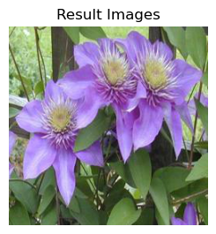
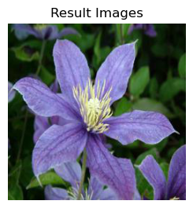
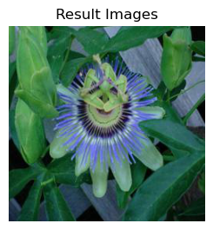
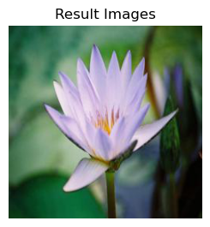
Image-Text Classifier （改）
Results (googlenet? Resnet14? our model?)
Input: "this flower is blue in color“
Outputs:

