Slide 1
Tableau
GDO - SP
Vinay Mahajan
Jan2017

Slide 2
Agenda
Tableau introduction and products
Tableau desktop
Example of simple visual creation
Concepts
Connecting the data
Sheets
Dashboards
Stories
Some of my work

Slide 3
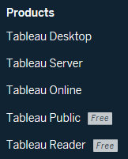
Tableau introduction and products
Based on research at Stanford University's Department of Computer Science between 1999 and 2002
A software company headquartered in Seattle, United States
Founded in Mountain View, California in January, 2003 by Chris Stolte
Visualization techniques for
Exploring and analyzing relational databases and data cubes.
It queries
Relational databases,
OLAP cubes [Online Analytical Processing applications],
Cloud databases, and
Spreadsheets and then generates a number of graph types.
VizQL: Visual Query Language

Slide 4
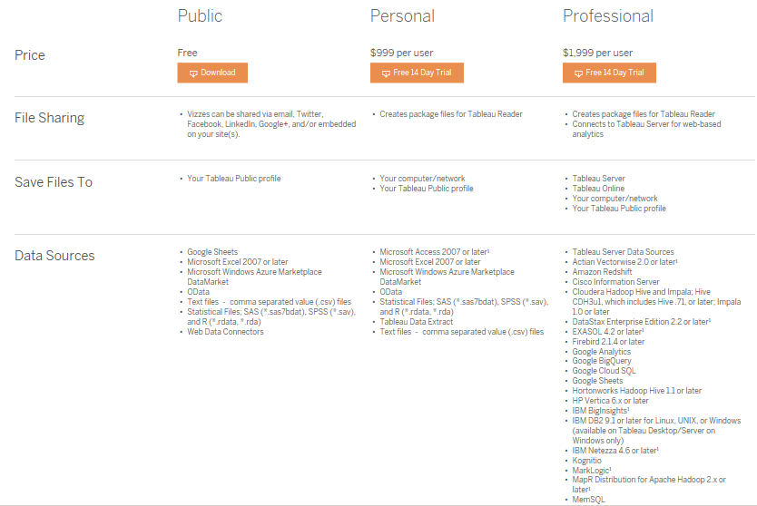
Tableau desktop
I use the Free software
+ many more

Slide 5
Example of simple visual creation
http://www.tableau.com/products/desktop
The created files are called “Vizzes”
The file extensions are “twbx”

Slide 6
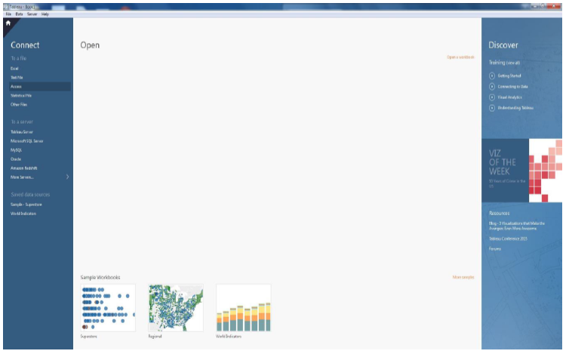
Concepts – connecting the data

Slide 7
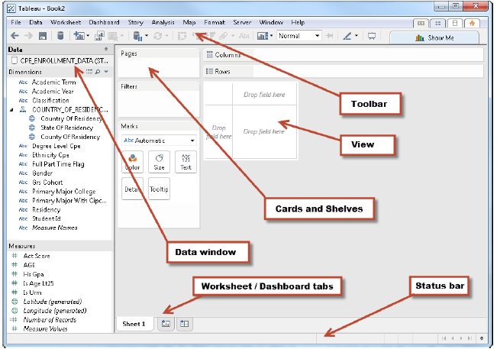
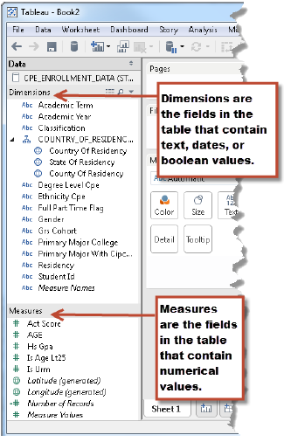
Concepts – sheet

Slide 8
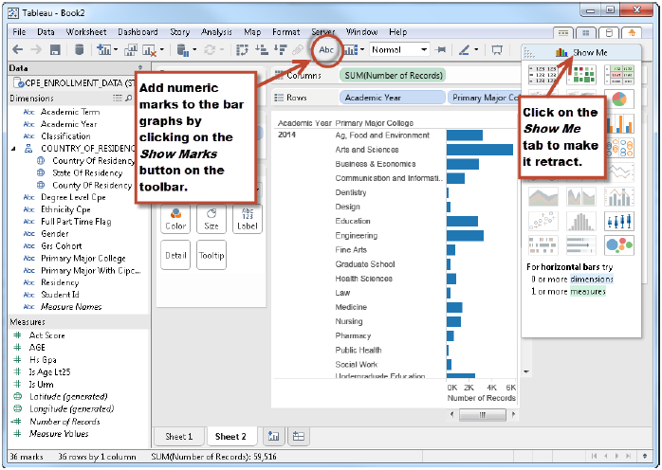
Concepts – sheet , creation of a graph

Slide 9
Some of my work
Use R to create the analysis datasets based on source data
Create CSV files – inputs for Tableau
Visuals:
Multiple sheets: maps, boxplots, text tables
https://public.tableau.com/profile/frlht#!/vizhome/04_patient_analysis_tablaeu/05bNoOfDis_agebox
Multiple sheets: monthly disease view drill down
https://public.tableau.com/profile/frlht#!/vizhome/IndividualPatientCalendar/Sheet3

Slide 10
Some of my work – cont’d
Operational nature display: number of patients per day
https://public.tableau.com/profile/frlht#!/vizhome/04_calendar_view/Sheet1
Summary of diseases – similar to the AE analysis, Dashboard example
https://public.tableau.com/profile/frlht#!/vizhome/Primary_disease_and_all_other_diseases/Dashboard2

