Slide 2
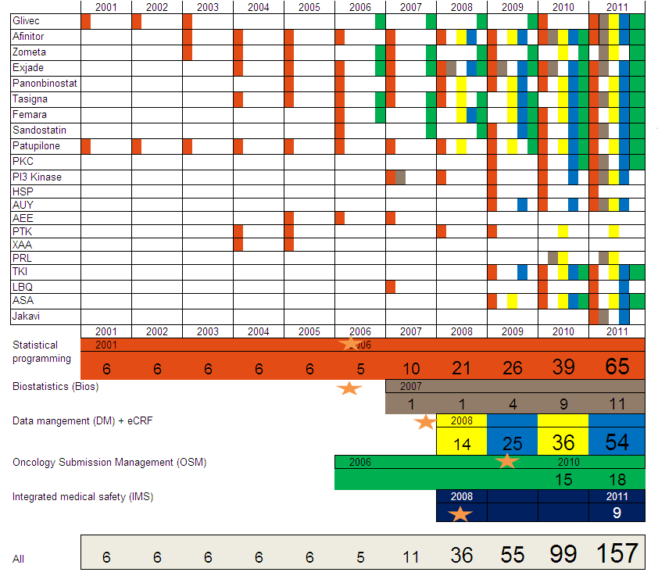
Note: Not a complete list of projects, but major contributions highlighted

Slide 3
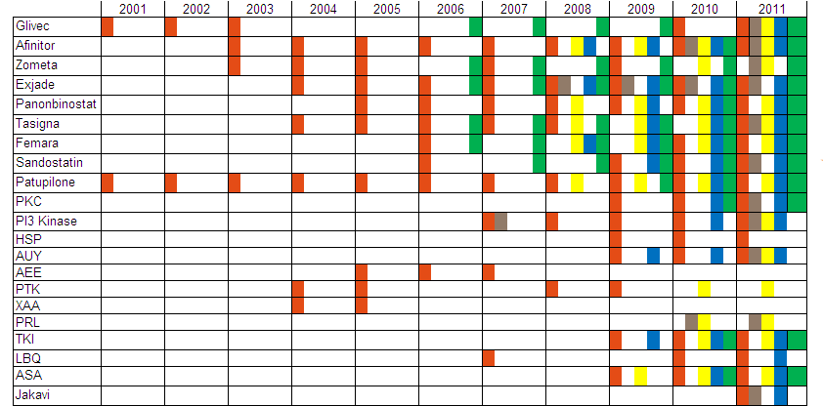

Slide 4
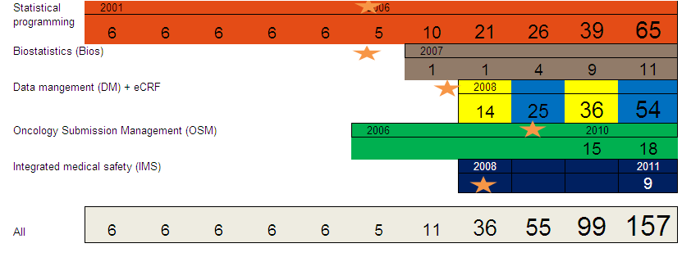
OGD & GMA team growth
GMA Sc. Comm to start in 2012 with 33 FTEs.

Slide 5
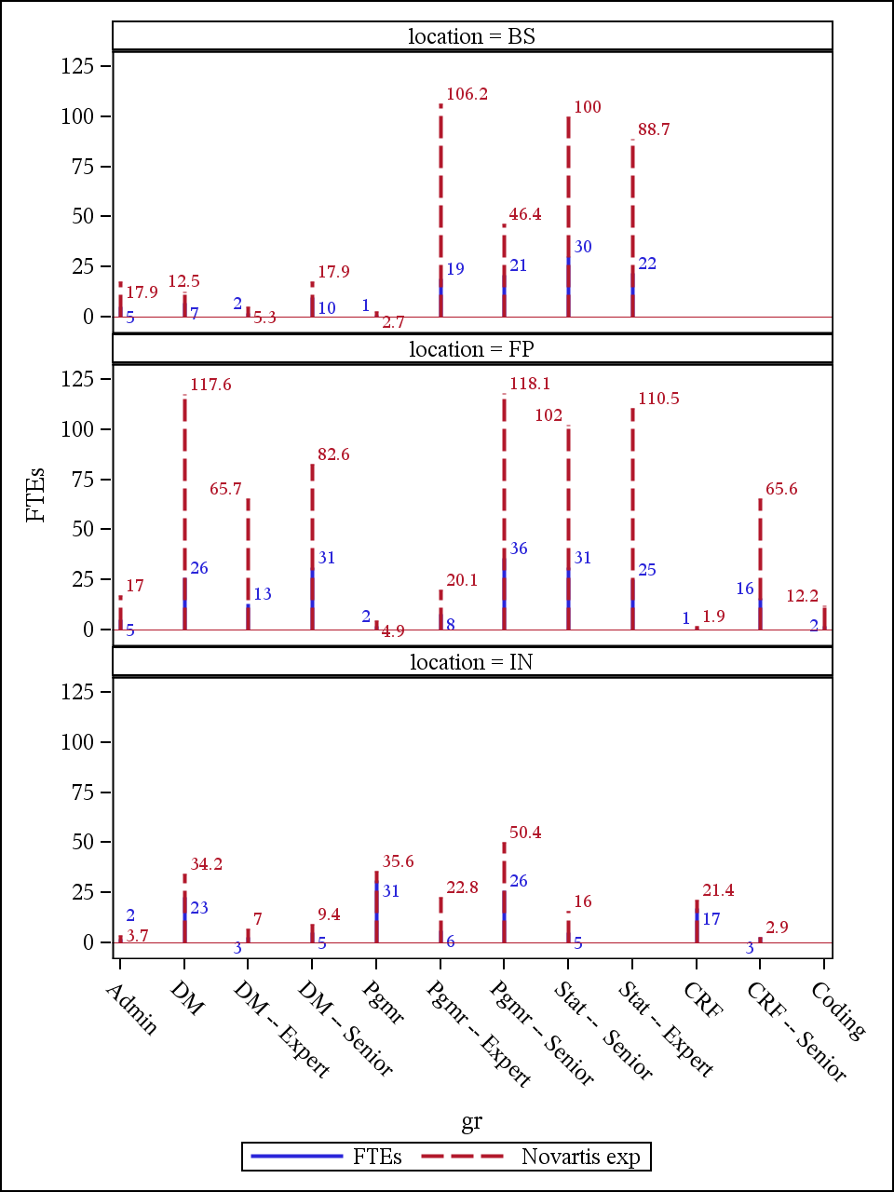

Slide 6
Signifor/SOM230 Cushing’s Submission
EU (2010) | FDA (June 2011) | ROW (Q4 2011)
Biometrics: Support for 7 CP trials Support for SCP EMA questions on SCP - 120 day responses | Biometrics: Support for 2 CP trials Support for SCP Support for CRTs | Biometrics: Chinese and Taiwanese application 2 Ethnic insensitivity reports Japanese sample size estimation
Medical Writing: Narratives for B2305 RMP for 120 Day update EMA questions – support for PV and RMP responses RMP response to 180 Day questions | Medical Writing: Narratives for B2305 Special safety reports | Medical Writing: DSUR
 | Data Management: TDM for 1 study B2305 special patient profiles | Data Management: DM for one study
EU
Signifor/SOM230 Acromegaly Submission
DM: TDM for 2 studies, DM for C2305 | Biometrics: Pivotal study PK/PD analysis, leading SCP activities, 2 CP trial support | MW: C2305 Narratives, Special safety reports, RMP, DSUR

