Slide 1
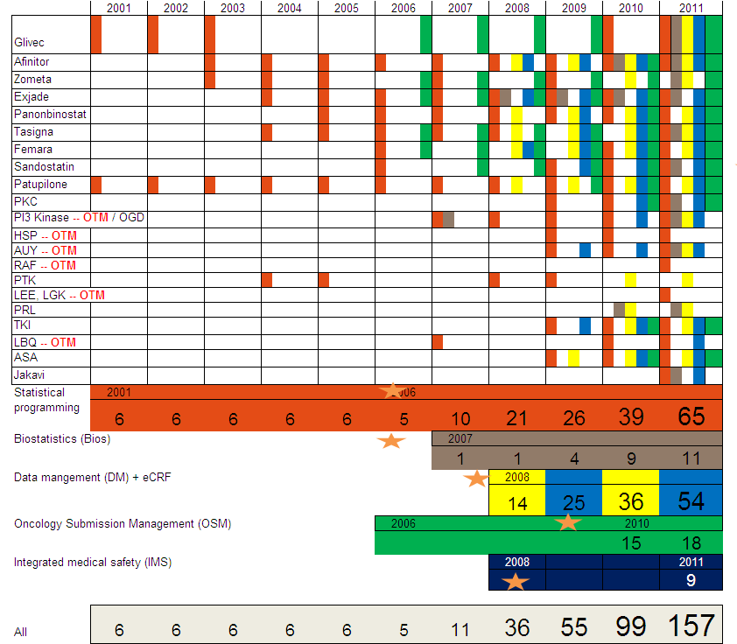
Note: Not a complete list of projects, but major contributions highlighted

