Slide 1
Anagha Bhatkhande Varsha Mahajan
Navigating Through Implementation Guide
October 30, 2017

Slide 2
About IG
SDTM IG guides the organizations on structure and format of standard clinical trial tabulation datasets.
These datasets are submitted to a regulatory authority such as the US Food and Drug Administration (FDA).
Current version of IG is 3.2
The SDTMIG should be used in close concert with the current version of the CDISC Study Data Tabulation Model (SDTM, available at http://www.cdisc.org/sdtm)

Slide 3
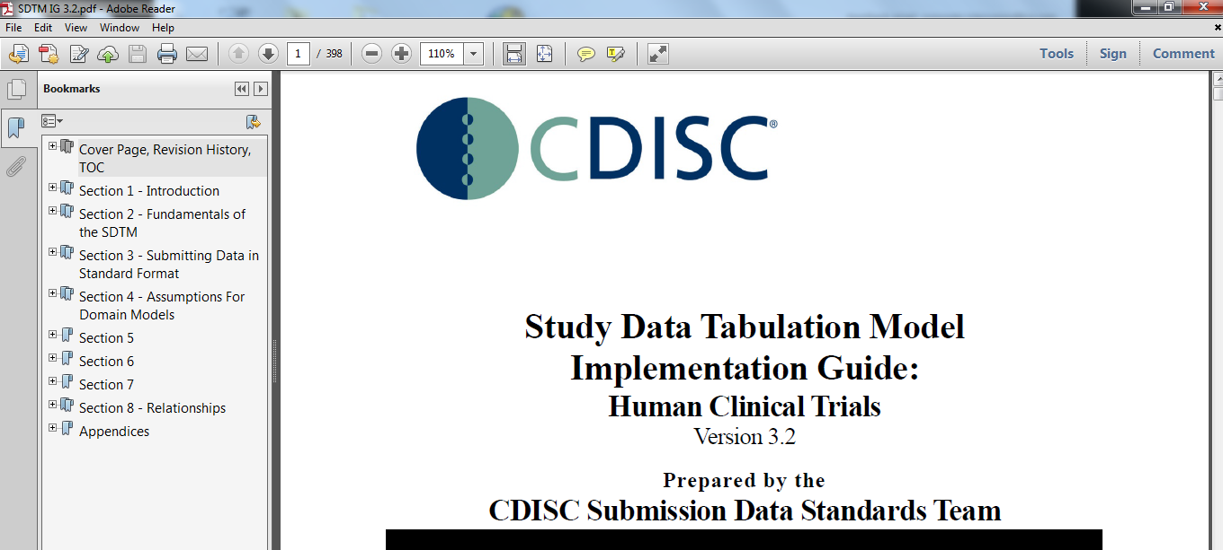

Slide 4
SDTM IG Sections
Section 1 Introduction:
Overall introduction
Describes changes from prior versions.
Section 2 Fundamentals of the SDTM
Basic concepts of the SDTM
How this implementation guide should be used in concert with the SDTM.
Section 3 – Submitting Data in Standard Format, explains how to describe metadata for regulatory submissions, and how to assess conformance with the standards.
Section 4 – Assumptions for Domain Models, describes basic concepts, business rules, and assumptions that should be taken into consideration before applying the domain models.
Section 5 – Models for Special-Purpose Domains, describes special-purpose domains, including Demographics, Comments, Subject Visits, and Subject Elements.
Section 6 – Domain Models Based on the General Observation Classes, provides specific metadata models based on the three general observation classes, along with assumptions and example data.
Section 7 – Trial Design Datasets, provides specific metadata models, assumptions, and examples.
Section 8 – Representing Relationships and Data, describes how to represent relationships between separate domains, datasets, and/or records, and information to help sponsors determine where data belongs in the SDTM.
Appendices provide additional background material and describe other supplemental material relevant to implementation.

Slide 5
Takeaway from EACH SECTION OF IG
Section | I will learn
1,2,3 | The key concepts for preparing domains and submitting data to regulatory authorities.
4 | What are the assumption while creating different domains
5 | Models for Special Purpose domains (You can refer back to Section 4 to link section 4 & 5) (implementation examples for each domain help to understand how to apply the domain models for specific types of data)
6 | Domain Models based on General Observation classes (implementation examples for each domain help to understand how to apply the domain models for specific types of data)
7 | Trial Design Domains to understand the fundamentals of the Trial Design Model
8 | Representing Relationships and Data helps to understand how to express relationships between datasets, records and additional variables not specifically defined in the models.
Appendices | Appendix C – Controlled Terminology, in particular, describes how CDISC Terminology is centrally managed by the CDISC Controlled Terminology Team. CDISC terminology is updated on a quarterly

Slide 6
Reference PAPER

Slide 7
References
https://www.pharmasug.org/proceedings/2016/DS/PharmaSUG-2016-DS04.pdf
https://www.cdisc.org/standards/foundational/sdtmig

Slide 8
End of Session

