Slide 1
Anagha Bhatkhande Varsha Mahajan
Discussion on Adverse Event SDTM – Event Class
October 30, 2017

Slide 2
Agenda
01
Overview of General Observations Class
02
Example from EVENTS class

Slide 3
Overview of General Observations Class
General Observations class : Subject-level observations captured during the study
Classified as Interventions, Events, or Findings
INTERVENTION CLASS :- (1) Data of investigational treatment as specified by the study protocol
(2) Therapeutic and other treatments coincident with the study assessment period (e.g., concomitant medications)
(3) Self-administered by the subject (such as use of alcohol, tobacco, or caffeine).
EVENT CLASS:- (1) Planned protocol milestones : randomization , study completion, occurrences, conditions
(2) Occurrences of unplanned events (Adverse Events)
(3) Incidences prior to trial (Medical History)
Concomitant Medications (CM)
Exposure as Collected (EC)
Exposure (EX)
Substance Use (SU)
Procedures (PR)
Adverse Events (AE)
Clinical Events (CE)
Disposition (DS)
Protocol Deviations (DV)
Healthcare Encounters (HO)
Medical History (MH)

Slide 4
Overview of General Observations Class(Contd…)
FINDINGS CLASS :- (1) Observations storing results of Tests based on planned/unplanned evaluations
(e.g. laboratory tests, ECG testing, and questions listed on questionnaires)
Drug Accountability (DA)
Death Details (DD)
ECG Test Results (EG)
Inclusion/Exclusion Criterion Not Met (IE)
Immunogenicity Specimen Assessments (IS)
Laboratory Test Results (LB)
Microbiology Specimen (MB)
Microscopic Findings (MI)
Morphology (MO)
Microbiology Susceptibility Test (MS)
PK Concentrations (PC)
PK Parameters (PP)
Physical Examination (PE)
Questionnaires (QS)
Reproductive System Findings (RP)
Disease Response (RS)
Subject Characteristics (SC)
Subject Status (SS)
Tumor Identification (TU)
Tumor Results (TR)
Vital Signs (VS)

Slide 5
Adverse Event SDTM
Adverse Event :- any untoward medical occurrence in a patient or clinical investigation subject administered a pharmaceutical product and which does not necessarily have to have a causal relationship with this treatment" (ICH E2A)
Scope of adverse event collection (pre-treatment events related to trial conduct, post treatment AEs, not collecting events that are assessed as efficacy endpoints) can be decided In consultation with regulatory authorities.
May be captured either as free text or via a pre-specified list of terms.
The events included in the AE dataset should be consistent with the protocol requirements.

Slide 6
Example
Subject XYZ-001-003 had rash from 10Oct2017 to 12Oct2017 which was related to the study treatment and it was severe
Information of Interest
Subject: XYZ-001-003
Untoward medical condition : Rash
Start date: 10Oct2017
End date:12Oct2017
Related to study medication
Gradually became Severe

Slide 7
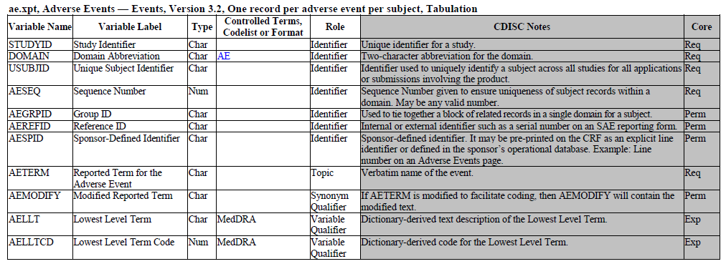
AE SDTM METADATA
Patient Identified : unique identifier
In this example USUBJID= XYZ-001-003
Required variable : Can not have a null value
verbatim term collected for the event.
In this example AETERM=Rash
Topic variable
Required variable : Can not have a null value
Why do we need to modify the Verbatim Term?

Slide 8
MedDRA Structure
System Organ Class
Gastrointestinal disorder
High Level Group Term
Gastrointestinal signs and symptoms
High Level Term
Nausea and vomiting symptoms
Preferred Term
Nausea
Lowest Level Term
Feeling queasy
MedDRA Hierarchy
Notes:
MedDRA : Developed by ICH* in 1990
Highly specific standards of medical terminology
Updated twice a year
Useful for analysis as it codes the data into standard form
Standardized MedDRA Queries (SMQs) help in identification and retrieval of safety data.
The SMQs are maintained with each release of MedDRA by the MSSO.
Non-current terms are flagged at the LLT level within MedDRA
Not recommended for continued use Not recommended for continued use
Retained within the terminology to preserve historical data for retrieval and analysis
Terms that are vague, ambiguous, out dated, truncated, or misspelled
Terms derived from other terminologies that do not fit MedDRA rules

Slide 9
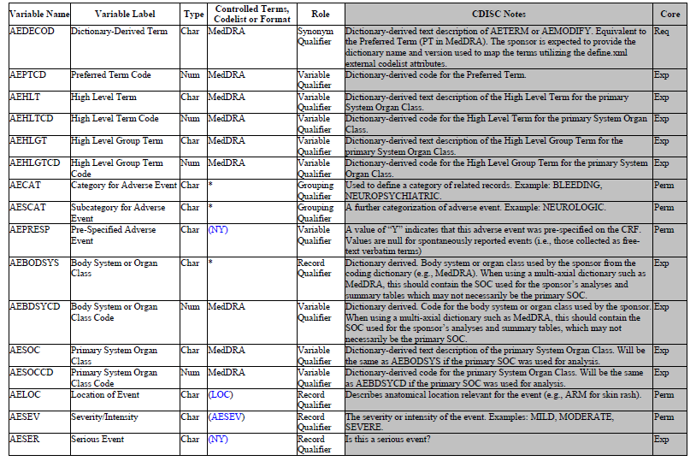
AE SDTM METADATA (contd…)
Preferred term using coding dictionary
Required Variable: Can not be missing
This is what we discussed in MedDRA
From coding dictionary associated with the adverse event by the sponsor
AE Severity

Slide 10
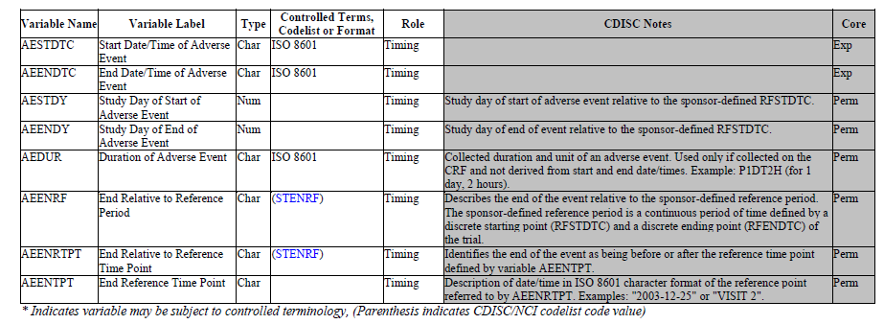
AE SDTM METADATA (contd…)
AE start and End date

Slide 11
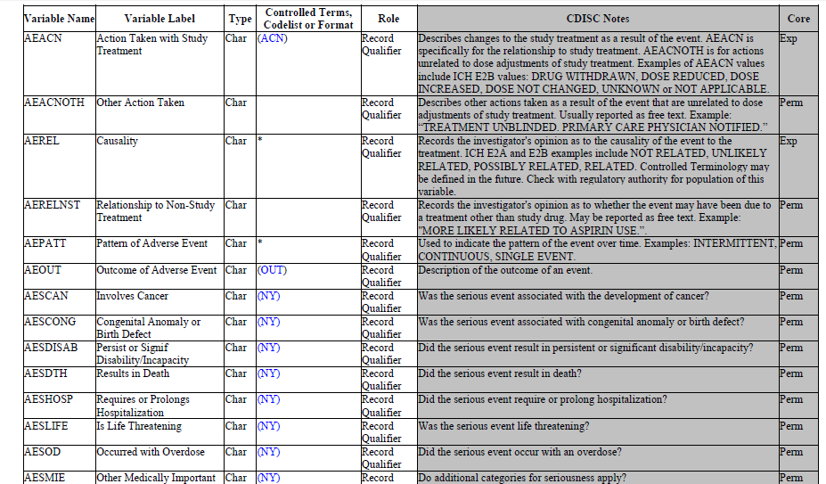
AE SDTM METADATA (contd…)
AE Related to Study medication
Final Toxicity Grade

Slide 12
NCI COMMON TERMINOLOGY CRITERIA for AE
The NCI Common Terminology Criteria for Adverse Events : Descriptive terminology for Adverse Event (AE) reporting.
Grade refers to the severity of the AE.
A grading (severity) scale is provided for each AE term.
The CTCAE displays Grades 1 through 5 with unique clinical descriptions of severity for each AE based on this general guideline
Grade 1: Mild; asymptomatic or mild symptoms; clinical or diagnostic observations only; intervention not indicated.
Grade 2: Moderate; minimal, local or noninvasive intervention indicated; limiting age-appropriate instrumental ADL*.
Grade 3: Severe or medically significant but not immediately life-threatening; hospitalization or prolongation of hospitalization indicated; disabling; limiting self care ADL**.
Grade 4 : Life-threatening consequences; urgent intervention indicated.
Grade 5 : Death related to AE. (AETOXGR can have values from Grade1 to Grade 4, Death due to AE is not reported in AETOXGR, it will be captured in DISPOSITION SDTM with Reason for Death as Adverse Event)
URL for the guidance document: https://evs.nci.nih.gov/ftp1/CTCAE/CTCAE_4.03_2010-06-14_QuickReference_5x7.pdf
Notes:
An AE is a term that is a unique representation of a specific event used for medical documentation and scientific analyses.

Slide 13
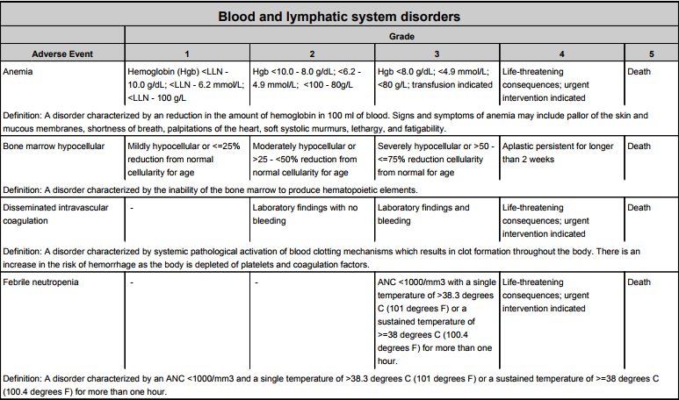
SNAPSHOT of GRADES from NCI CTC AE guideline

Slide 14
Example
Subject XYZ-001-003 had rash from 10Oct2017 to 12Oct2017 which was related to the study treatment and it was severe
Information of Interest
Subject: XYZ-001-003 USUBJID
Untoward medical condition : Rash AETERM
Start date: 10Oct2017 AESTDTC
End date:12Oct2017 AEENDTC
Related to study medication AEREL
Gradually became Severe AESEV

Slide 15
AE Data Snapshot
Topic
Variable
Timing Variable
Synonym
Qualifier
Record Qualifier
STUDYID | SUBJID | USUBJID | AETERM | AESTDTC | AEENDTC | AEDECODE | AEBODSYS | AEREL | AESEV
XYZ | 003 | XYZ-001-003 | Rash | 2017-10-10 | 2017-10-12 | Rash | Skin and Subcutaneous tissue disorder | RELATED | SEVERE

Slide 16
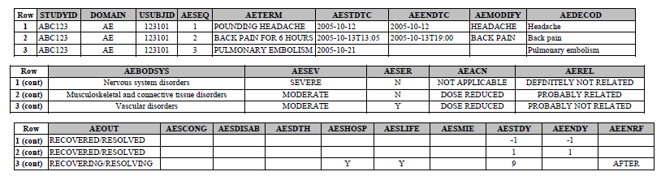
EXAMPLE 2
This is an example of data from an AE CRF that collects AE terms as free text. The first study drug was administered to the subject on October 13, 2006 at 12:00. Three AEs were reported. AEs were coded using MedDRA, and the sponsor’s procedures include the possibility of modifying the reported term to aid in coding.
Modified Term for Reporting purpose
Verbatim Term
Decoded as per MedDRA Dictionary
The CRF is structured so that seriousness category variables (e.g., AESDTH, AESHOSP) are checked only when AESER is answered “Y.”

Slide 17
AE STRUCTURE
The structure of the AE domain is one record per adverse event per subject.
You may submit one record that covers an adverse event from start to finish
A patient may have multiple AE records with changes in severity, causality, seriousness and outcome
These records can be “Collapsed” into a single AE record showing highest level of severity, causality etc.
OR
You may submit a new record when severity, causality, or seriousness changes or worsens.
One record per adverse event per subject per changing severity, causality etc
Individual record in above case, Indicates that each record is considered to represent a different event.
Notes:
The submission dataset structure may differ from the structure at the time of collection. E.g. You may collect data at each visit in order to meet operational needs, but submit records that summarize the event and report the highest level of severity, causality, seriousness etc.

