Slide 1
Anagha Bhatkhande Varsha Mahajan
QUESTIONNAIRE SDTM – FINDINGS CLASS
October 30, 2017

Slide 2
Agenda
01
Example from FINDINGS class

Slide 3
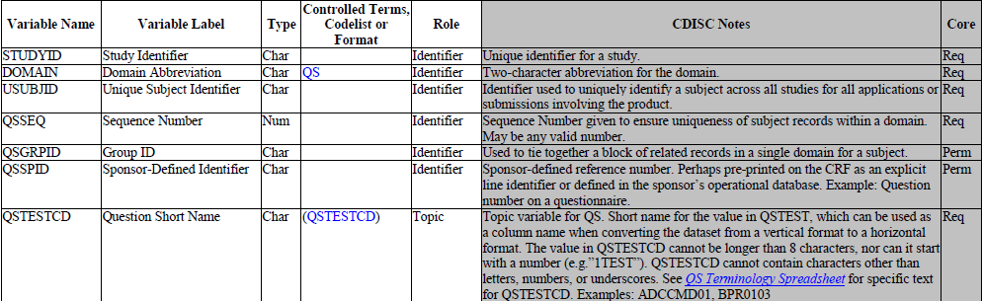
QS SDTM METADATA

Slide 4
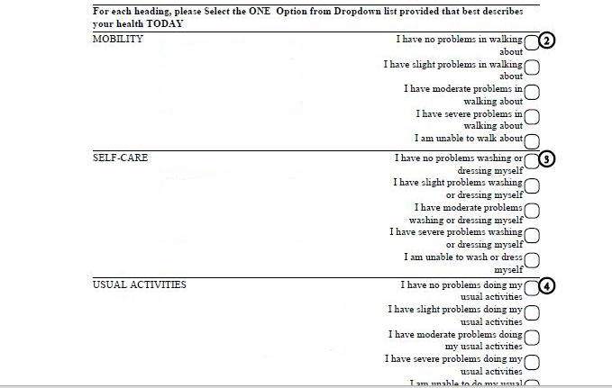
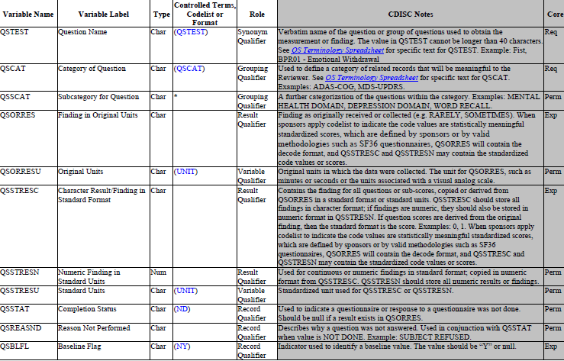
QS SDTM METADATA
QSTEST
QSORRES
QSSTRESC=coded values in Character Format
QSSTRESN=coded values in Numeric Format
Baseline Flag

Slide 5
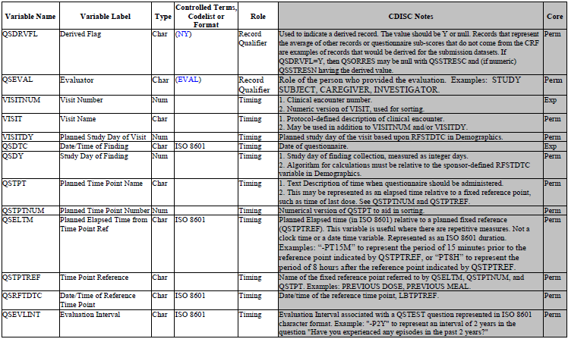
QS SDTM METADATA

Slide 6
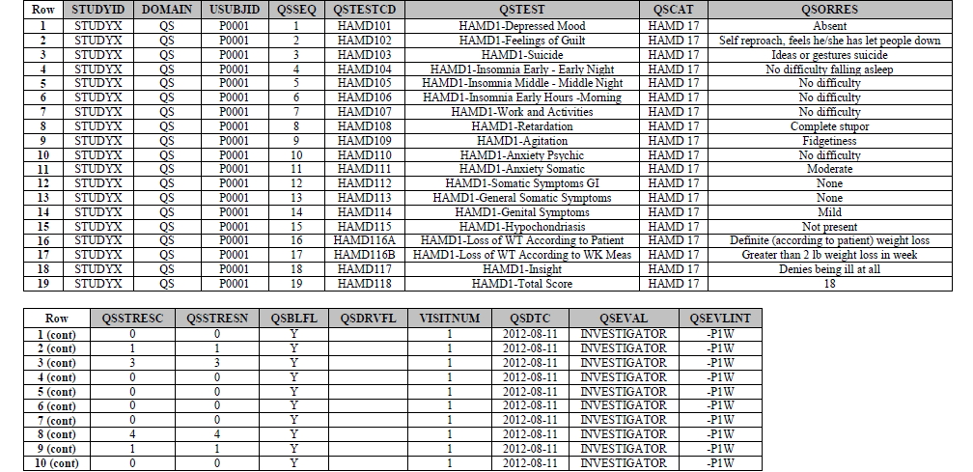
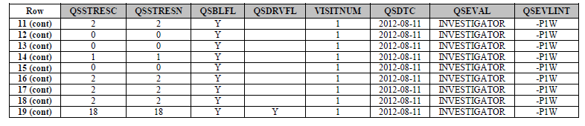
Data Snapshot of QS SDTM
flag indicates that the record is derived

Slide 7
End of Session

