Slide 1
Anagha Bhatkhande
Varsha Mahajan
FINDINGS ABOUT SDTM – FINDINGS CLASS
October 31, 2017

Slide 2
Agenda
01
Example from FINDINGS class

Slide 3
FINDINGS ABOUT SDTM
Findings about Events or Interventions : Specialized Findings class from General Observations
To be used when data can not be represented in the events or interventions or it’s SUPP dataset
It has all the variables from FINDINGS CLASS , in addition also provide –OBJ variables
Structure: One record per finding per object per time point per time point reference per visit per subject.

Slide 4
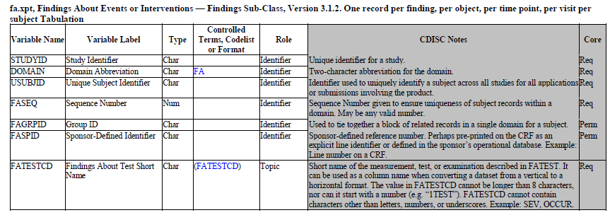
FA SDTM METADATA

Slide 5
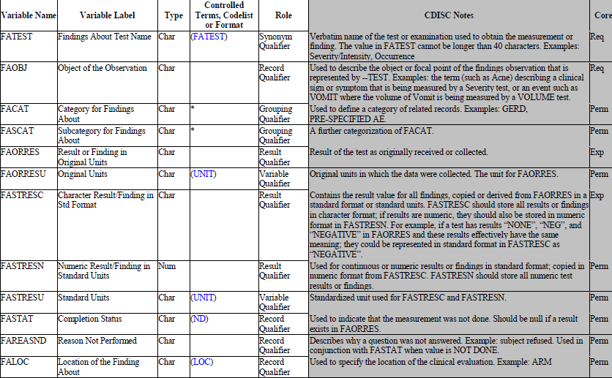
FA SDTM METADATA
Unique to FA, in conjunction with FATESTCD it describes the Topic of observation

Slide 6
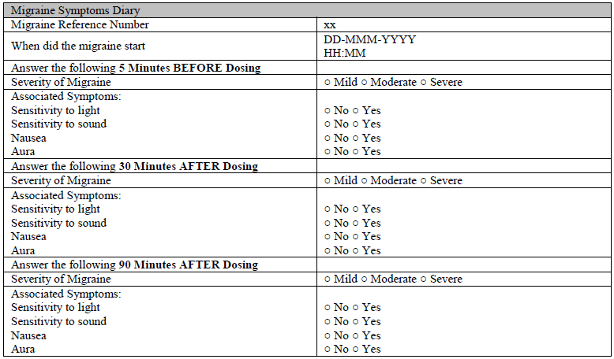
Example 1
In this example Migraine is not reported as AE but is a Clinical event
Collected data shows occurrences of related symptoms
Data collected at multiple time points
FATESTCD=OCCUR
FAOBJ=Symptom Description

Slide 7
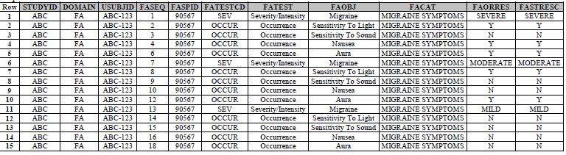
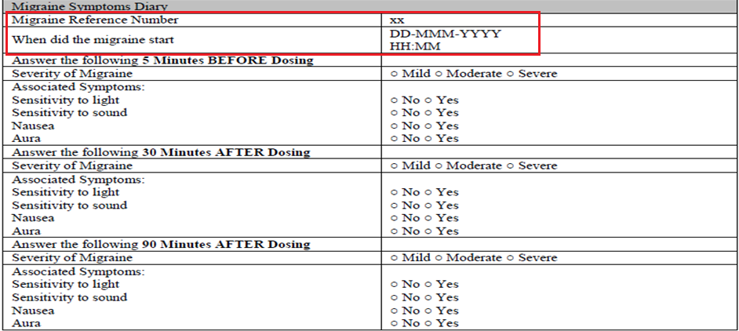
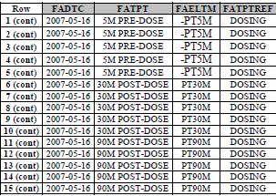
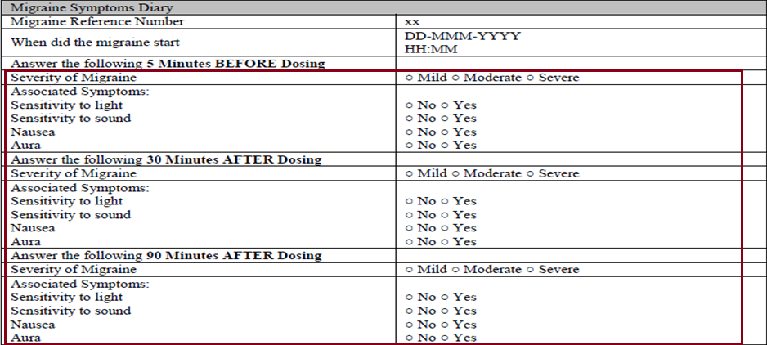
Example 1 : DATA SNAPSHOT

Slide 8

RELREC
A dataset level Relationship is displayed using RELREC dataset
--SPID is used as identifier variable
As you can see Relation Type is MANY for FA dataset and ONE for CE dataset

Slide 9
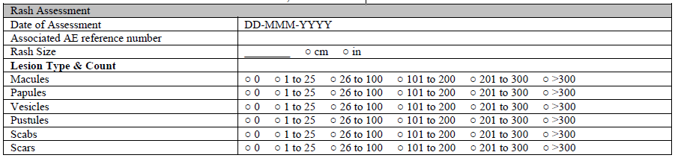
Example 2
As you can see on CRF page Rash is collected as an Adverse Event
Rash Assessment CRF page
This CRF collects details about rash events at each visit, until resolved.
Can I store this information in AE dataset?
Conti….

Slide 10
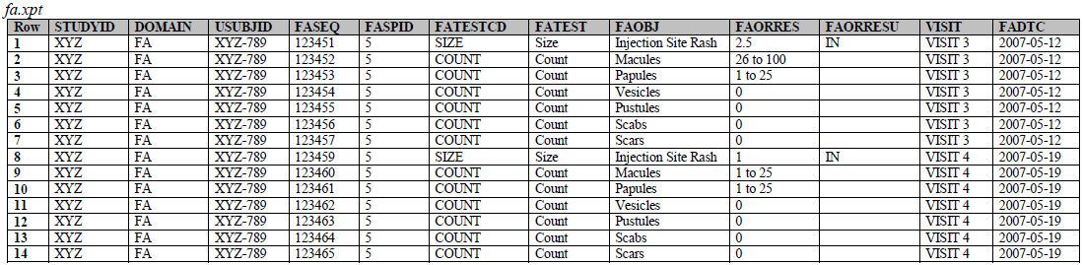
Example 2 : DATA SNAPSHOT

Slide 11
End of Session

