Slide 1
Anagha Bhatkhande Varsha Mahajan
Workshop on CRF mapping : General Observations Class
October 31, 2017

Slide 2
Agenda
01
Mapping information in Events class
02
Mapping information in Interventions class
03
Mapping information in Findings class

Slide 3
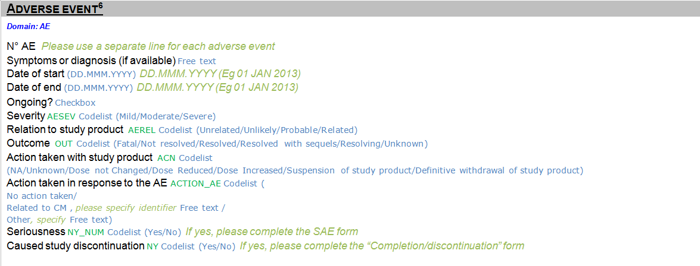
Mapping data in Events Class
AE.AESPID
AE.AETERM
AE.AESTDTC
AE.AEENDTC
AE.AEENRTPT
AE.AEENTPT =Date of last contact
AE.AESEV
AE.AEREL
AE.AEOUT
AE.AEACN
AE.AEACNOTH
SUPPAE.ACNRELCM
SUPPAE.ACNOSP
AE.AESER
SUPPAE.AEDISC

Slide 4
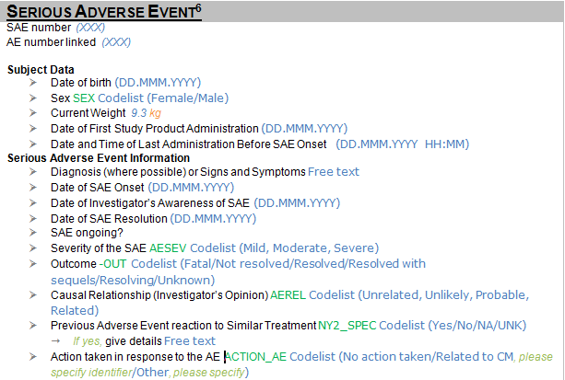
Mapping data in Events Class
SUPPAE.SWEIGHT
SUPPAE.ENAEDTC
SUPPAE.INVSDTC
SUPPAE.PRVAE
SUPPAE.PRVAEOTH

Slide 5
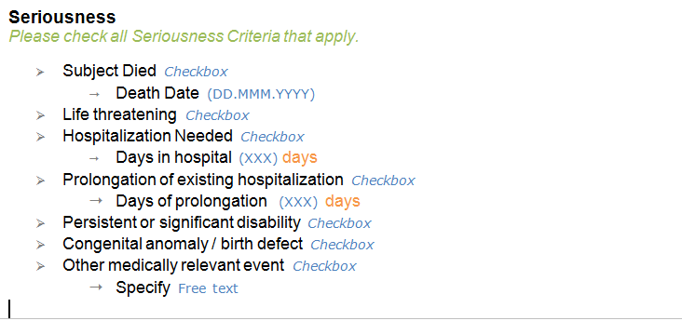
Mapping data in Events Class
AE.AESDTH
AE.AESLIFE
AE.AESHOSP
SUPPAE.HOSDAYS
AE.AEPHOSP
SUPPAE.PHOSDAYS
AE.AESDISAB
AE.AESCONG
AE.AESMIE
SUPPAE.AESMIESP

Slide 6
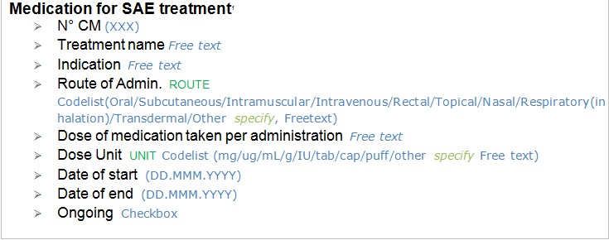
Mapping data in Interventions Class
CM.CMSPID
CM.CMTRT
CM.CMINDC
CM.CMROUTE
SUPPCM.ADMROUTE
CM.CMDOSE
CM.CMDOSEU
CM.CMSTDTC.
SUPPCM.CMUSPC
CM.CMENDTC
CM.CMENRTPT
CM.CMENTPT=LAST CONTACT DATE

Slide 7
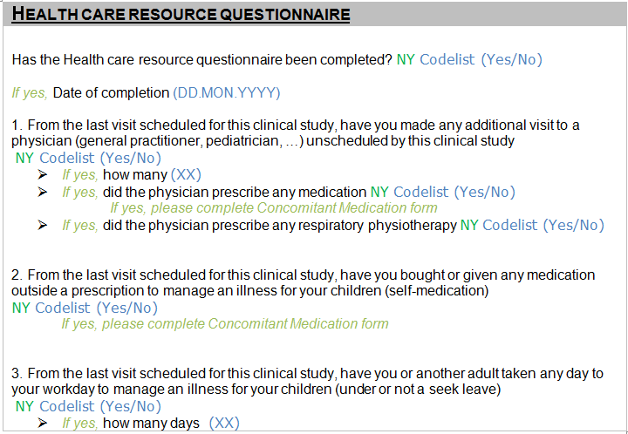
Mapping data in Findings Class
FA.FATESTCD=OCCUR
FA.FAOBJ=Healthcare resource questionnaire completion
FACAT=Healthcare resource Questionnaire
FA.FAORRES= Y/N
FA.FATESTCD=DATE , for above FAOBJ
FA.FATESTCD=OCCUR FAOBJ=Unscheduled Visit FACAT=Healthcare…….
FA.FATESTCD= OCCUR FAOBJ=Prescribed Medication FACAT=Healthcare…….
FA.FATESTCD=OCCUR FAOBJ=Prescribed respiratory physiotherapy FACAT=Healthcare…….
FA.FATESTCD=OCCUR FA.FAOBJ=Self medication FACT=Healthcare
FA.TESTCD=OCCUR FA.FAOBJ=Absence at work FAORRES
FA.FATESTCD=Total number FAOBJ=Absence at work FAORRES

Slide 8
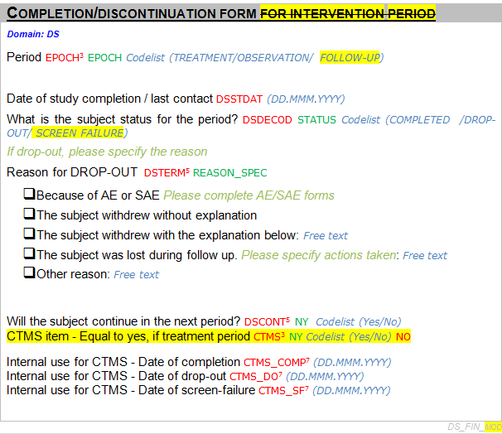
Disposition
DS.EPOCH
DS.DSSTDTC, DSCAT=DISPOSITION EVENT
DS.DSDECOD
DS.DSTERM
SUPPDS. DSCONT

