Slide 1
Anagha Bhatkhande Varsha Mahajan
Overview of Trial Design Domains
October 31, 2017
TCS confidential

Slide 2


Confidentiality Statement
This document contains information which is commercially confidential to Tata Consultancy Services Ltd. ("TCS") and is provided for the sole purpose of permitting the recipient to evaluate the proposal submitted within the document. In consideration of the receipt of this document, the recipient agrees to maintain the information it contains in confidence and not to reproduce or otherwise disclose the contents of this document to any person outside the recipient's evaluation team or nominated advisors. The document may not be used, reproduced or disclosed to others, except as specifically permitted by TCS in writing. The recipient of this document, by its retention and use, agrees to take reasonable endeavours to protect the document and the information it contains from loss or theft.
© 2017 - TATA Consultancy Services Limited (TCS)
TCS confidential

Slide 3
Agenda
01
Overview of Trial Design Model
02
Trial Summary
03
Trial Inclusion
04
Trial Visit
05
Trial Element
06
Trial Arm
TCS confidential

Slide 4
Overview of Trial Design Domains
Trial Design domains :
Define the standard structure of representing the planned sequence of events and treatment plan for the trial
Provide a standard way to define treatment groups and planned visits
Also support in comparison of designs of different trials
Used to compare planned and actual treatments and visits.
Things to remember :
Accurate representation of the treatment paths and rules defined in the protocol
These domains serve as the basis for deriving the actual treatment path for a given subject
Subject Elements (SE) and Subject Visits (SV) represent a subject’s actual path
SE and SV are created using rules defined in the trial design domains TE, TV
TCS confidential

Slide 5
Trial Design Domains
There are 5 Trial design datasets
Trial Arms (TA)
Trial Visits (TV)
Trial Element(TE)
Trial Inclusion/Exclusion(TI)
Trial Summary(TS)
These datasets provide a complete summary of the clinical trial protocol
These datasets do not contain any subject level information
These datasets are created first and then remaining SDTM domains
TCS confidential

Slide 6
Example clinical trial
This is a 14 weeks randomized, double-blind, placebo-controlled trial phase II clinical trial for patients with Type -2 Diabetes Miletus
Comparing the dosage of active drug versus placebo in 1:1 ratio in capsule form for patients suffering with Type -2 Diabetes Miletus.
Patients with >=18 years of age who have been diagnosed with Type -2 Diabetes Miletus and have been on Metformin for more than 6 months.
Type-2 Diabetes patients were with the HbA1c levels >6.5%.
Dosage will be administered BID before lunch and dinner
Safety of the drug will be periodically assessed.
Effectiveness of the active drug will be ascertained if the reduction of HbA1c values from the baseline is > 3%
200 patients both male and female will be enrolled in the trial. Pregnant or lactating women will be excluded from the study.
TCS confidential

Slide 7
Trial Summary (TS) Domain
TS describes basic information item of the protocol in a structured format – At a glance summary
TS contains one record for each trial summary parameter
TS records information about the trial phase, protocol title, and design objectives
Variable Name | Variable Label | Type | Description
STUDYID | Study Identifier | Char | Unique identifier for a study.
DOMAIN | Domain Abbreviation | Char | Two-character abbreviation for the domain, which must be TS.
TSSEQ | Sequence Number | Num | Sequence number to ensure uniqueness within the dataset.
TSGRPID | Group ID | Char | Used to tie together a group of related records.
TSPARMCD | Trial Summary Parameter Short Name | Char | TSPARMCD (the companion to TSPARM) is limited to 8 characters and does not have special character restrictions. These values should be short for ease of use in programming, but it is not expected that TSPARMCD will need to serve as variable names. Examples: AGEMIN, AGEMAX
TSPARM | Trial Summary Parameter | Char | Term for the Trial Summary Parameter. The value in TSPARM cannot be longer than 40 characters. Examples Planned Minimum Age of Subjects, Planned Maximum Age of Subjects
TSVAL | Parameter Value | Char | Value of TSPARM. Example: “ASTHMA” when TSPARM value is “Trial Indications”. If TSVAL is null; a value is required for TSVALNF. Text over 200 characters can be added to additional columns TSVAL1-TSVALn.
TSVALNF | Parameter Null Flavor | Char | Null flavor for the value of TSVAL describing the reason the value is null, to be populated if and only if TSVAL is null.
TSVALCD | Parameter Value Code | Char | Code of the term in TSVAL from Reference Terminology cited in TSVCDREF.
TSVCDREF | Name of the Reference Terminology | Char | The name of the Reference Terminology from which TSVALCD is taken. For example; CDISC, SNOMED, ISO 8601.
TSVCDVER | Version of the Reference Terminology | Char | The version number of the Reference Terminology cited in TSVCDREF, if applicable.
Would be filled only when TSVAL is null
TCS confidential

Slide 8
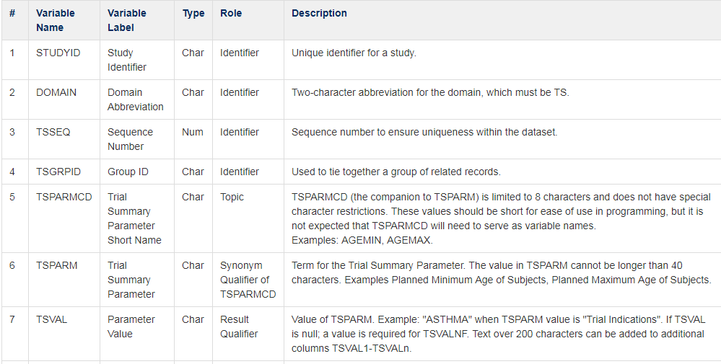
Trial Summary (TS) Domain - Metadata
TCS confidential

Slide 9
Trial Summary (TS) Domain - Implementation
STUDYID | DOMAIN | TSSEQ | TSGRPID | TSPARMCD | TSPARM | TSVAL | TSVAL 1
CDISCtraining | TS | 1 | 1 | ADDON | Added on to Existing Treatments | Yes
CDISCtraining | TS | 1 | 1 | AGEMAX | Planned Maximum Age of Subjects | NA
CDISCtraining | TS | 1 | 1 | AGEMIN | Planned Minimum Age of Subjects | 18
CDISCtraining | TS | 1 | 1 | LENGTH | Planned Trial Length | 14 weeks
CDISCtraining | TS | 1 | 1 | PLANSUB | Planned Number of Subjects | 200
CDISCtraining | TS | 1 | 1 | RANDOM | Trial is Randomized | Yes
CDISCtraining | TS | 1 | 1 | SEXPOP | Sex of Participants | Both
CDISCtraining | TS | 1 | 1 | STOPRULE | Study Stop Rules | None
CDISCtraining | TS | 1 | 1 | TBLIND | Trial Blinding Schema | Double blind
CDISCtraining | TS | 1 | 1 | TCNTRL | Control Type | Placebo
CDISCtraining | TS | 1 | 1 | TDIGRP | Diagnosis Group | Type -2 Diabetes Miletus
CDISCtraining | TS | 1 | 1 | TINDTP | Trial Indication Type | Treatment
CDISCtraining | TS | 1 | 1 | TITLE | Trial Title | 14 weeks randomized, double-blind, placebo-controlled trial phase II clinical trial for patients with Type -2 Diabetes Miletus | comparing the dosage of active drug versus placebo in 1:1 ratio in capsule form
CDISCtraining | TS | 1 | 1 | TPHASE | Trial Phase Classification | Phase II Trial
CDISCtraining | TS | 1 | 1 | TTYPE | Trial Type | Efficacy
CDISCtraining | TS | 2 | 1 | TTYPE | Trial Type | Safety
TCS confidential

Slide 10
Trial Inclusion/Exclusion (TI) Domain
Not subject-oriented
Contains one record for each of the inclusion and exclusion criteria for the trial
Populate this domain with the data from IE domain if already present; else create from protocol
Variable Name | Variable Label | Type | Description
STUDYID | Study Identifier | Char | Unique identifier for a study.
DOMAIN | Domain Abbreviation | Char | Two-character abbreviation for the domain, which must be TI.
IETESTCD | Inclusion/Exclusion Criterion Short Name | Char | Short name IETEST. It can be used as a column name when converting a dataset from a vertical to a horizontal format. The value in IETESTCD cannot be longer than 8 characters, nor can it start with a number (e.g., “1TEST”). IETESTCD cannot contain characters other than letters, numbers, or underscores. The name “IE” prefix is used to ensure consistency with the IE domain
IETEST | Inclusion/Exclusion Criterion | Char | Full text of the inclusion or exclusion criterion. The prefix “IE” is used to ensure consistency with the IE domain.
IECAT | Inclusion/Exclusion Category | Char | Used for categorization of the Inclusion/Exclusion Criterion: INCLUSION, EXCLUSION.
IESCAT | Inclusion/Exclusion Subcategory | Char | A further categorization of the exception criterion. Can be used to distinguish criteria for a sub-study or for to categorize as a major or minor exceptions. Examples: MAJOR, MINOR.
TIRL | Inclusion/Exclusion Criterion Rule | Char | Rule that expresses the criterion in computer-executable form.
TIVERS | Protocol Criteria Versions | Char | The number of this version of the Inclusion/Exclusion criteria. May be omitted if there is only one version.
TCS confidential
Notes:
Link to IE domain
STUDYID, IECAT, IETESTCD, IETEST
Subject IETEST/IETESTDC must match Trial Inclusion/Exclusion IETEST/IETESTCD
Best to create TI first, before you tackle IE
Common questions:
How to truncate if >200 characters?
Truncation – potential for duplicate IETEST values
Protocol amendment: do we need to add to TI only the changed criteria or all criteria?
Local amendment

Slide 11
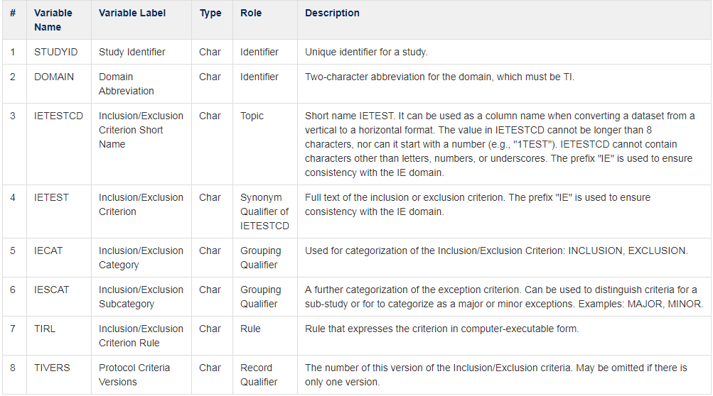
Trial Inclusion/Exclusion (TI) Domain - Metadata
TCS confidential

Slide 12
Trial Inclusion/Exclusion (TI) Domain - Implementation
STUDYID | DOMAIN | IETESTCD | IETEST | IECAT | IESCAT | TIVERS | TIRL (Programming conditions to be defined only if programmable
CDISCtraining | TI | INCL01 | Has Type -2 diabetes | INCLUSION | Major | 1 | HbA1c> 6.5%
CDISCtraining | TI | INCL02 | Age 18 years or greater | INCLUSION | Major | 1 | AgeN >=18
CDISCtraining | TI | EXCL01 | Pregnant or lactating | EXCLUSION | Major | 1
CDISCtraining | TI | INCL03 | Greater than 6 months use of Metformin | INCLUSION | Major | 1
CDISCtraining | TI | INCL01 | Has Type -2 diabetes | INCLUSION | Major | 2
CDISCtraining | TI | INCL02A | Age 18 years or greater and Less than 65 years | INCLUSION | Major | 2
CDISCtraining | TI | EXCL01 | Pregnant or lactating | EXCLUSION | Major | 2
CDISCtraining | TI | INCL03 | Greater than 6 months use of Metformin | INCLUSION | Major | 2
TCS confidential

Slide 13
Trial Visit (TV) Domain
Describes the planned visits in a trial
Timing variables VISIT, VISITNUM and VISITDY describe these visits
VISIT and VISITDY permissible, VISITNUM is Required
VISITNUM is numeric version of Visit, used for sorting
1 record per planned visit per arm
A visit may span over several days (eg screening visit)
Planned Treatment arm (ARMCD) is Expected variable
ARMCD is blank if schedule of visits is same for all arms
Variable Name | Variable Label | Type | Description
STUDYID | Study Identifier | Char | Unique identifier for a study.
DOMAIN | Domain Abbreviation | Char | Two-character abbreviation for the domain, which must be TV.
VISITNUM | Visit Number | Num | Clinical encounter number. Numeric version of VISIT can be used for sorting.
VISIT | Visit Name | Char | Protocol-defined description of the clinical encounter. May be used in addition to VISITNUM and/or VISITDY as a text description of the clinical encounter.
VISITDY | Planned Study Day of Visit | Num | Planned study day of VISIT. Due to its sequential nature, can be used for sorting.
ARMCD | Planned Arm Code | Char | ARMCD is limited to 20 characters and does not have special character restrictions. If the timing of visits for a trial does not depend on which ARM a subject is in, then ARMCD should be null.
ARM | Description of Planned Arm | Char | Name given to Arm or treatment group.
TVSTRL | Visit Start Rule | Char | Rule describing when the visit starts, in relation to the sequence of Elements.
TVENRL | Visit End Rule | Char | Rule describing when the visit ends, in relation to the sequence of Elements.
TCS confidential
Notes:
Create Subject Visits dataset from Visit based SDTM datasets

Slide 14
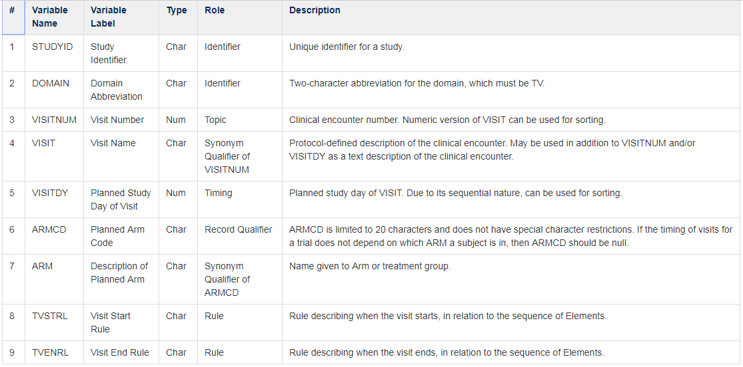
Trial Visit (TV) Domain - Metadata
TCS confidential

Slide 15
Trial Visit (TV) Domain - Implementation
STUDYID | DOMAIN | VISITNUM | VISIT | VISITDY | TVSTRL | TVENRL
CDISCtraining | TV | 100 | Screening |  | Start of screening period 28 days prior to day 1 | 1 day prior to Day 1
CDISCtraining | TV | 200 | Day 1 | 1 | First day of intake of study drug
CDISCtraining | TV | 300 | Week 1 | 7 | 1 week after start of study drug
CDISCtraining | TV | 400 | Week 2 | 14 | 2 weeks after start of study drug
CDISCtraining | TV | 500 | Week 3 | 21 | 3 weeks after start of study drug
CDISCtraining | TV | 600 | Week 4 | 28 | 4 weeks after start of study drug
CDISCtraining | TV | 700 | Week 5 | 35 | 5 weeks after start of study drug
CDISCtraining | TV | 800 | Week 6 | 42 | 6 weeks after start of study drug
CDISCtraining | TV | 900 | Week 7 | 49 | 7 weeks after start of study drug
CDISCtraining | TV | 1000 | Week 8 | 56 | 8 weeks after start of study drug
CDISCtraining | TV | 1100 | Week 9 | 63 | 9 weeks after start of study drug
CDISCtraining | TV | 1200 | Week 10 | 70 | 10 weeks after start of study drug
CDISCtraining | TV | 1300 | Week 11 | 77 | 11 weeks after start of study drug
CDISCtraining | TV | 1400 | Week 12 | 84 | 12 weeks after start of study drug
CDISCtraining | TV | 1500 | Week 13 | 91 | 13 weeks after start of study drug
CDISCtraining | TV | 1600 | End of Treatment | 98 | 14 weeks after start of study drug
CDISCtraining | TV | 1700 | Post Treatment Follow-up |  | 28 days post End of treatment
TCS confidential

Slide 16
Our example study design – Arms, Elements and Epoch
Epochs
Screening
Screen
Screen
Double-blind
Treatment A
Placebo
Follow-up
Follow Up
Follow Up
ARMS
Columns shown with large rectangles are epochs. 3 epochs
We have 2 Arms; Arm A and Arm P; An Arm is a planned sequence of Elements within Epochs, and is often referred to as a treatment group.
We have 4 Elements; Screening, Treatment A, Placebo and Follow-up
ARM A
ARM P
Elements
TCS confidential

Slide 17
Trial Elements (TE) Domain
Describes the Element code unique for each element
Provides the element description and the rules for starting and ending an Element
An Element is the basic building block that is used to describe the administration of planned interventions
Periods of time when there are no planned interventions (such as screening or washout) are also considered Elements
Variable Name | Variable Label | Type | Description
STUDYID | Study Identifier | Char | Unique identifier for a study.
DOMAIN | Domain Abbreviation | Char | Two-character abbreviation for the domain, which must be TV.
ETCD | Element Code | Char | ETCD (the companion to ELEMENT) is limited to 8 characters and does not have special character restrictions. These values should be short for ease of use in programming, but it is not expected that ETCD will need to serve as a variable name.
ELEMENT | Description of Element | Char | The name of the Element.
TESTRL | Rule for Start of Element | Char | Expresses the rule for beginning the Element.
TEENRL | Rule for End of Element | Char | Expresses the rule for ending the Element. Either TEENRL or TEDUR must be present for each Element.
TEDUR | Planned Duration of Element | Char | Planned Duration of Element in ISO 8601 format. Used when the rule for ending the Element is applied after a fixed duration.
TCS confidential

Slide 18
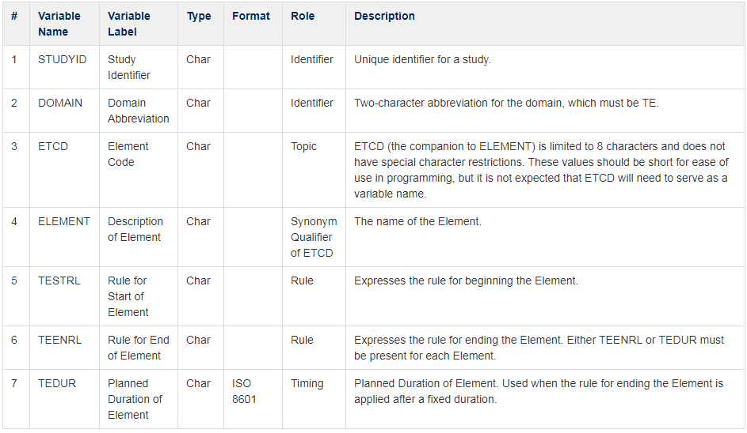
Trial Elements (TE) Domain - Metadata
TCS confidential

Slide 19
Trial Elements (TE) Domain - Implementation
STUDYID | DOMAIN | ETCD | ELEMENT | TESTRL | TEENRL
CDISCtraining | TE | SCREEN | Screening | Informed consent | 1 Day prior to Day 1 of study drug
CDISCtraining | TE | TRTA | Treatment A BID | First dose of study treatment where drug is Treatment A | Study treatment End
CDISCtraining | TE | PBO | Placebo BID | First dose of study treatment where drug is Placebo | Study treatment End
CDISCtraining | TE | FU | Follow-up | Last Dose of study medication + 1 | 28 days after the start of the element
TCS confidential

Slide 20
Trial Arms (TA) Domain
High level treatment plan
Based on the concepts of Elements, Arms and Epochs
Composed of Elements from Trial Elements
Planned ARM values in DM correspond to ARM values in Trial Arms
Describes the sequence of Elements within each Arm, as well as rules for moving through these Elements, referred to as Branches (TABRANCH) and Transitions (TATRANS)
Names of ARM should reflect the protocol
Variable Name | Variable Label | Type | Description
STUDYID | Study Identifier | Char | Unique identifier for a study.
DOMAIN | Domain Abbreviation | Char | Two-character abbreviation for the domain, which must be TA.
ARMCD | Planned Arm Code | Char | ARMCD is limited to 20 characters and does not have special character restrictions. If the timing of visits for a trial does not depend on which ARM a subject is in, then ARMCD should be null.
ARM | Description of Planned Arm | Char | Name given to Arm or treatment group.
TAETORD | Planned Order of Element within Arm | Num | Number that gives the order of the Element within the Arm.
ETCD | Element Code | Char | ETCD (the companion to ELEMENT) is limited to 8 characters and does not have special character restrictions. These values should be short for ease of use in programming, but it is not expected that ETCD will need to serve as a variable name.
ELEMENT | Description of Element | Char | The name of the Element.
TABRANCH | Branch | Char | Condition subjects meet, at a “branch” in the Trial Design at the end of this Element, to be included in this Arm. Example: Randomization to DRUG X.
TATRANS | Transition Rule | Char | If the trial design allows a subject to transition to an Element other than the next Element in sequence, then the conditions for transitioning to those other Elements, and the alternative Element sequences, are specified in this rule (e.g., Responders go to washout).
EPOCH | Epoch | Char | Name of the Trial Epoch with which this Element of the Arm is associated.
TCS confidential

Slide 21
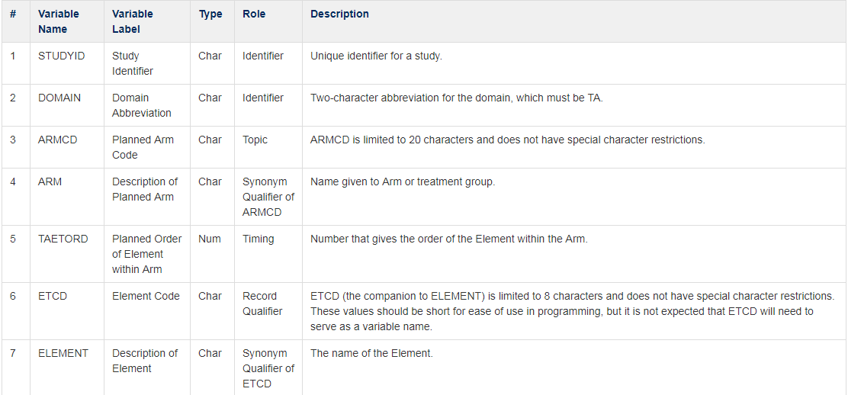
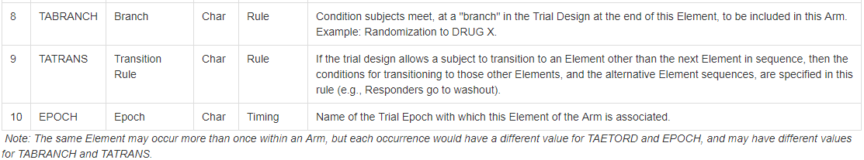
Trial Arms (TA) Domain - Metadata
TCS confidential

Slide 22
Trial Arms (TA) Domain - Implementation
STUDYID | DOMAIN | ARMCD | ARM | EPOCH | TAETORD | ETCD | ELEMENT | TABRANCH | TATRANS
CDISCtraining | TA | A | ARM A | Screen Epoch | 1 | SCREEN | Screening | Randomized to Treatment A
CDISCtraining | TA | A | ARM A | Treatment Epoch | 2 | TRTA | Treatment A BID
CDISCtraining | TA | A | ARM A | Follow-up Epoch | 3 | FU | Follow-up
CDISCtraining | TA | P | ARM P | Screen Epoch | 1 | SCREEN | Screening | Randomized to Placebo
CDISCtraining | TA | P | ARM P | Treatment Epoch | 2 | PBO | Placebo BID
CDISCtraining | TA | P | ARM P | Follow-up Epoch | 3 | FU | Follow-up
TCS confidential

Slide 23
Trial Design Domain - Summary
Challenges
Finding the information needed for an accurate representation of the study.
Creating TDM tables can be as much of an art as it is a science
Keep consistency across domains
Effects of these Domains:
TI:
IE (IETESTCD, IETEST, IECAT – all required)
TE:
TA, SE (ETCD (req.), ELEMENT)
TV:
SV (VISITNUM (req.), VISIT, VISITDY)
TA:
DM (ARMCD, ARM – all required)
CO (TAETORD)
SE, SV, CM, EX, SU, AE, DS, MH, DV, CE, EG, IE, LB, PE,
QS, SC, VS, DA, MB, MS, PC, PP, FA (EPOCH, TAETORD)
TCS confidential

