Slide 1
Anagha Bhatkhande Varsha Mahajan
Understanding RELREC and Supplemental Qualifier
November 1, 2017

Slide 2
Agenda
01
Understand Supplemental qualifiers
02
Understand Relationship Records Dataset

Slide 3
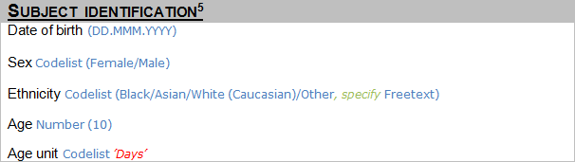
Understanding SUPPLEMENTAL QUALIFIER
Have we stored this data anywhere ?
Check your IG to see which Variable can store this data
I want to create a new variable to store this variable, as I do not find a variable in Demographic SDTM, Can I?

Slide 4
Supplemental Qualifier
You can not add New Variables in the SDTM dataset
Non standard data can be stored in the Supplemental Qualifiers special purpose dataset
Supplemental Qualifiers data will be presented as SUPP–
-- being the domain name for which you are creating SUPP data
E.g SUPPDM, SUPPAE etc

Slide 5
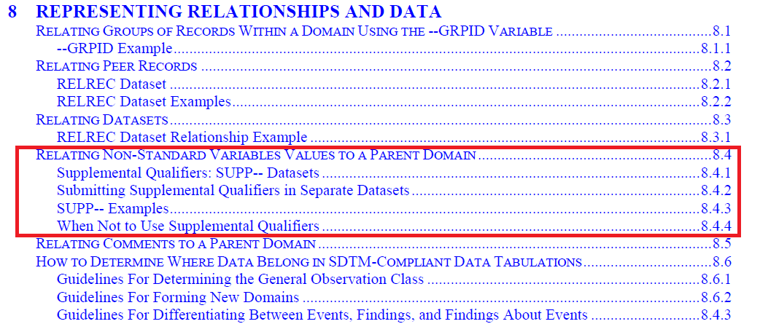
SDTM IG : Section 8

Slide 6
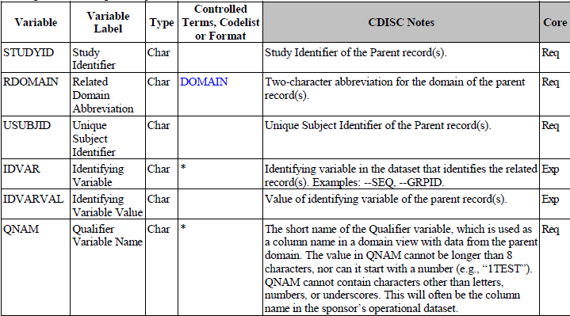
Structure of SUPP-- dataset
Value stored in QNAM is the name of new variable that user wants to create

Slide 7
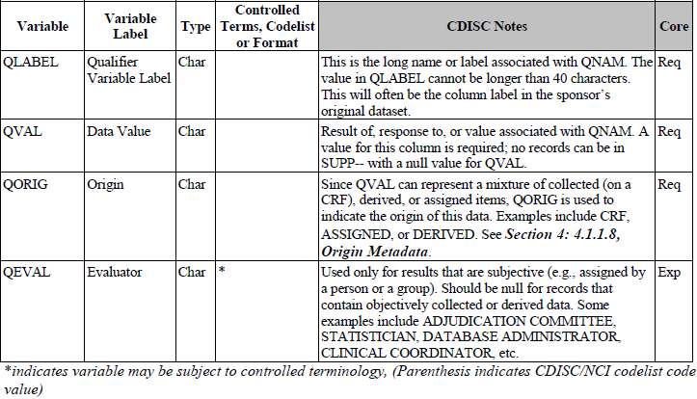
Structure of SUPP-- dataset
User defined label for the new variable
Value of the new variable, in this example it will be the free text that use eneters on CRF
Source or Origin of the information

Slide 8
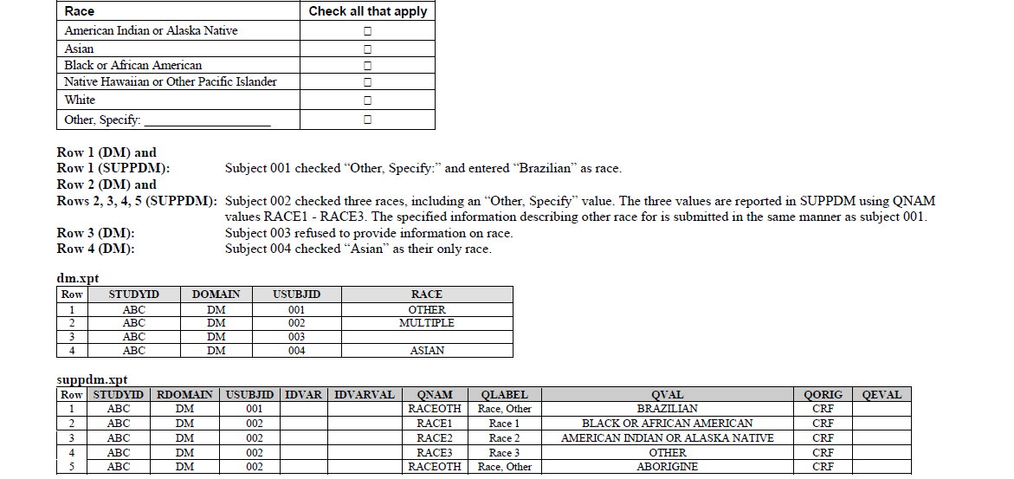
Example of MULTIPLE RACE
Additional information will be included in the Supplemental Qualifiers dataset
If multiple races are collected then the value of RACE should be
“MULTIPLE”
Controlled Terminology for RACE should be used in both DM and SUPPDM

Slide 9
SUPPDM Data Snapshot
STUDYID | USUBJID | RDOMAIN | QNAM | QLABEL | QVAL | QORIG
XXXX | XXX-002-004 | DM | RACEOTH | Race, Other Specifys | BRAZILIAN | ASIAN

Slide 10
RELREC DATASET
The Related Records (RELREC) domain is a Special-Purpose Relationship domain in the SDTM
It is used to identify relationships between records in two (or more) domains.
The RELREC domain can be used to describe relationships between
- records for a subject
- relationships between different domains
In RELREC, a relationship is constructed by adding a record to RELREC for each record to be
related and by assigning a unique character identifier value for that relationship.

Slide 11
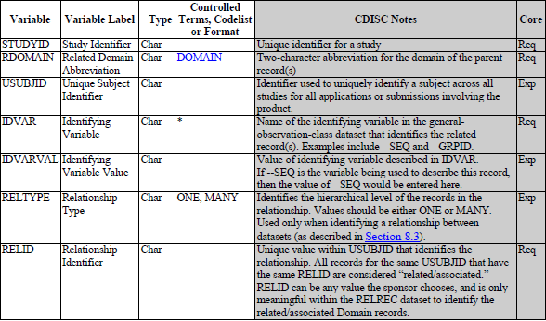
RELREC METADATA

Slide 12
CASE 1 : RECORDS FOR ONE SUBJECT
Used for records based on CRF collected information (Not applicable for derived records)
Single record can be related by using a unique record identifier variable like XXSEQ in IDVAR
Group records for a patient can be related using a grouping variable XXGRPID in IDVAR
RELID must be same for all related records within each subject

Slide 13
RELREC for relationship in Records
Record in DS Domain
STUDYID | DOMAIN | USUBJID | DSSEQ | DSTERM | DSDECODE | DSCAT | EPOCH | DSDTC
XYZ999 | DS | Xyz999-1000-1001 | 001 | Heart Failure | DEATH | DISPOSITION EVENT | TREATMENT | 2017-10-10
Record in AE Domain
STUDYID | DOMAIN | USUBJID | AESEQ | AETERM | AEDECODE | AEBOBSYS | AESER | AESTDH | AESTDTC | AEENDTC
XYZ999 | DS | Xyz999-1000-1001 | 002 | Heart Failure | HEART FAILURE | CARDIOVASCULAR SYSTEM DISORDER | Y | Y | 2017-10-10 | 2017-10-10
For this patient record with DSSEQ=1 is related with AESEQ=2; RELID=1 indicates both are related
Record in RELREC domain
STUDYID | RDOMAIN | USUBJID | IDVAR | IDVARVAL | RELTYPE | RELID
XYZ999 | DS | Xyz999-1000-1001 | DSSEQ | 001 | ONE | 1
XYZ999 | AE | Xyz999-1000-1001 | AESEQ | 002 | ONE | 1

Slide 14
CASE 2 : RELATING MORE THAN ONE DATASET
Include single record for each dataset
This record should have the key(s) of the dataset that can be used to relate
USUBJID is not required , as relation is set between two datasets and not for a single patient
IDVARVAL is not populated because the relationship exists for all values of IDVAR within a subject

Slide 15
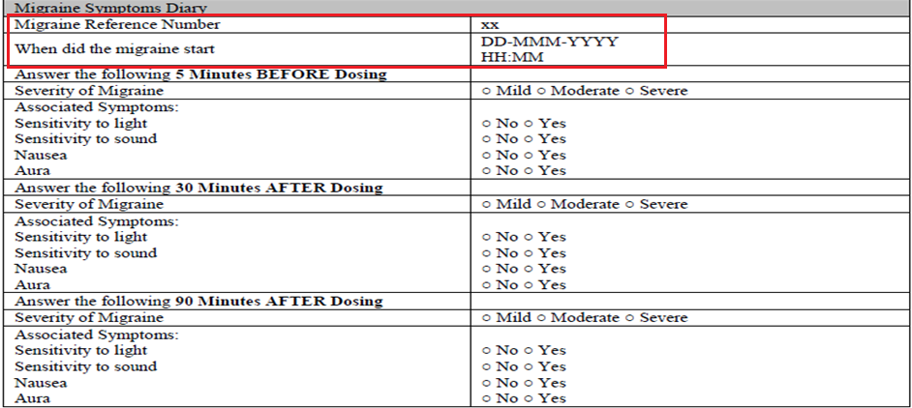
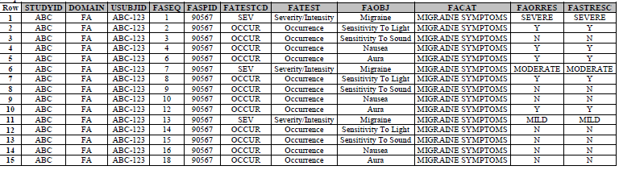
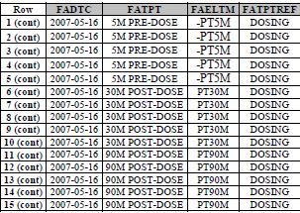
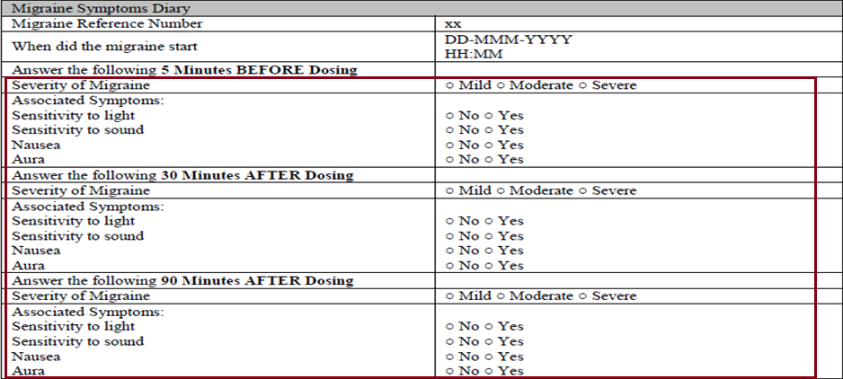
RELREC for relationship between two Datasets

Slide 16

RELREC for relationship between two Datasets (Contd…)

Slide 17
RECAP Points
The RELREC is important that it can identify relationships between records in two (or more) domains
Relationship represented in RELREC is collected relationships, either by explicit references or check boxes on the Case Report Form (CRF) and this relationship can only be mapped to RELREC
SEQ is used to be the IDVAR to merge/join records between datasets when relating records for a subject while GRPID playing the same role when relating across datasets

Slide 18
End of Session

