Slide 1
Anagha Bhatkhande Varsha Mahajan
SDTM Overview
October 30, 2017

Slide 2


Confidentiality Statement
This document contains information which is commercially confidential to Tata Consultancy Services Ltd. ("TCS") and is provided for the sole purpose of permitting the recipient to evaluate the proposal submitted within the document. In consideration of the receipt of this document, the recipient agrees to maintain the information it contains in confidence and not to reproduce or otherwise disclose the contents of this document to any person outside the recipient's evaluation team or nominated advisors. The document may not be used, reproduced or disclosed to others, except as specifically permitted by TCS in writing. The recipient of this document, by its retention and use, agrees to take reasonable endeavours to protect the document and the information it contains from loss or theft.
© 2017 - TATA Consultancy Services Limited (TCS)
TCS Confidential

Slide 3
Agenda
01
Introduction to SDTM s
TCS Confidential

Slide 4
SDTM - Benefits
FDA and PMDA require standards for their review
Provides a standard for representation of data
Eases data review – facilitating standard tools
Provides guidance to handle atypical data
Standardizes non clinical, medical devices, pharmacogenomics/ genetic study data
Sponsor Benefits
Standard and streamlined process in collecting, organizing, managing, analyzing and reporting of data
Flexibility to handle instream data changes protocol – CRF – data – Analysis
Eases implementation of data aggregation and warehouse creation; facilitating data mining and re-usability
Facilitates the process of data sharing
Shorter timelines for data review
Similar standards for submission across different HAs – cost and time benefits
Trial design standards and library for trial components
Accelerates and improves the submission process – efficient data submission
TCS Confidential

Slide 5
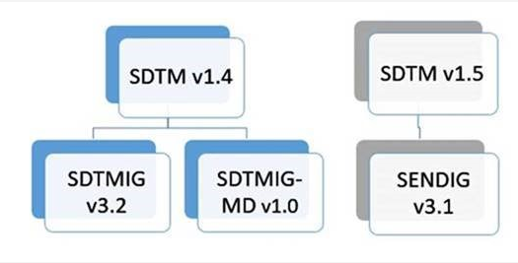
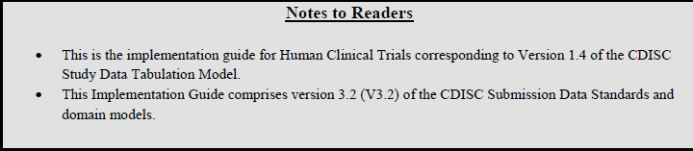
SDTM and SDTM IG
One SDTM version can be referenced by multiple IGs.
Each IG will reference the SDTM version it is associated with.
TCS Confidential
Notes:
and a new version of the SDTM will appear to support a new version of any one of those IGs.

Slide 6
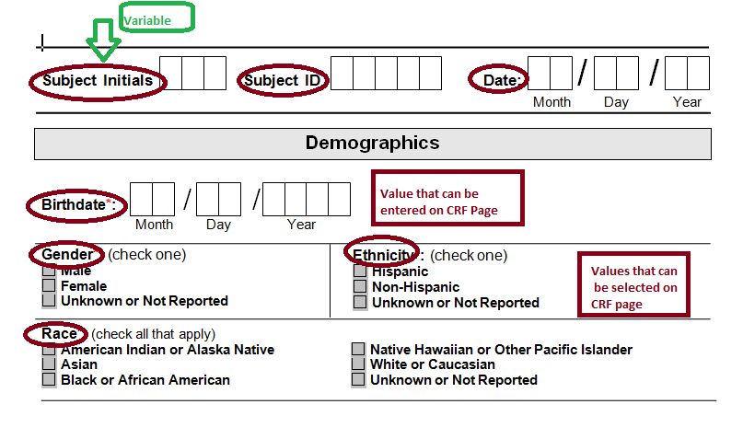
Example 1 : Demographic Page – non standard
TCS Confidential

Slide 7
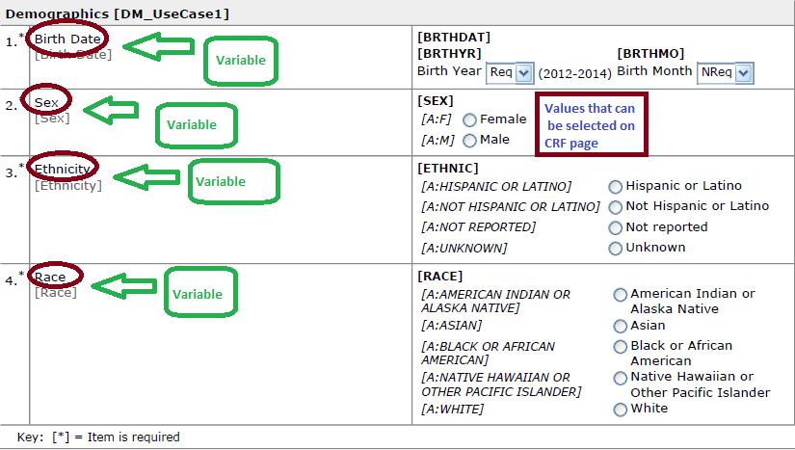
Example 2 : Demographic Page – standard
TCS Confidential

Slide 8
Exercise using Example 1 & 2
1
What are Variables?
2
Comparison of Example 1 & 2
TCS Confidential

Slide 9
Understanding Key Terms in SDTMs
The model is built around the concept of Observations.
Observations are discrete pieces of information collected during a study.
Observations normally correspond to rows in a dataset.
Each observation can be described by a series of named variables.
Each variable, normally corresponds to a column in a dataset, can be classified according to its Role.
A domain is defined as a collection of observations with a topic-specific commonality about a subject.
TCS Confidential

Slide 10
Understanding Contents of SDTM
SUBJID | USUSBJID | BRTHDTC | SEX | RACE | ETHNIC
1001 | XYZ12345-1001 | 2006-01-12 | M | ASIAN | Non Hispanic
1002 | XYZ12345-1002 | 1980-07-14 | M | ASIAN | Non Hispanic
1003 | XYZ12345-1003 | 1945-03-21 | M | ASIAN | Non Hispanic
1004 | XYZ12345-1004 | 2000-12-12 | F | ASIAN | Non Hispanic
Variables
Here we have 4 observations and 6 variables.
Values
TCS Confidential

Slide 11
Knowledge check
Q1) Observations normally corresponds to ------- in dataset
Ans: Rows
Q2) Variables normally corresponds to ------- in dataset, and can be classified based on the -----
Ans: Columns, Role
Q3) Domain is a collection of ------ with topic specific commonality of a subject
Ans: Observations
Q4) Observations are ------ collected during the study
Ans: Discrete pieces of information
TCS confidential

Slide 12
Data Captured During Clinical Trial
Disposition
We collect information for a patient on various Case Report forms as displayed in the adjoining figure
In SDTM terminology we call this as Domains
It is important to Classify this information as objective of each information is different
Vital
Signs
Medical
History
ECG
Other
Medications
Study
Treatment
Demographic
info
Laboratory
data
Adverse
Events
Surgeries/
Procedures
TCS Confidential

Slide 13
Classification of Data
Events
Interventions
Findings
When you want to know What happened to a patient in past, what is happening to a patient during trial or what are the different milestones patient is completing as defined in Protocol, CDISC classifies this Info as EVENTS
Which study treatment patient has taken, what was the frequency, route etc. In addition to the study medications what other medications are taken by patient. Did the patient undergo any procedure? Did the patient use any substance during trial?
Did the patient do any test? (e.g Laboratory test, ECG, Vital signs etc), what were the results of the test? Were any pharmacokinetic tests done? Did the subject fill any questionnaire data? If yes what were the answers to the questions
Some data can not be classified in the above categories that will go as “Special Purpose” domain
Data related to Trial design, Trial visit, Trial Element, Trial Summary can not be mapped into above classes and is mapped in Trial Design Domains
Relationship between different domains or additional information in a same domain can be mapped into RELREC or SUPPQUAL
TCS Confidential

Slide 14
SDTM Overview
Major components of SDTM which helps in structuring the data are:
Data
Class
Variable Roles
Core Variables
Structured SDTM Data
TCS Confidential

Slide 15
SDTM Overview : Data Class
Describes the datasets or domains within the SDTM. These are Categorized into 6 classes
General Observations
Interventions
Events
Findings
Special Purpose
Trial Design
Relationship
Investigational drug, medicinal product, therapeutic or any other treatments administered to the subject which can cause a physiologic change in the subject
Planned protocol milestones, study evaluations and the incidents that occur during the or prior to the course of the clinical trial.
Planned and unplanned observations/evaluation during the course of the clinical trial.
Additional important information that does not fit the General observation class
The clinical trial design, objectives and the planned schedule as defined in the protocol are represented in this class
Related records (RELREC)
Intervention Domains:
Exposure (EX)
Exposure as collected (EC)
Concomitant/Prior Medications (CM)
Procedures (PR)
Substance Use (SU)
Event domains:
Adverse Events (AE)
Medical History (MH)
Clinical Events (CE)
Disposition (DS)
Protocol Deviations (PD)
Finding domains:
ECG test Results (EG)
Laboratory Test Results (LB)
Pharmacokinetics Findings (PC)
Questionnaires (QS)
Physical Examination (PE) etc.
Special Purpose domains:
Demographics (DM)
Subject Visit (SV)
Subject Elements (SE)
Comments (CO)
Trial Design domains:
Trial Arms (TA)
Trial Inclusion/Exclusion (TI)
Trial Elements (TE)
Trial Visits (TV)
Trial Summary (TS).
Supplemental Qualifiers (SUPP--)
TCS Confidential

Slide 16
Knowledge check
Q1) Name 3 classes in General Observations class
Ans: Events, Interventions, Findings
Q2) Relationship between different domains need to be mapped in which dataset?
Ans: RELREC
Q3) Why do we need special purpose domains?
Ans: To store data that can not be mapped into General observations classes
Q4) Name major components of SDTM dataset
Ans: Data Class, Variable Roles, Core Variables
TCS confidential

Slide 17
SDTM Overview : Variable Roles
A Role determines the type of information conveyed by the variable about each distinct observation and how it can be used.
Variables have 5 main roles within SDTM
Identifier
Topic
Timing
Qualifier
Rule
Key Distinguishers aid in identifying the records
Specifies the
focus of the
observation
Timing of the observation
Additional important information that describes the results or traits of the observation
Algorithm or method to define start, end, branching or looping condition in Trial Domains
Study Identifier (STUDYID)
Subject Identifier (USUBJID)
Sequence Identifier (--SEQ)
Lab Test Name (LBTEST)
Adverse Event Term
(AETERM)
Reported Drug Name
(CMTRT)
Lab
Lab Assessment Date (LBDTC)
Adverse Event Start Date (AESTDTC)
Exposure End Date (EXENDTC)
Lab Test Result (LBORRES)
Adverse Event Severity (AESEV)
Conmed Dose (CMDOSE)
TABRANCH, TATRANSITION in TA domain
TCS Confidential

Slide 18
SDTM Overview : Qualifier classification
The Qualifier variable is further classified in to 5 subclasses
Grouping
Result
Variable
Synonym
Record
Used to group or categorize observations within a domain
Contains specific results in “Findings” domain, either original or standardized format.
Contain additional information to more clearly define values in another variable.
Contain an alternative name for another variable (usually the topic variable)
Contains additional information about the observation as a whole
Lab Category (LBCAT)/ (LBSCAT) etc.
LAB Results and Ranges (LBORRES), (LBSTRESN), (LBSTRESC) etc.
(e.g., units, normal range).
E.g. CMDOSU, LBORRESU, LBSTRESU etc.
LBTEST, AEMODIFY etc.
(e.g., severity, subject position for vital signs) e.g. AEOUT, AEACN, CMSTAT etc.
TCS Confidential

Slide 19
Knowledge Check
Match the column:
Examples of SDTM Variables | Sub classification of Qualifier variable
XXCAT Variables | Variable
XXORRES, XXSTRESC, XXSTRESN | Grouping
XXU | Result
XXMODIFY , XXTEST | Record
XXOUT, XXACN,XXSTAT | Synonym
TCS Confidential

Slide 20
SDTM Overview : Core Variable Classification
The Core variable is further classified in to 3 types
Required
Expected
Permissible
Basic to the identification of a data record
Establish the observation context
If collected
or derived
Must always
be included
Must always
be included
Must be included if collected
Cannot be null for any record
Can be null for some records
Can be null
or present
TCS Confidential

Slide 21
Knowledge check
Q1) What does the Role of variable signify?
Ans: Type of information conveyed by the variables and it’s use
Q2) What are the different types of roles a variable can have?
Identifier
Topic
Timing
Qualifier
Rule
TCS confidential

Slide 22
Knowledge check
Q1) What is the sub classification of ‘Qualifier’ variable?
Grouping
Result
Variable
Synonym
Record
Q2) What is the Core of Variable?
Required
Expected
Permissible
TCS confidential

Slide 23
Knowledge Check
Match the column:
Characteristics “Core” of Variable | Core variable classification
Variable can be null or present | Expected
Variable can not have null value and must be included in dataset | Permissible
Variable can have null value and must be included in dataset | Required
TCS Confidential

Slide 24
SNAPSOT of Standard Domain
General Observation Classes
Special-Purpose
Trial design
domains
Interventions
Events
Findings
Demographics
TA
Concomitant Medications
Adverse
Events
Inclusion / Exclusion Criteria Not Met
Physical Examination
Comments
TI
TV
Vital
Signs
Findings About
Subject Elements
TE
Disposition
Exposure
TS
Medical History
ECG
Questionnaires
Labs
Subject Visits
Substance Use
Deviations
Subject Characteristics
Clinical Events
Drug Accountability
Relationship Datasets
Microbiology Specimen
Microbiology Susceptibility
RELREC
SUPPQUAL
PK Concentrations
PK Parameters
TCS Confidential

Slide 25
List of SDTM Domain - IG 3.2
Special-Purpose Domains
Findings General Observation Class
• Comments (CO) • Demographics (DM)
• Subject Elements (SE) • Subject Visits (SV)
• Drug Accountability (DA) • Death Details (DD)
• ECG Test Results (EG) • Inclusion/Exclusion Criterion Not Met (IE)
• Immunogenicity Specimen Assessments (IS)
• Laboratory Test Results (LB)
• Microbiology Specimen (MB) • Microscopic Findings (MI)
• Morphology (MO) • Microbiology Susceptibility Test (MS)
• PK Concentrations (PC) • PK Parameters (PP)
• Physical Examination (PE) • Questionnaires (QS)
• Reproductive System Findings (RP)
• Disease Response (RS)
• Subject Characteristics (SC) • Subject Status (SS)
• Tumor Identification (TU) • Tumor Results (TR)
• Vital Signs (VS)
Interventions General Observation Class
• Concomitant Medications (CM) • Exposure as Collected (EC) • Exposure (EX) • Substance Use (SU) • Procedures (PR)
Events General Observation Class
• Adverse Events (AE) • Clinical Events (CE)
• Disposition (DS) • Protocol Deviations (DV)
• Healthcare Encounters (HO) • Medical History (MH)
Trial Design Domains
Findings About
• Trial Arms (TA) • Trial Disease Assessment (TD) • Trial Elements (TE) • Trial Visits (TV) • Trial Inclusion/Exclusion Criteria (TI) • Trial Summary (TS)
• Findings About (FA) • Skin Response (SR)
RELREC and SUPPQUAL
• RELREC •Supplemental Qualifier (SUPPQUAL)
TCS Confidential

Slide 26
Knowledge Check
Classify the domains as per SDTM standards:
Demographics, Inclusion/Exclusion criteria Not met, Trial inclusion/Exclusion criteria, Subject Visits, Exposure, Drug Accountability, Trial Arms, Comments, Disposition, Substance Use, PK Concentrations, Relationship between AE and CM, Additional information about Race <Specify>
General Observation Classes
Special-Purpose
Trial design
domains
Interventions
Events
Findings
Demographics
TA
Adverse
Events
Inclusion / Exclusion Criteria Not Met
Comments
TI
Concomitant Medications
TV
Vital
Signs
Findings About
Subject Elements
TE
Disposition
TS
Exposure
Medical History
ECG
Questionnaires
Labs
Subject Visits
Substance Use
Deviations
Subject Characteristics
Clinical Events
Drug Accountability
Relationship Datasets
Microbiology Specimen
Microbiology Susceptibility
RELREC
SUPPQUAL
PK Concentrations
PK Parameters
Physical Examination

Slide 27
Before and After SDTM
BEFORE SDTM | AFTER SDTM
Non standard Domain names | Standard Domain names
Variable Domain structure | Standard Domain structure
Variable Domain variables | Standard Domain variables
Variability of Domain variable names | Standard Domain variable names
Variety of Data classification | Standardized Data classification
Variety of Data storage / formatting | Standardized Data storage / formatting
Variability of variable roles | Standardized variable roles
Variable Data structure for atypical data e.g. questionnaires, TA specific data | Harmonized Data structure for atypical data
TCS Confidential

Slide 28
End of Session

