Slide 1
Exploring Value Potential Through Empirical Modeling

Slide 2
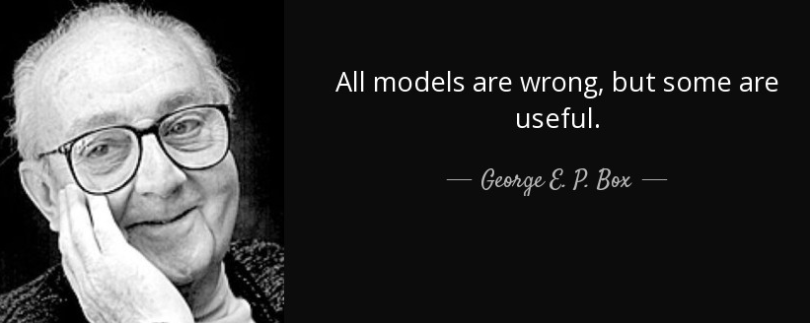
Prelude

Slide 3
B&SP Value Chain
Increasing Complexity
The size of the block does not necessarily determine the volume of the activity
eCTD: Electronic Common Technical Document; EudraCT: European Union Drug Regulating Authorities Clinical Trials; ADaM: Analysis Data Model; ISS: Integrated Summary of Safety; ISE: Integrated Summary of Efficacy; DSUR: Development Safety Update Report; PSUR: Periodic Safety Report; PBRER: Periodic Benefit-Risk Evaluation Report; RMP: Risk Management Plan; SAP: Statistical Analysis Plan
Notes:
Separate pices

Slide 4
B&SP: Volume of Activities and Associates Mix – FY 17 vs. FY 20
Associates Mix
FY 17 (N= 300)
FY 20 (N= 600)
BPO 2, 31.8
FY 20: 500 resources based in India + 100 resources based in US/ EU to handle the top of the value chain

Slide 5
And Now the Model……

Slide 6

Next Steps…
Thank You...
Promise what we deliver, deliver what we promise, that’s certainty

