Slide 1
Clinical Pharma information extraction Proof of Concept Follow up
Version: 1.00
Date: Nov 17, 2015

Slide 2
Agenda
Objective and requirements
01
Objective
Requirement
Types of data sources and examples
02
Solution approach
03
PoC scope
Process related
Questions/Clarifications
04
References
05

Slide 3
Objective & Requirements
Expedited data extraction
Clinical trials are expensive. It’s cost effective to run a mathematical model of the clinical trial rather than the actual trials. So more mathematical model validation is desirable.
For running mathematical models input data is necessary.
The data is mostly present in unstructured text in various papers, studies, FDA submissions.
Data extraction is mostly manual, time consuming and error prone.
Because of these constraints only a limited number of models are validated in a year.
Objective
Explore and demonstrate
Data extraction from natural language free form texts from PDF files
Data extraction from natural language text in tables from PDF files
Data extraction from images e.g. charts and graphs in PDF files
Present data in structured format (Excel files)
Transformation of structured data (Not is scope for the first phase but should be thought through)
Scope

Slide 4
Types of data sources
FDA
Abstract
Journal
Poster
Clinical trials
Registry

Slide 5
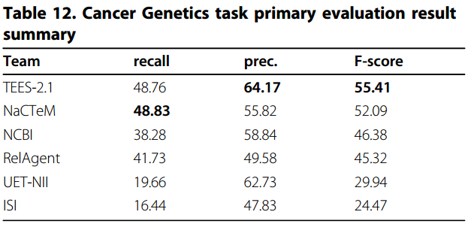
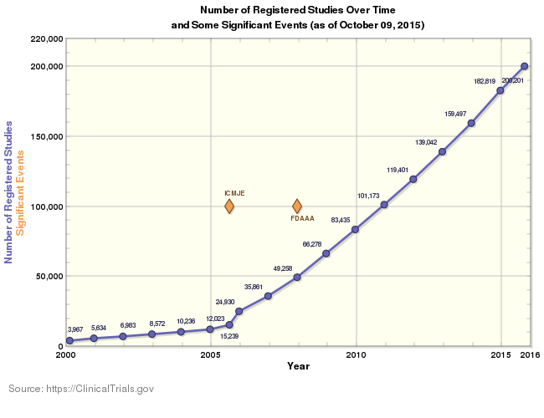
Data examples
Free text extraction
Named entity extraction (NER)
Table data extraction
Named entity extraction (NER)
Image data extraction
Pioglitazone may cause fluid retention, a well-known side effect of thiazolidinediones, and may exacerbate heart failure. Patients with type 2 diabetes and mild cardiac disease (New York Heart Association functional class I) received pioglitazone (n=151) or glyburide (n=149) for 1 year. The primary endpoint was change in distance covered in the 6-minute walk test. Main secondary endpoints included comparison of cardiovascular mortality and morbidity, analysis of changes from baseline in cardiac structure and function by echocardiogram, and lipid panel. There was no significant treatment difference in the mean change from baseline in the 6-minute walk test (-11.7 m [95% confidence interval, -29.79 to 6.42]). Cardiovascular mortality and morbidity were not significantly different between the treatment groups. Echocardiographic data suggested no significant deterioration in cardiac function with pioglitazone, although more heart failure (10 vs 7 patients), edema (21.2% vs 12.8%), and weight gain (2.56+/-4.62 kg vs 0.86+/-3.85 kg) were observed than with glyburide.

Slide 6
Solution Approach (end to end)

Slide 7
Solution Approach
Model training (entity and name identification)
Human intervention (connecting names with entities)

Slide 8
Model analysis

Slide 9
Human intervention
993 treatment canagliflozin sitagliptin beta cell 2 diabetes metformin sulfonylurea G. E. A. C. M. G. D. Austria Pisa School Medicine Biomedical Engineering Padova Italy R D LLC Raritan USA Background Canagliflozin CANA SGLT2 inhibitor sitagliptin SITA DPP-4 inhibitor plasma glucose PG CANA PG urinary glucose excretion SITA active hormones GLP-1 GIP CANA SITA treatment postprandial glucose PPG CF 2 diabetes mellitus T2DM inadequate metformin sulfonylurea MET SU Phase 3 CANA 300 mg SITA 100 mg therapy T2DM inadequate MET SU baseline characteristics 57 HbA1c 8.1 % body weight 88 kg BMI 32 A 249 FS-MMTT baseline 52 FS-MMTT PG insulin points PG PG FPG PG FS-MMTT MPG incremental PG FS-MMTT MiPG CF insulin secretion ISR ISR PG Calculated CF ISR 9 glucose glucose sensitivity slope ISR PG FS-MMTT 135 ANCOVA baseline CANA SITA FPG PPG baseline Figure FPG SE FPG -1.6 0.2 CANA -0.6 0.3 SITA 0.001 MPG MPG -3.1 0.3 CANA -1.8 0.4 SITA 0.001 CANA SITA incremental PG MiPG -1.5 0.2 CANA -1.2 0.2 SITA ISR PG Figure ISR 9 ISR 9 41 7 CANA 31 11 SITA numerical glucose sensitivity treatment CANA SITA T2DM inadequate glucose MET SU CANA FPG MPG SITA CF Clinical Trial Registration NCT01137812 Janssen LLC
HbA1c
Body weight
Insuline secretion
BMI

Slide 10
Questions/Clarifications
PoC scope
For PoC could we try to do few things and show the results incrementally the value e.g. steps might be:
Processing free form text from Journals
Processing tables from Journals
Processing tables from clinical trials website etc.
Processing images with UI
Process (UI and human intervention):
We need some input on the user personas so that we can design the UI and get some feedback (will they be scientists or data operators)
How will the extractions be validated for correctness.

Slide 11
References
NER papers:
https://web.stanford.edu/class/cs124/lec/Information_Extraction_and_Named_Entity_Recognition.pdf
http://cogcomp.cs.illinois.edu/papers/RatinovRo09.pdf
http://nlp.stanford.edu/pubs/bionlp-camera.pdf
http://repository.upenn.edu/cgi/viewcontent.cgi?article=1083&context=ircs_reports
BioNLP papers:
https://www.aclweb.org/anthology/W/W13/W13-20.pdf
http://www.ncbi.nlm.nih.gov/pmc/articles/PMC4511510/pdf/1471-2105-16-S10-S2.pdf

Slide 12
Questions?

