Slide 1
Biostatistics and Statistical Programming
Competency Development Methodology
May 22, 2017

Slide 2
Agenda
Competency Development Methodology
Objective
Need
Competency Categorization
Functional Competency
Behavioural Competency
Competency Assessment - Statistical Programming
Competency Assessment - Biostatistics
Competency Level
Gap Analysis
Individual Development Plan

Slide 3
Competency Development Methodology

Slide 4
Competency Development Methodology
Objective
Need
Following are (but not limited) the Objectives of the Initiative
Education and Awareness
Identifying Individual Strengths and Areas of Improvement
Continued Growth Plan for Business
GAP Analysis
Structured Individual Development Plan
Associate:
Build awareness of the overall big pharma picture
Self-aware of personal needs and gap
Build a robust and planned career road map
Organization:
Needs to know the team competencies and the Gaps
Help support the team competencies to be mapped with business objectives (domain specific)
Support overall sustainable growth and learning agile organization

Slide 5
Competency Categorization

Slide 6
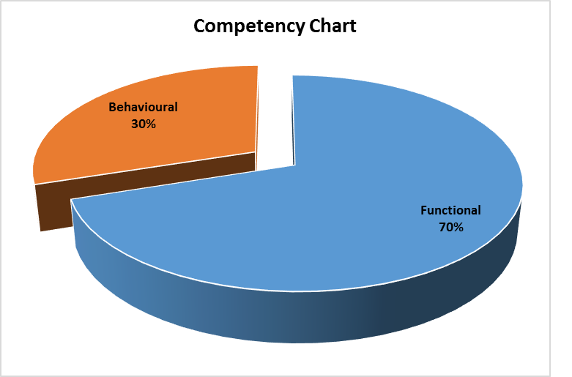
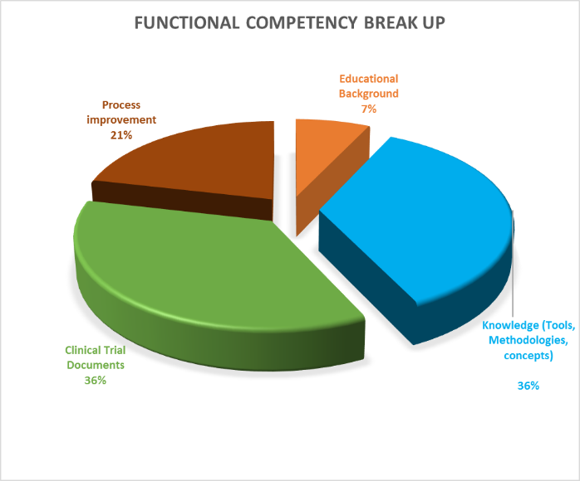
Competency categorization
Functional (Technical)
Behavioural (Non-Technical)
Focuses on
Educational Background
Knowledge
Clinical Trial Documents
Process Improvements
(Weightage defined by SME)
Focuses on
Planning and Organization
Soft Skills
(Weightage defined by SME)
A Self assessment coupled with managerial guidance of each criteria will help an individual to know where they stand and what are the improvement areas
Self Learning/ ILT sessions by SMEs/Superusers can facilitate some of the Training sessions for common areas of development

Slide 7
Competency Assessment - Statistical Programming

Slide 8



Functional competency – Statistical Programming
Knowledge [Expressed as Area of knowledge and not skill, includes knowledge of process, methodologies, concepts and tools]
Basic Level (E0)
Basics of SAS programming(Data steps, statements, functions, procedures, formats etc.,),
Understanding of clinical research phases
ICH guidelines (Good clinical practice) & FDA regulations
Intermediate Level (E1)
Advance SAS programming (Graphs, proc report, macros etc.,).
Understanding of clinical research phases,
ICH guidelines (Good clinical practice), FDA regulations & basic statistics.
Should have basic understanding of study design(parallel/cross-over).
Basic understanding of various clinical derivations and end-points.
Advance Level (E2)
Hands-on experience of SAS programming (developing ADS and Medium complex TFLs) including user defined macros, ability to debug the macros.
Understanding of clinical research phases,
ICH guidelines (Good clinical practice), FDA regulations & basics of statistics.
Should have understanding of study design(parallel/cross-over)
Basic therapeutic areas and the end-points & basics of drug development process.
Ability to perform eCTD submission
Expert Level (E3)
Hands-on experience of SAS programming (developing ADS and high complex TLFs ) , SDTM mapping
Develop user defined macros, ability to debug the macros.
Understanding of clinical research phases,
ICH guidelines (Good clinical practice), FDA regulations & basics of statistics.
Should have understanding of study design(parallel/cross-over)
Therapeutic areas and the end-points & drug development process.
Ability to translate statistical methods in to programming
Develop programming specification and review of mock shells
Provide inputs to cross functional documents (e.g. Data Review Plan, Investigator Brochure, CSR, DSUR,RMP, PSUR/PBREB)
Ability to perform eCTD submission
Master Level (E4)
Proficiency in SAS programming (developing ADS and high complex TLFs ) , expert SDTM mapping
Develop and maintain user defined macros, ability to debug the macros.
Understanding of clinical research phases,
ICH guidelines (Good clinical practice), FDA regulations & basics of statistics.
Should have understanding of study design(parallel/cross-over)
Good Knowledge and Experience wrt Therapeutic area/s and drug development process.
Ability to translate statistical methods in to programming
8) Inputs to SAP and mock shells and develop and review programming specifications
Provide inputs to cross functional documents (e.g. Data Review Plan, Investigator Brochure, CSR, DSUR,RMP, PSUR/PBREB,ISS/ISE)
Ability to perform eCTD submission
Ability to support ad hoc request from regulatory bodies with short TAT

Slide 9
Functional competency – Statistical Programming
Clinical Trial Documents (Protocol, Case Report Form, Statistical Analysis Plan and Programming specifications)
Basic Level (E0)
Ability to list the key elements of the protocol- Type of study, Scope, Study Design, Study Objectives, Primary & Secondary end points, Relevancy, Therapeutic Area and relate it to the study.
Ability to list statistical concepts used in the study and relate it to the study.
Ability to list the study criteria and connect it with the study programming.
Ability to list CRF domains covered for data collection, Understand data classification and flow of data in the CRF and relate to TLF shells
Intermediate Level (E1)
Ability to list and explain key statistical elements of the protocol and connect with the CRF, data, SAP, shells, visit schedule, etc.,
Ability to understand the statistical concepts, end points used in the study design and connect it to mock shells and TLF & programming.
Ability to map data with CRF and link it to TLF programming.
Ability to develop dataset specifications for simple domains (e.g. DM) and or develop dataset specifications for a low complex study.
Advance Level (E2)
Ability to identify the necessary data and data constraints, that could be the roadblock & could have impact on programming.
Ability to understand proposed statistical methodologies on a study.
Ability to understand the statistical needs and contribute to SAP review from programming aspect.
Ability to identify the derived variable require for analysis dataset.
Giving input to the CRF/ Annotated CRF while designing.
Ability to understand the irrelevant variable captured in CRF and optimize the requirement.
Ability to develop dataset specifications for a low or medium complex study.
Expert Level (E3)
Ability to understand the statistical methods / concepts mentioned in the protocol, inclusion exclusion criteria, good understanding about clinical concepts (e.g. population definition, disease background, visit schedule etc.)
Ability to map the protocol endpoints with programming derivations
Ability to understand the statistical needs and contribute to SAP creation/review from programming aspect.
The derived variables identified, in earlier level, should be understood and explain the logic for those variables.
Giving input to the CRF/ Annotated CRF while designing.
Ability to understand the irrelevant variable captured in CRF and optimize the requirement if needed.
Ability to develop dataset specifications for any type of study low/medium/high complex study.
Ability to develop or provide inputs to Therapeutic Area specific derivations
Master Level (E4)
Ability to understand the statistical methods / concepts mentioned in the protocol, inclusion exclusion criteria, good understanding about the population definition.
Ability to map the protocol endpoints with programming derivations
Ability to develop or provide inputs to Clinical Submission planning Document by reviewing multiple study protocols required for pooling of ISS/ISE
Ability to understand the statistical needs and contribute to SAP creation/review from programming aspect for simple to complex studies including pooling and other cross-functional deliverables
The derived variables identified, in earlier level, should be understood and explain the logic for those variables
Ability to understand the data quality pertaining to statistical analysis like categorical variables for model fitment or bivariate / multivariate analysis.
Ability to censor the data for survival analysis or time to event data when necessary.
In addition to all, ability to develop pooling dataset specifications and or review and provide guidance and mentor team members.
Ability to develop or provide inputs to Therapeutic Area specific derivations

Slide 10
Functional competency – Statistical Programming
Process Improvement (Automation, Asset Creation and Process Framework)
Advance Level (E2)
Ability to identify the limitations of the existing tool and the probable bugs that the tool can encounter and propose the appropriate solution.
Ability to contribute in creation of assets such as templates, presentations, forms, reusable checklists, reports, project plans etc.
Should have been a part of a process improvement initiative/ project
Should have contributed to developing lessons learnt and best practices documents
Basic Level (E0)
Ability to understand and use available automated tools
Intermediate Level (E1)
Ability to understand and use available automated tools
Expert Level (E3)
Ability to develop automation tools/macro/utility/concept with assimilation of various / all possible concepts for the particular domain.
Ability to contribute in creation of assets such as work instructions, guidelines and Process flows to streamline statistical programming activities .
Should have lead a process improvement initiative/ project.
Should have developed lessons learnt and best practices documents on topics of expertise.
Master Level (E4)
Ability to evolve with similar or improvised versions of the tool for TCS own platform.
Ability to contribute in creation of assets such as work instructions, SOPs, guidelines and Process flows.
Ability to provide guidance and mentor team members.
Should have lead a process improvement initiative/ project which resulted in substantial financial benefits.
Should have developed lessons learnt and best practices documents on the areas of expertise.
Should have created some level of automation/ macros for process improvement.

Slide 11
Behavioural competency – Statistical Programming
Planning and organization (Project management and Team management)
Basic Level (E0)
Ability to manage deliverables assigned and meet timelines as agreed within the team
Taking ownership for quality of the deliverables produced by self
Provide timely update to the study / project lead on the deliverable status
Intermediate Level (E1)
Support building timelines for delivery by providing inputs.
Ability to manage deliverables assigned and meet timelines as agreed within the team
Accountable for quality of the deliverables produced by self
Provide timely update to the study / project lead on the deliverable status
Advance Level (E2)
Planning timelines for deliverable for study
Accountable for overall quality of the deliverables for self and team
Ability to communicate with client and within the team
Ability to manage study team and deliverables
Expert Level (E3)
Planning timelines for deliverable
Manage deliverables for multiple studies
Accountable for overall quality of the deliverables
Effective communication with client and within the team
Ability to Negotiate deliverables by providing inputs to timelines
Ability to forecast issues and provide mitigation plan
Provide cross functional inputs (timely escalation of data issues to DM)
Ability to lead multiple study teams
Master Level (E4)
Planning timelines for deliverable
Manage deliverables for multiple studies/ submission
Accountable for overall quality of the deliverables
Effective communication with client and within the team
Ability to Negotiate deliverables by providing inputs to timelines
Ability to forecast issues and provide mitigation plan
Provide cross functional inputs (timely escalation of data issues to DM)
Ability to manage client delivery

Slide 12
Behavioural competency – Statistical Programming
Soft Skills
Basic Level (E0)
Oral Communication
Problem Solving
Planning and Organizing
Teamwork
Attention to detail
Seeking information
Intermediate Level (E1)
Oral Communication
Technological orientation
Problem Solving
Planning and Organizing
Teamwork
Attention to detail
Seeking information
Result orientation
Advance Level (E2)
Oral Communication
Technological orientation
Problem Solving
Planning and Organizing
Teamwork
Attention to detail
Seeking information
Result orientation
Decision Making
Written Communication
Expert Level (E3)
Oral Communication
Technological orientation
Problem Solving
Planning and Organizing
Teamwork
Team Leadership
Developing Others
Client Focus
Attention to detail
Seeking information
Master Level (E4)
Oral Communication
Technological orientation
Problem Solving
Planning and Organizing
Teamwork
Team Leadership
Developing Others
Client Focus
Attention to detail
Seeking information
Delegation
Conceptual Thinking
Result orientation
Consensus Building
Initiative and Drive
Managing Conflict
Risk Management
Decision Making
Written Communication
Delegation
Conceptual Thinking
Result orientation
Consensus Building
Initiative and Drive
Managing Conflict
Risk Management
Decision Making
Written Communication
Organizational Awareness

Slide 13
Competency Assessment - Biostatistics

Slide 14
Functional competency – Biostatistics
Knowledge [Expressed as Area of knowledge and not skill, includes knowledge of process, methodologies, concepts and tools]
Basic Level (E0)
Understanding application of basic statistics in clinical research and application of basics of SAS programming
Understanding of clinical research phases
ICH guidelines (Good clinical practice) & FDA regulations
Should have basic understanding of study design(parallel/cross-over).
Understanding of randomization concept
Intermediate Level (E1)
Application of statistical methods in clinical trials using SAS statistical procedures including basic SAS programming and setting up low complexity SAP under senior guidance
Understanding of clinical research phases,
ICH guidelines (Good clinical practice), FDA regulations.
Should have basic understanding of study design(parallel/cross-over).
Basic understanding of various clinical derivations and end-points.
Understanding of randomization scheme and methodology
Advance Level (E2)
Application of statistical methods in clinical trials using SAS statistical procedures including basic SAS programming
Develop SAP and mock shells for low or medium complex study designs with minimal senior guidance
Understanding of clinical research phases,
ICH guidelines (Good clinical practice), FDA regulations.
Should have understanding of study design(parallel/cross-over)
Basic therapeutic areas and the end-points & basics of drug development process.
Generation of randomization schedule
Ability to perform eCTD submission
Expert Level (E3)
Application of statistical methods in clinical trials using SAS statistical procedures including basic SAS programming
Develop and Review SAP and mock shells various complexities including submission plans.
Understanding of clinical research phases,
ICH guidelines (Good clinical practice), FDA regulations.
Should have understanding of study design(parallel/cross-over)
Therapeutic areas and the end-points & drug development process.
Summarizes and interprets statistical results
Provide inputs to cross functional documents (e.g. Data Review Plan, Investigator Brochure, CSR, DSUR,RMP, PSUR/PBREB)
Generation and review of randomization schedule and methodology
Ability to perform eCTD submission
Master Level (E4)
Application of statistical methods in clinical trials using SAS statistical procedures including basic SAS programming. Building models and tools for statistical usage.
Develop and Review SAP and mock shells for various complexities including submission plans.
Provide senior review/ guidance on statistical aspect during course of clinical study.
Understanding of clinical research phases
ICH guidelines (Good clinical practice), FDA regulations.
Should have understanding of study design(parallel/cross-over)
Therapeutic areas and the end-points & drug development process.
Summarizes and interprets statistical results
Provides high-level and accurate bio statistical advice to support health authority requests if any
Provide inputs to cross functional documents (e.g. Data Review Plan, Investigator Brochure, CSR, DSUR,RMP, PSUR/PBREB)
Generation and review of randomization schedule and methodology
Ability to perform eCTD submission

Slide 15
Functional competency – Biostatistics
Clinical Trial Documents (Protocol, Case Report Form, Statistical Analysis Plan and Programming specifications)
Basic Level (E0)
Ability to list the key elements of the protocol- Type of study, Scope, Study Design, Study Objectives, Primary & Secondary end points, Relevancy, Therapeutic Area and relate it to the study.
Understands the nature of the study questions and hypothesis
Ability to list statistical concepts used in the study and relate it to the study.
Ability to list the study criteria and connect it with the study programming.
Ability to list CRF domains covered for data collection, Understand data classification and flow of data in the CRF and relate to TLF shells
Intermediate Level (E1)
Ability to list and explain key statistical elements of the protocol and connect with the CRF, data, SAP, shells, visit schedule, etc.
Understands the nature of the study questions and hypothesis
Ability to understand the statistical concepts, end points used in the study design.
Ability to apply bio statistical principles and methods to support the statistical analysis for the primary and secondary endpoints based on the protocol
Ability to map data with CRF and Protocol to ensure the Mock shells suggested are appropriate.
Learn and develop skills on CRF and Protocol Alignment (CaPA)
Advance Level (E2)
Ability to identify the necessary data and data constraints, that could be the roadblock & could have impact on programming.
Ability to understand proposed statistical methodologies on a study.
Understands the nature of the study questions and hypothesis
Ability to understand the statistical concepts, end points used in the study design.
Ability to apply bio statistical principles and methods to support the statistical analysis for the primary and secondary endpoints based on the protocol
Ability to elaborate the statistical methodology in to the SAP and provide programming pseudocodes.
Giving input to the CRF/ Annotated CRF while designing.
Ability to understand the irrelevant variable captured in CRF and optimize the requirement.
Ensure CaPA
Expert Level (E3)
Ability to understand the statistical methods / concepts mentioned in the protocol, inclusion exclusion criteria, good understanding about the population definition.
Understands the nature of the study questions and hypothesis
Ability to provide statistical inputs to the design of the trial as well as sample size and power calculation based on the endpoint.
Ability to understand the statistical concepts, end points used in the study design.
Ability to apply bio statistical principles and methods to support the statistical analysis for the primary and secondary endpoints based on the protocol
Ability to elaborate the statistical methodology in to the SAP and provide programming pseudocodes.
Ability to explain statistical concepts clearly and checks for understanding
Giving input to the CRF/ Annotated CRF while designing.
Ability to understand the irrelevant variable captured in CRF and optimize the requirement if needed.
Ensure CaPA
Provide and Review statistical interpretations for all the statistical endpoints
Clearly outlines the background, aims, statistical methods and interpretation of results based on analyses
Presents data to support clear interpretation
Master Level (E4)
Along with all other, ability to review and provide inputs (esp. on population flags and key derived variables) the programming specification for analysis dataset, TLF and mock shells if required.
Understands the nature of the study questions and hypothesis
Ability to develop or provide inputs to Clinical Submission planning Document by reviewing multiple study protocols required for pooling for SCS or SCE or SCP
Ability to provide statistical inputs to complex study design using adaptive , Bayesian, group sequential etc. methodologies as well as sample size and power calculation based on the endpoint.
Ability to understand the statistical concepts, end points used in the study design.
Ability to apply bio statistical principles and methods to support the statistical analysis for the primary and secondary endpoints based on the protocol
Ability to elaborate the statistical methodology in to the SAP and provide programming pseudocodes.
Ability to explain statistical concepts clearly and checks for understanding
Applies regulatory framework and guidance for statistical analysis of certain endpoints
Ability to resolve issues to help reach consensus about the design of the study or analysis plan
Ability to understand the data quality pertaining to statistical analysis like categorical variables for model fitment or bivariate / multivariate analysis.
Ability to censor the data for survival analysis or time to event data when necessary.
Ensure CaPA
Provide and Review statistical interpretations for all the statistical endpoints
Clearly outlines the background, aims, statistical methods and interpretation of results based on analyses
Presents data to support clear interpretation
Communicates complex statistical information in easy to understand language. Logically explains methods, interprets results and checks for understanding

Slide 16
Functional competency – Biostatistics
Process Improvement (Asset Creation and Process Framework)
Basic Level (E0)
Adhere to client standards and meet expectations
Intermediate Level (E1)
Adhere to client standards and meet expectations
Advance Level (E2)
Ability to contribute in creation of assets such as templates, forms, reusable checklists, reports, project plans etc. .,
Should have been a part of a process improvement initiative/ project
Should have contributed to developing lessons learnt and best practices documents
Expert Level (E3)
Ability to contribute in creation of assets such as work instructions, guidelines and Process flows to streamline statistical programming activities.
Should have lead a process improvement initiative/ project.
Should have developed lessons learnt and best practices documents on topics of expertise.
Master Level (E4)
Ability to contribute in creation of assets such as work instructions, SOPs, guidelines and Process flows.
Ability to provide guidance and mentor team members.
Should have lead a process improvement initiative/ project which resulted in substantial financial benefits.
Training and mentoring for understanding of role and purpose of data collections by different health authorities.
Should have developed lessons learnt and best practices documents on the areas of expertise.

Slide 17
Behavioural competency – Biostatistics
Planning and organization (Project management and Team management)
Basic Level (E0)
Ability to manage deliverables assigned and meet timelines as agreed within the team
Taking ownership for quality of the deliverables produced by self
Intermediate Level (E1)
Support building timelines for delivery by providing inputs.
Ability to manage deliverables assigned and meet timelines as agreed within the team
Accountable for quality of the deliverables produced by self
Provide timely update to the study / project lead on the deliverable status
Advance Level (E2)
Planning timelines for deliverable for study
Manage deliverables
Accountable for overall quality of the deliverables
Ability to communicate with client and within the team
Ability to manage study team
Expert Level (E3)
Planning timelines for deliverable
Manage deliverables for multiple studies
Accountable for overall quality of the deliverables
Effective communication with client and within the team
Ability to Negotiate deliverables by providing inputs to timelines
Ability to forecast issues and provide mitigation plan
Provide cross functional inputs (timely escalation of data issues to DM)
Ability to lead multiple study teams
Master Level (E4)
Planning timelines for deliverable
Manage deliverables for multiple studies/ submission
Accountable for overall quality of the deliverables
Effective communication with client and within the team
Ability to Negotiate deliverables by providing inputs to timelines
Ability to forecast issues and provide mitigation plan
Provide cross functional inputs (timely escalation of data issues to DM)
Ability to manage client delivery

Slide 18
Behavioural competency – Biostatistics
Soft Skills
Basic Level (E0)
Oral Communication
Problem Solving
Planning and Organizing
Teamwork
Attention to detail
Seeking information
Written Communication
Intermediate Level (E1)
Oral Communication
Technological orientation
Problem Solving
Planning and Organizing
Teamwork
Attention to detail
Seeking information
Result orientation
Written communication
Advance Level (E2)
Oral Communication
Technological orientation
Problem Solving
Planning and Organizing
Teamwork
Attention to detail
Seeking information
Result orientation
Decision Making
Written Communication
Expert Level (E3)
Oral Communication
Technological orientation
Problem Solving
Planning and Organizing
Teamwork
Team Leadership
Developing Others
Client Focus
Attention to detail
Seeking information
Master Level (E4)
Oral Communication
Technological orientation
Problem Solving
Planning and Organizing
Teamwork
Team Leadership
Developing Others
Client Focus
Attention to detail
Seeking information
Delegation
Conceptual Thinking
Result orientation
Consensus Building
Initiative and Drive
Managing Conflict
Risk Management
Decision Making
Written Communication
Delegation
Conceptual Thinking
Result orientation
Consensus Building
Initiative and Drive
Managing Conflict
Risk Management
Decision Making
Written Communication
Organizational Awareness

Slide 19
Competency Levels

Slide 20
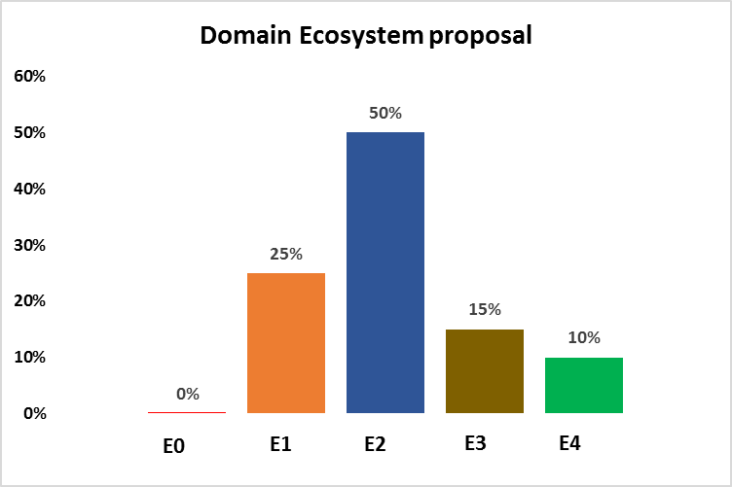
Competency Levels
E0: Basic Level – Within 6 to 9 months of joining every E0 needs to move to E1 level of competency
E1: Intermediate Level – Has an exposure to the knowledge area not practiced it
E2: Advance Level – Has an exposure to the knowledge area and has practiced it
E3: Expert Level – Has an exposure to the knowledge area, has practiced over a period of time, and is a perfectionist
E4: Master Level – Is a researcher and master in the particular knowledge area
The Ecosystem (Levels & percentage)
can be defined by the domain
Ecosystem

Slide 21
Next Steps

Slide 22
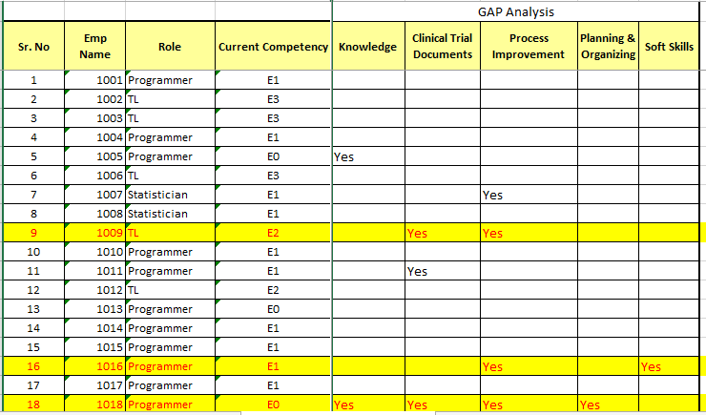
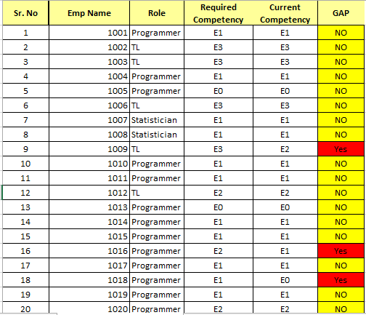
GAP Analysis
Ecosystem

Slide 23
Individual Development Plan
Ecosystem

Slide 24
Thanks

