Slide 1


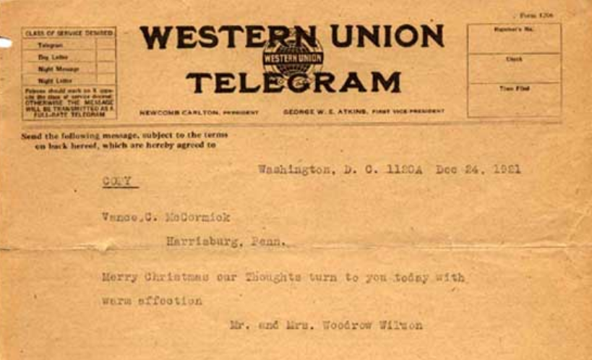



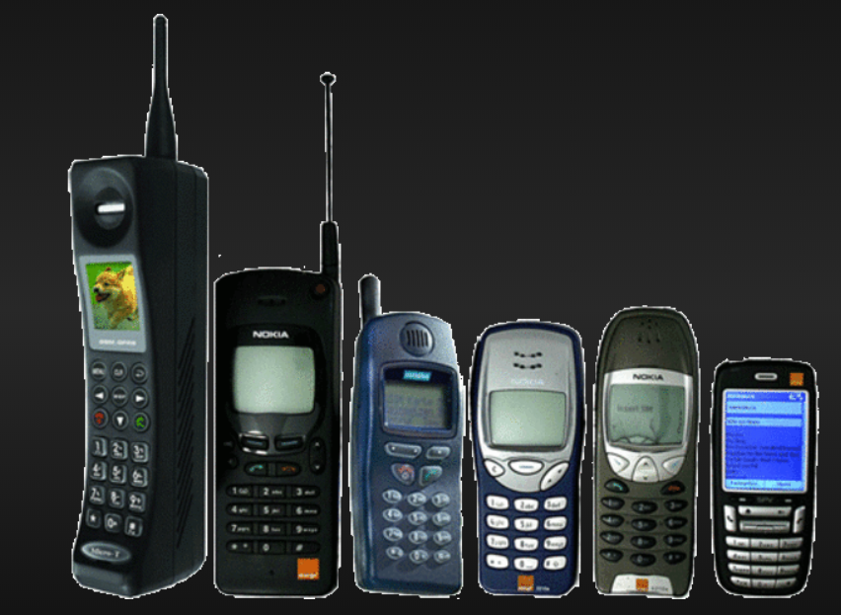



Notes:
Innovation 4.0 synonymous with industry 4.0
industry evolving with innovation and thus became Industry 4.0: it is a new version of Industry
not version of innovation

