Slide 1
Big Data Technology HIVE
Prof. Sarada Samantaray
M. Tech CS, ISI Kolkata
Associate Dean, NMIMS University

Slide 2

What is HIVE?
A metadata service that projects
tabular schema over folders
Enables the contents of folders to be queried as tables,
using SQL-like query semantics
Queries are translated into jobs
Execution engine can be Tez or MapReduce

Slide 3
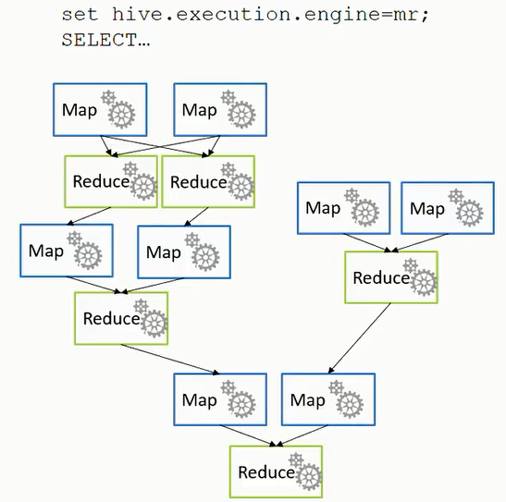
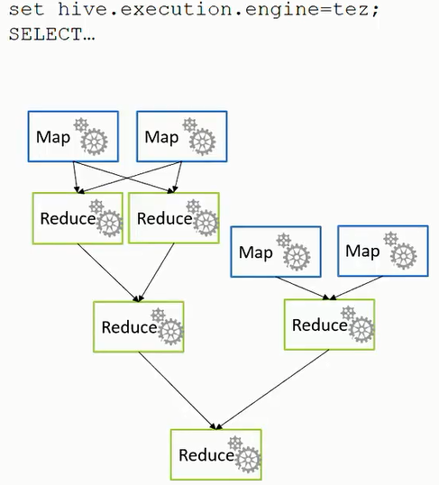

Slide 4
How do I create and load Hive tables
Use the CREATE TABLE HiveQL statement
Define schema metadata to be projected onto data in a folder when the table is queried (not when it is created)
Specify the file format and file location
Default to text file format in the <database>/<table_name> folder
Default database is in /hive/warehouse
Create additional databases using CREATE DATABASE
Create internal or external tables
Internal tables manage the lifetime of the underlying folders
External tables are managed independently from folders

Slide 5
CREATE TABLE table1
(col1 STRING,
col2 INT)
ROW FORMAT DELIMITED FIELDS TERMINATED BY ‘ ‘;
CREATE TABLE table2
(col1 STRING,
col2 INT)
ROW FORMAT DELIMITED FIELDS TERMINATED BY ‘ ‘
STORED AS TEXTFILE LOCATION ‘/data/table2’;
Internal table (folder deleted when table is dropped)
Default location
/hive/warehouse/table1
Stored in a custom folder (but still internal, so the folder is deleted when table is dropped)

Slide 6
CREATE EXTERNAL TABLE table3
(col1 STRING,
col2 INT)
ROW FORMAT DELIMITED FIELDS TERMINATED BY ‘ ‘
STORED AS TEXTFILE LOCATION ‘/data/table3’;
External table (folders are files are left intact when the table is dropped)

Slide 7
Hive data types
Numeric
Integers: TINYINT, SMALLINT, INT, BIGINT
Fractional: FLOAT, DOUBLE, DECIMAL
Character
STRING, VARCHAR, CHAR
Date/Time
TIMESTAMP
DATE
Special
BOOLEAN, BINARY, ARRAY, MAP, STRUCT, UNIONTYPE

Slide 8
Save data files in table folders (or create table on existing files!)
Put myfile.txt /data/table1
Use the LOAD statement
LOAD DATA [LOCAL] INPATH /TABLE Mydata/source’ INTO Table;
Use the INSERT statement
INSERT INTO TABLE table2
SELECT col1, UPPER(col2)
FROM table1;
Use a CREATE TABLE AS SELECT (CTAS) statement
CREATE TABLE table3
ROW FORMT DELIMITED FIELDS TERMINATED BY ‘\t‘
STORED AS TEXTFILE LOCATION ‘/data/summarytable’
AS
SELECT col1, SUM(col2) As Total
FROM table1
GROUP BY col1;

Slide 9
DEMO

Slide 10
How do I query Hive tables?
Query data using the SELECT HiveQL statement
SELECT col1, SUM(col2) AS TotalCol2
FROM MyTable
WHERE col3 = ‘ABC’ AND col4 < 10
GROUP BY col1
ORDER BY col4;
Hive translate the query into jobs and applies the table schema to the underlying data files

Slide 11
Views are named queries that abstract underlying tables
CREATE VIEW v_SummarizedData
AS
SELECT col1, SUM(col2) AS TotalCol2
FROM mytable
GROUP BY col1;
SELECT col1, TotalCol2 FROM v_SummarizedData;

Slide 12
Partitioning, Skewing and Clustering Tables
CREATE TABLE part_table
(col1 INT,
col2 STRING)
PARTITIONED BY (col3 STRIMG);
INSERT INTO TABLE part_table PARTTION(col3=‘A’)
SELECT col1, col2
FROM stg_table
WHERE col3 = ‘A’;

Slide 13
SET hive.exec.dynamic.partition = true;
SET hive.exec.dynamic.partition.mode = nonstrict;
INSERT INTO TABLE part_table PARTTION(col3)
SELECT col1, col2, col3
FROM stg_table;

Slide 14
Skewing
CREATE TABLE skewed_table
(col1 INT, col2 STRING, col3 STRING)
SKEWED BY (col3) ON (‘A’) [STORED AS DIRECTORY];
INSERT INTO TABLE skewed_table
SELECT col1, col2, col3
FROM stg_table;

Slide 15
Clustering
CREATE TABLE clust_table
(col1 INT, col2 STRING, col3 STRING)
CLUSTERED BY (col3) INTO 3 BUCKETS;
INSERT INTO TABLE clust_table
SELECT col1, col2, col3
FROM stg_table;

