Slide 1
Amortized Analysis
Some of the slides are from Prof. Leong Hon Wai’s resources at National University of Singapore

Slide 2
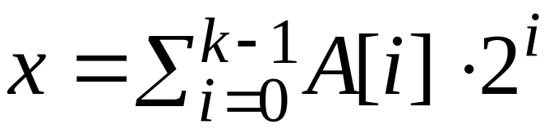
Incrementing a Binary Counter
k-bit Binary Counter: A[0..k−1]
INCREMENT(A)
1. i ← 0
2. while i < length[A] and A[i] = 1
3. do A[i] ← 0 ⊳ reset a bit
4. i ← i + 1
5. if i < length[A]
6. then A[i] ← 1 ⊳ set a bit

Slide 3
k-bit Binary Counter
Ctr | A[4] | A[3] | A[2] | A[1] | A[0]
0 | 0 | 0 | 0 | 0 | 0
1 | 0 | 0 | 0 | 0 | 1
2 | 0 | 0 | 0 | 1 | 0
3 | 0 | 0 | 0 | 1 | 1
4 | 0 | 0 | 1 | 0 | 0
5 | 0 | 0 | 1 | 0 | 1
6 | 0 | 0 | 1 | 1 | 0
7 | 0 | 0 | 1 | 1 | 1
8 | 0 | 1 | 0 | 0 | 0
9 | 0 | 1 | 0 | 0 | 1
10 | 0 | 1 | 0 | 1 | 0
11 | 0 | 1 | 0 | 1 | 1

Slide 4
k-bit Binary Counter
Ctr | A[4] | A[3] | A[2] | A[1] | A[0] | Cost
0 | 0 | 0 | 0 | 0 | 0 | 0
1 | 0 | 0 | 0 | 0 | 1 | 1
2 | 0 | 0 | 0 | 1 | 0 | 3
3 | 0 | 0 | 0 | 1 | 1 | 4
4 | 0 | 0 | 1 | 0 | 0 | 7
5 | 0 | 0 | 1 | 0 | 1 | 8
6 | 0 | 0 | 1 | 1 | 0 | 10
7 | 0 | 0 | 1 | 1 | 1 | 11
8 | 0 | 1 | 0 | 0 | 0 | 15
9 | 0 | 1 | 0 | 0 | 1 | 16
10 | 0 | 1 | 0 | 1 | 0 | 18
11 | 0 | 1 | 0 | 1 | 1 | 19

Slide 5
Worst-case analysis
Consider a sequence of n increments. The worst-case time to execute one increment is Θ(k). Therefore, the worst-case time for n increments is n · Θ(k) = Θ(n⋅ k).
WRONG! In fact, the worst-case cost for n increments is only Θ(n) ≪ Θ(n⋅ k).
Let’s see why.
Note: You’d be correct
if you’d said O(n⋅ k).
But, it’s an overestimate.

Slide 6
Tighter analysis
Total cost of n operations
Ctr | A[4] | A[3] | A[2] | A[1] | A[0] | Cost
0 | 0 | 0 | 0 | 0 | 0 | 0
1 | 0 | 0 | 0 | 0 | 1 | 1
2 | 0 | 0 | 0 | 1 | 0 | 3
3 | 0 | 0 | 0 | 1 | 1 | 4
4 | 0 | 0 | 1 | 0 | 0 | 7
5 | 0 | 0 | 1 | 0 | 1 | 8
6 | 0 | 0 | 1 | 1 | 0 | 10
7 | 0 | 0 | 1 | 1 | 1 | 11
8 | 0 | 1 | 0 | 0 | 0 | 15
9 | 0 | 1 | 0 | 0 | 1 | 16
10 | 0 | 1 | 0 | 1 | 0 | 18
11 | 0 | 1 | 0 | 1 | 1 | 19
A[0] flipped every op n
A[1] flipped every 2 ops n/2
A[2] flipped every 4 ops n/2²
A[3] flipped every 8 ops n/2³
… … … … …
A[i] flipped every 2^{i} ops n/2^{i}

Slide 7
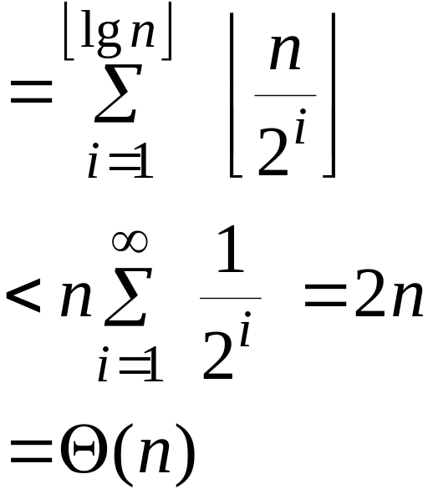
Tighter analysis (continued)
Cost of n increments
Thus, the average cost of each increment operation is Θ(n)/n = Θ(1).
.

Slide 8
Amortized analysis
An amortized analysis is any strategy for analyzing a sequence of operations to show that the average cost per operation is small, even though a single operation within the sequence might be expensive.
Even though we’re taking averages, however, probability is not involved!
An amortized analysis guarantees the average performance of each operation in the worst case.

Slide 9
Amortized analysis II
Designing of an algorithm and the analysis of its running time are often closely intertwined.
Amortized analysis is not just an analysis tool, it is also a way of thinking about designing algorithms.

Slide 10
Types of amortized analyses
Three common amortization arguments:
the aggregate method,
the accounting method,
the potential method.
We’ve just seen an aggregate analysis.
The aggregate method, though simple, lacks the precision of the other two methods. In particular, the accounting and potential methods allow a specific amortized cost to be allocated to each operation.

Slide 11
Aggregate Analysis
Show that for all n, a sequence of n operations take worst-case time T(n) in total
In the worst case, the average cost, or amortized cost , per operation is T(n)/n.
The amortized cost applies to each operation, even when there are several types of operations in the sequence.

Slide 12
Stack Example I
3 ops:
 | Push(S,x) | Pop(S) | Multi-pop(S,k)
Worst-case cost: | O(1) | O(1) | O(min(|S|,k) = O(n)
Amortized cost: O(1) per op

Slide 13
Stack Example II
Sequence of n push, pop, Multipop operations
  Worst-case cost of Multipop is O(n)
  Have n operations
  Therefore, worst-case cost of sequence is O(n²)
Observations
  Each object can be popped only once per time that it’s pushed
  Have <= n pushes => <= n pops, including those in Multipop
  Therefore total cost = O(n)
  Average over n operations => O(1) per operation on average
Notice that no probability involved

Slide 14
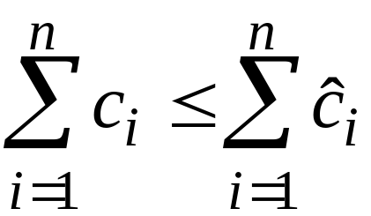
Accounting method
Charge i th operation a fictitious amortized cost ĉ_{i}, where $1 pays for 1 unit of work (i.e., time).
  Assign different charges (amortized cost ) to different operations
      Some are charged more than actual cost
      Some are charged less
This fee is consumed to perform the operation.
Any amount not immediately consumed is stored in the bank for use by subsequent operations.
The bank balance (the credit) must not go negative!
We must ensure that
for all n.
Thus, the total amortized costs provide an upper bound on the total true costs.

Slide 15
A Simple Example: Accounting
3 ops:
 | Push(S,x) | Pop(S) | Multi-pop(S,k)
Assigned cost: | 2 | 0 | 0
Actual cost: | 1 | 1 | min(|S|,k)
1
0
0
0
1
1
0
1
1
1
1
1
1
1
1
Push(S,x) pays for possible later pop of x.

Slide 16
Stack Example: Accounting Methods
When pushing an object, pay $2
  $1 pays for the push
  $1 is prepayment for it being popped by either pop or Multipop
  Since each object has $1, which is credit, the credit can never go negative
  Therefore, total amortized cost = O(n), is an upper bound on total actual cost

Slide 17
Accounting analysis of INCREMENT
Charge an amortized cost of $2 every time a bit is set from 0 to 1
$1 pays for the actual bit setting.
$1 is stored for later re-setting (from 1 to 0).
At any point, every 1 bit in the counter has $1 on it… that pays for resetting it. (reset is “free”)
Example:
0 0 0 1^{$1} 0 1^{$1} 0
0 0 0 1^{$1} 0 1^{$1} 1^{$1}
Cost = $2
0 0 0 1^{$1} 1^{$1} 0 0
Cost = $2

Slide 18
Incrementing a Binary Counter
INCREMENT(A)
1. i ← 0
2. while i < length[A] and A[i] = 1
3. do A[i] ← 0 ⊳ reset a bit
4. i ← i + 1
5. if i < length[A]
6. then A[i] ← 1 ⊳ set a bit
When Incrementing,
  Amortized cost for line 3 = $0
  Amortized cost for line 6 = $2
Amortized cost for INCREMENT(A) = $2
Amortized cost for n INCREMENT(A) = $2n =O(n)

Slide 19
Accounting analysis (continued)
Key invariant: Bank balance never drops below 0. Thus, the sum of the amortized costs provides an upper bound on the sum of the true costs.
i 1 2 3 4 5 6 7 8 9 10
#1’s 1 1 2 1 2 2 3 1 2 2
c_{i} 1 2 1 3 1 2 1 4 1 2
ĉ_{i} 2 2 2 2 2 2 2 2 2 2
bank_{i} 1 1 2 1 2 2 3 1 2 2

Slide 20
Potential method
IDEA: View the bank account as the potential energy (à la physics) of the dynamic set.
Framework:
Start with an initial data structure D₀.
Operation i transforms D_{i–1} to D_{i}.
The cost of operation i is c_{i}.
Define a potential function Φ : {D_{i}} → R,
such that Φ(D₀ ) = 0 and Φ(D_{i} ) ≥ 0 for all i.
The amortized cost ĉ_{i} with respect to Φ is defined to be ĉ_{i} = c_{i} + Φ(D_{i}) – Φ(D_{i–1}).

Slide 21
Potential method II
Like the accounting method, but think of the credit as potential stored with the entire data structure.
  Accounting method stores credit with specific objects while potential method stores potential in the data structure as a whole.
  Can release potential to pay for future operations
Most flexible of the amortized analysis methods ).

Slide 22
Understanding potentials
ĉ_{i} = c_{i} + Φ(D_{i}) – Φ(D_{i–1})
potential difference ΔΦ_{i}
If ΔΦ_{i} > 0, then ĉ_{i} > c_{i}. Operation i stores work in the data structure for later use.
If ΔΦ_{i} < 0, then ĉ_{i} < c_{i}. The data structure delivers up stored work to help pay for operation i.

Slide 23
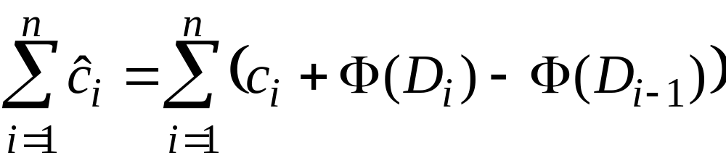
Amortized costs bound the true costs
The total amortized cost of n operations is
Summing both sides.

Slide 24
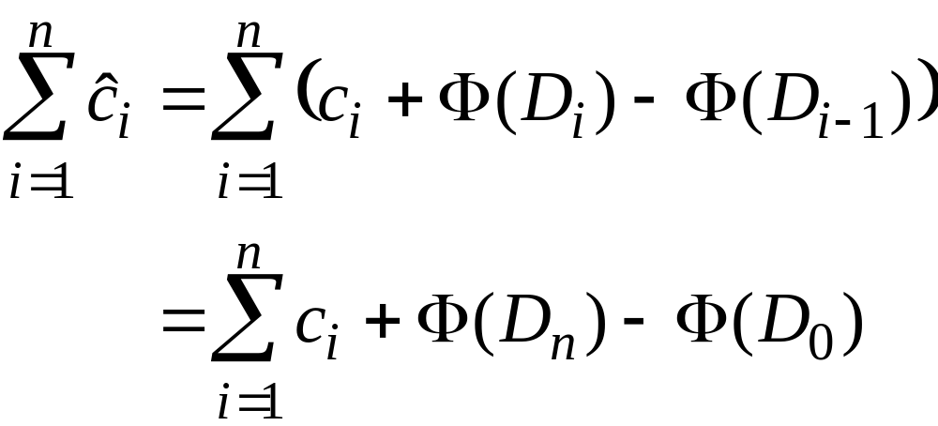
Amortized costs bound the true costs
The total amortized cost of n operations is
The series telescopes.

Slide 25
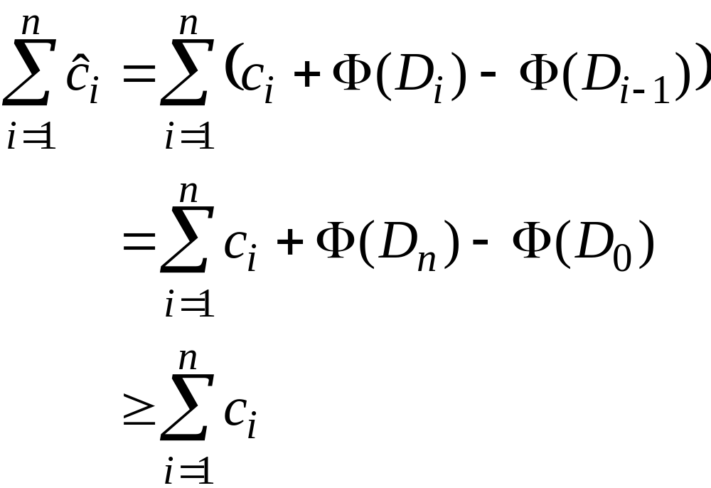
Amortized costs bound the true costs
The total amortized cost of n operations is
since Φ(D_{n}) ≥ 0 and
Φ(D₀ ) = 0.

Slide 26
Stack Example: Potential
Define: φ(D_{i}) = #items in stack Thus, φ(D₀)=0.
Plug in for operations:
  Push: ĉ_{i} = c_{i} + φ(D_{i}) - φ(D_{i-1})
  = 1 + j - (j-1)
  = 2
  Pop: ĉ_{i} = c_{i} + φ(D_{i}) - φ(D_{i-1})
  = 1 + (j-1) - j
  = 0
  Multi-pop: ĉ_{i} = c_{i} + φ(D_{i}) - φ(D_{i-1})
  = k’ + (j-k’) - j k’=min(|S|,k)
  = 0
Thus O(1) amortized time per op.

Slide 27
Potential analysis of INCREMENT
Define the potential of the counter after the i^{th} operation by Φ(D_{i}) = b_{i}, the number of 1’s in the counter after the i^{th} operation.
Note:
Φ(D₀ ) = 0,
Φ(D_{i}) ≥ 0 for all i.
Example:
0 0 0 1 0 1 0
Φ = 2
(
0 0 0 1^{$1} 0 1^{$1} 0
Accounting method)

Slide 28
Calculation of amortized costs
Assume ith INCREMENT resets t_{i} bits (in line 3).
Actual cost c_{i} = (t_{i} + 1)
Number of 1’s after ith operation: b_{i} = b_{i–1} – t_{i} + 1
The amortized cost of the i th INCREMENT is
ĉ_{i} = c_{i} + Φ(D_{i}) – Φ(D_{i–1})
= (t_{i} + 1) + (1 − t_{i})
= 2
Therefore, n INCREMENTs cost Θ(n) in the worst case.

Slide 29
Next example:
Dynamic Tables
  A nice use of amortized analysis

