Slide 1
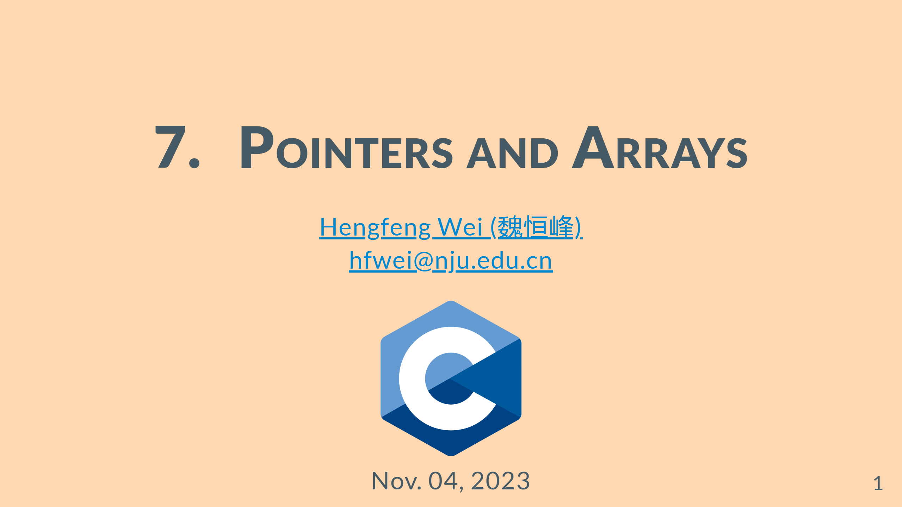
Notes:
--- # Review </br> ### <font color = red>Recursion</font> (<mark>mergesort.c</mark>) <br> ### <font color = blue>Data Types</font>

Slide 2
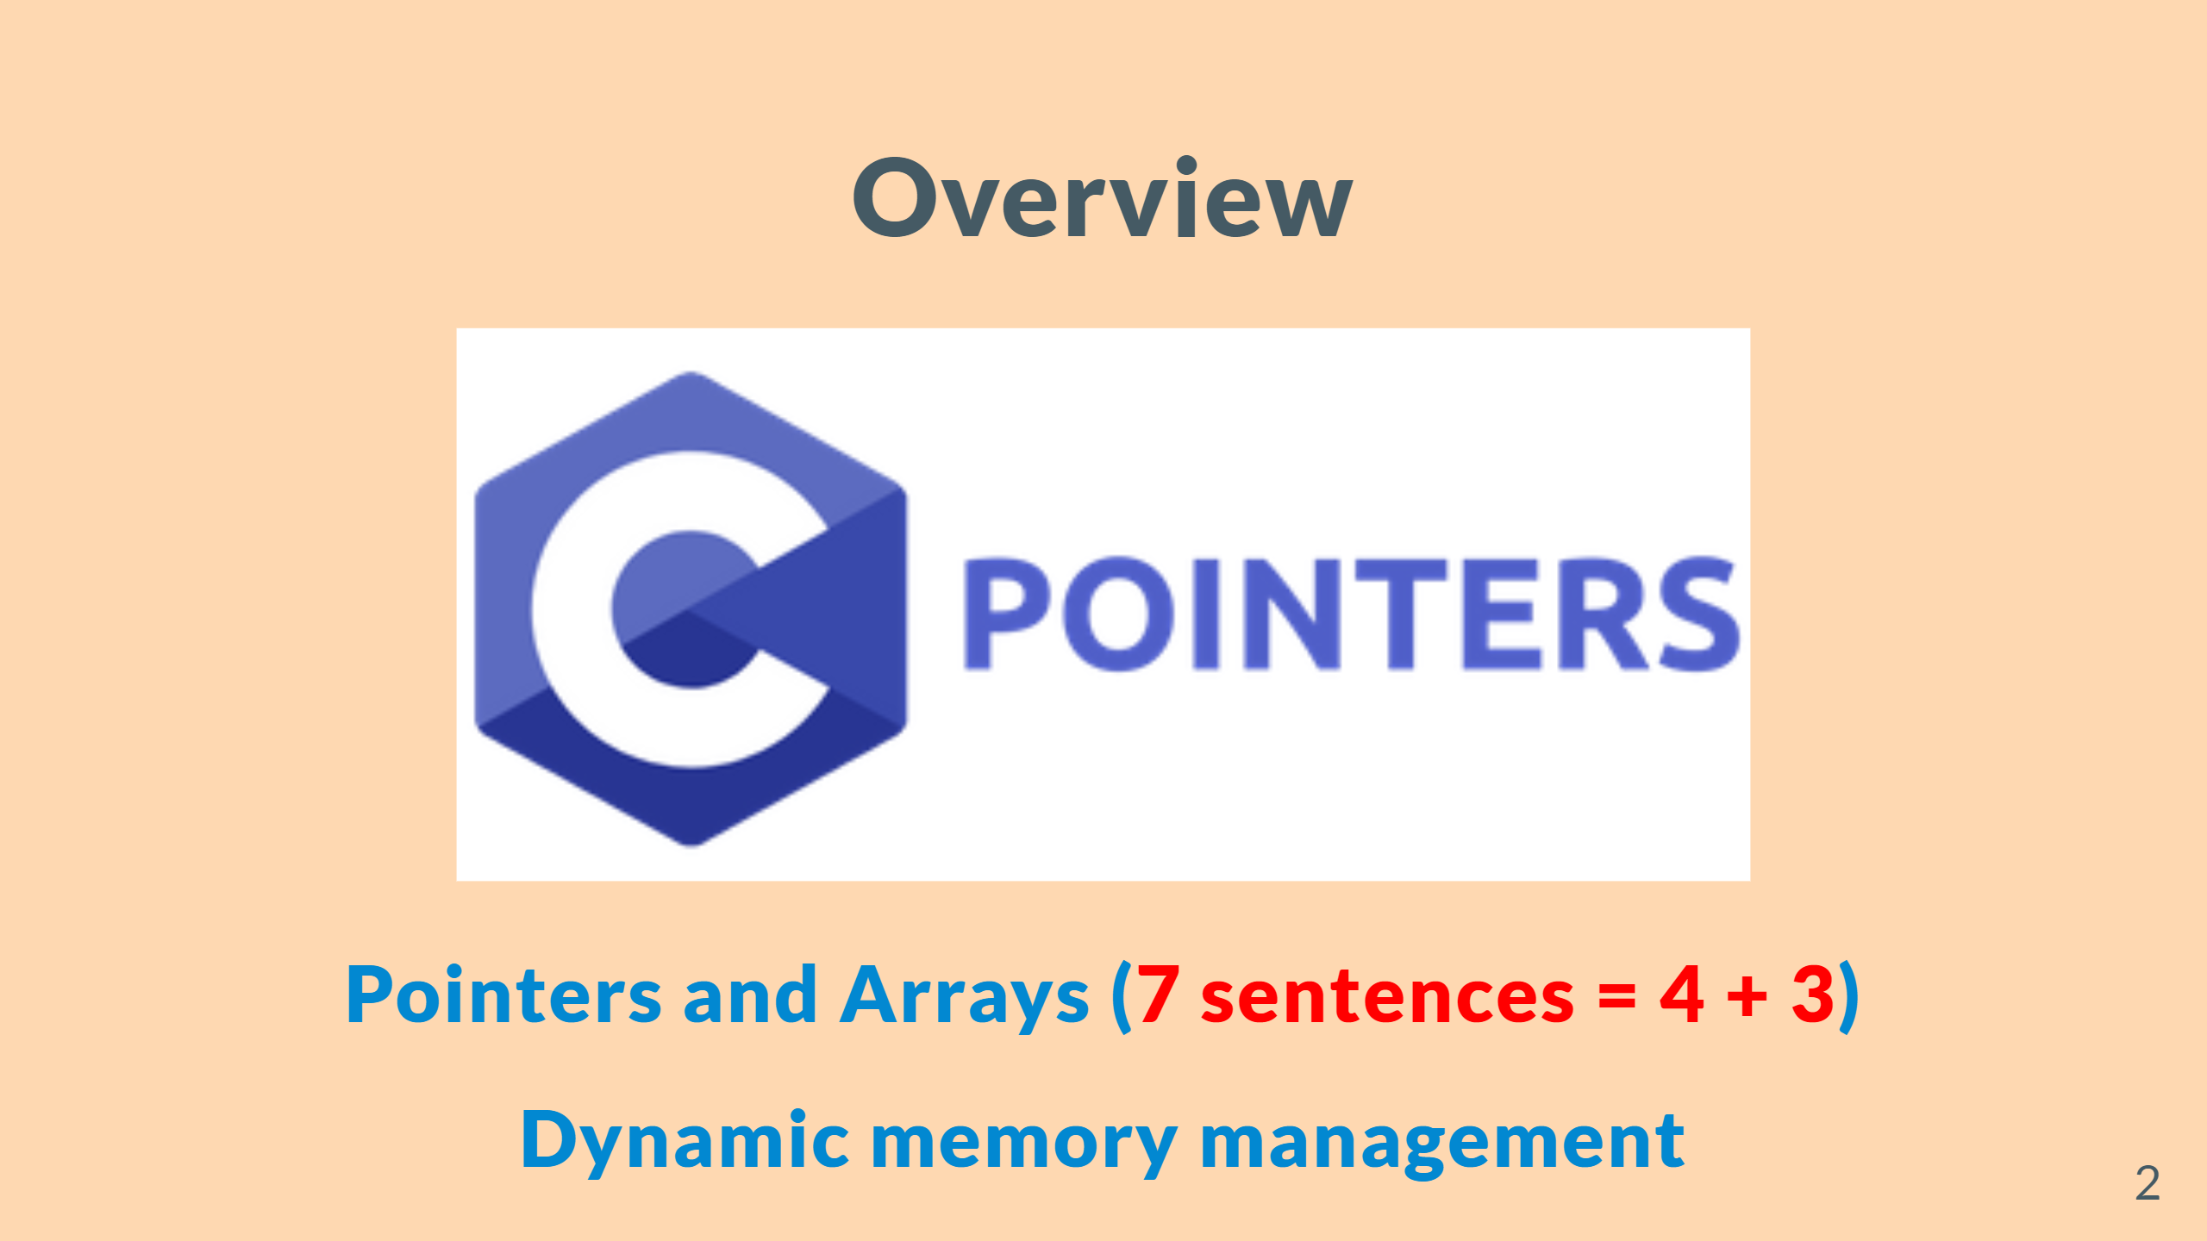
Notes:
--- # Overview ![w:600](figs/C%2B%2B-Pointers.png) &emsp; ![w:450](figs/Java-Pointers.jpg)

Slide 3
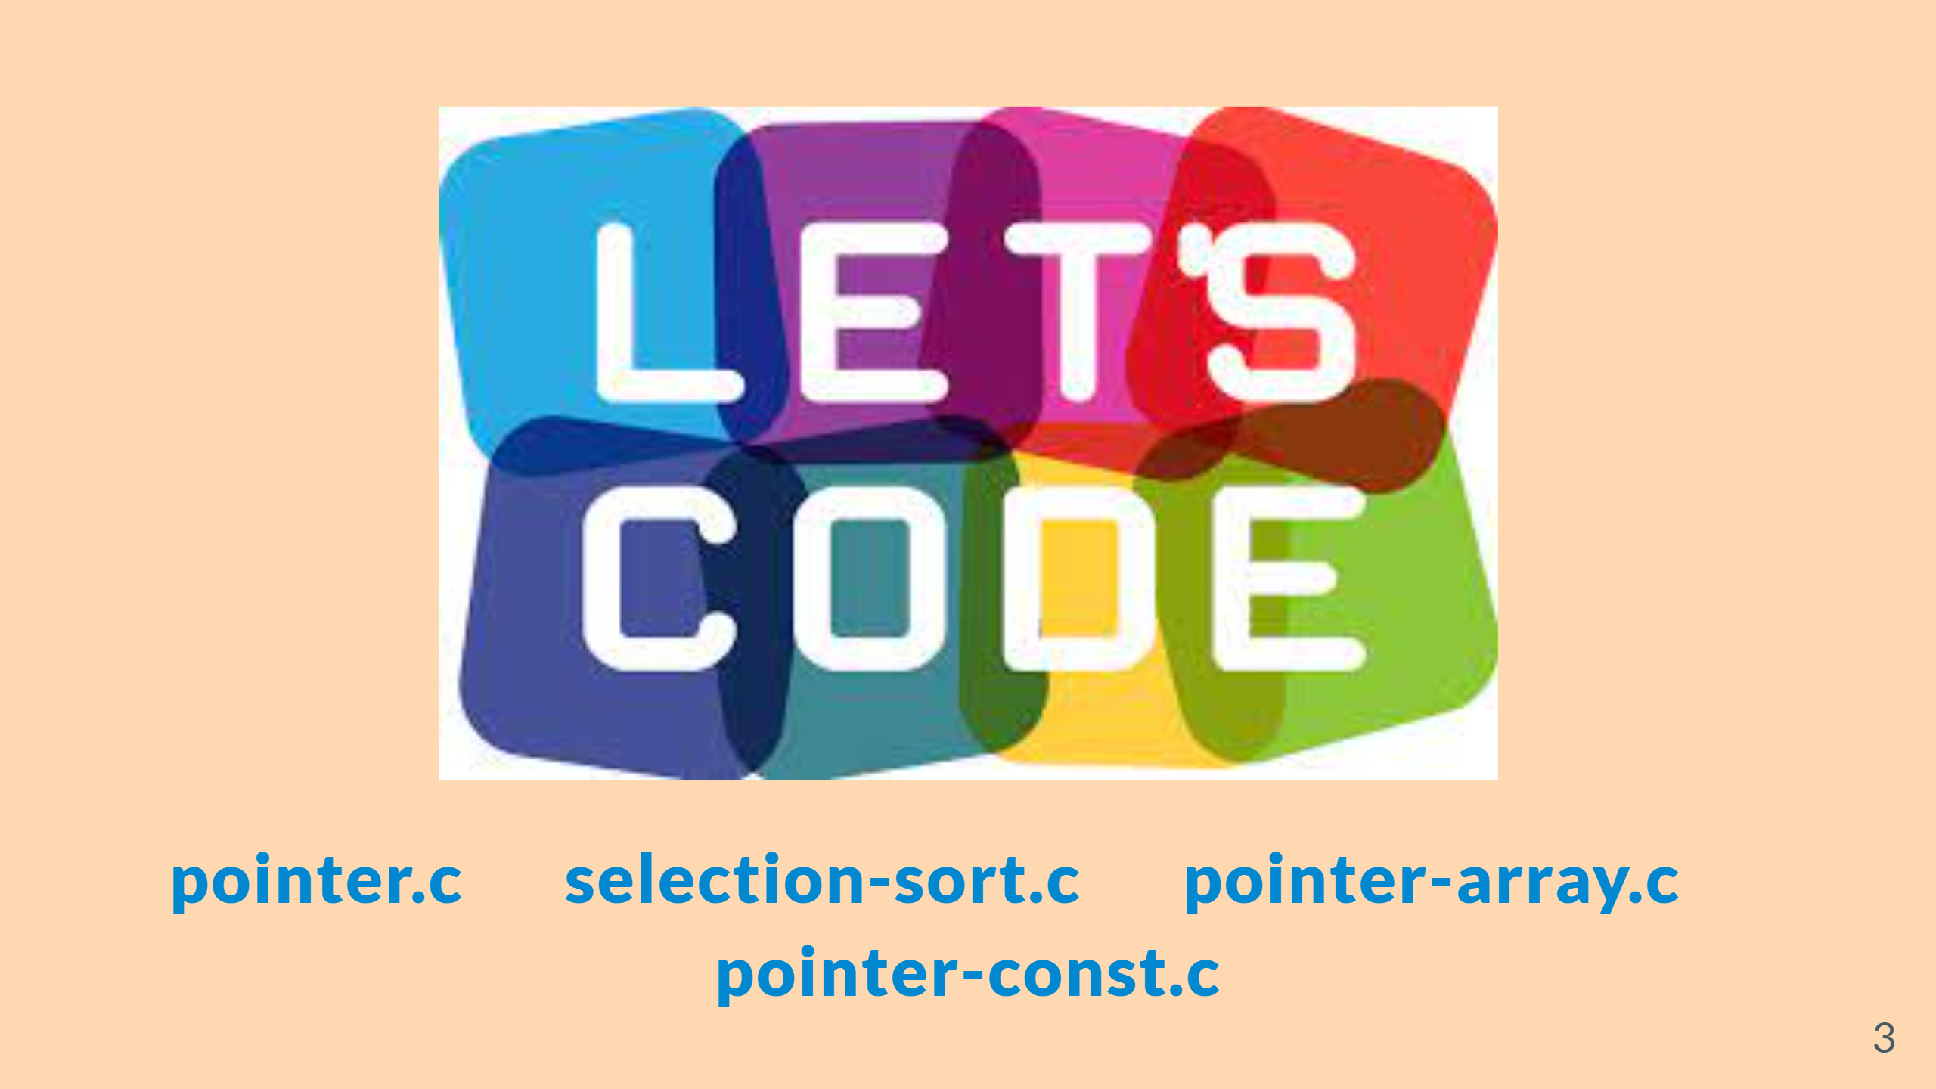

Slide 4
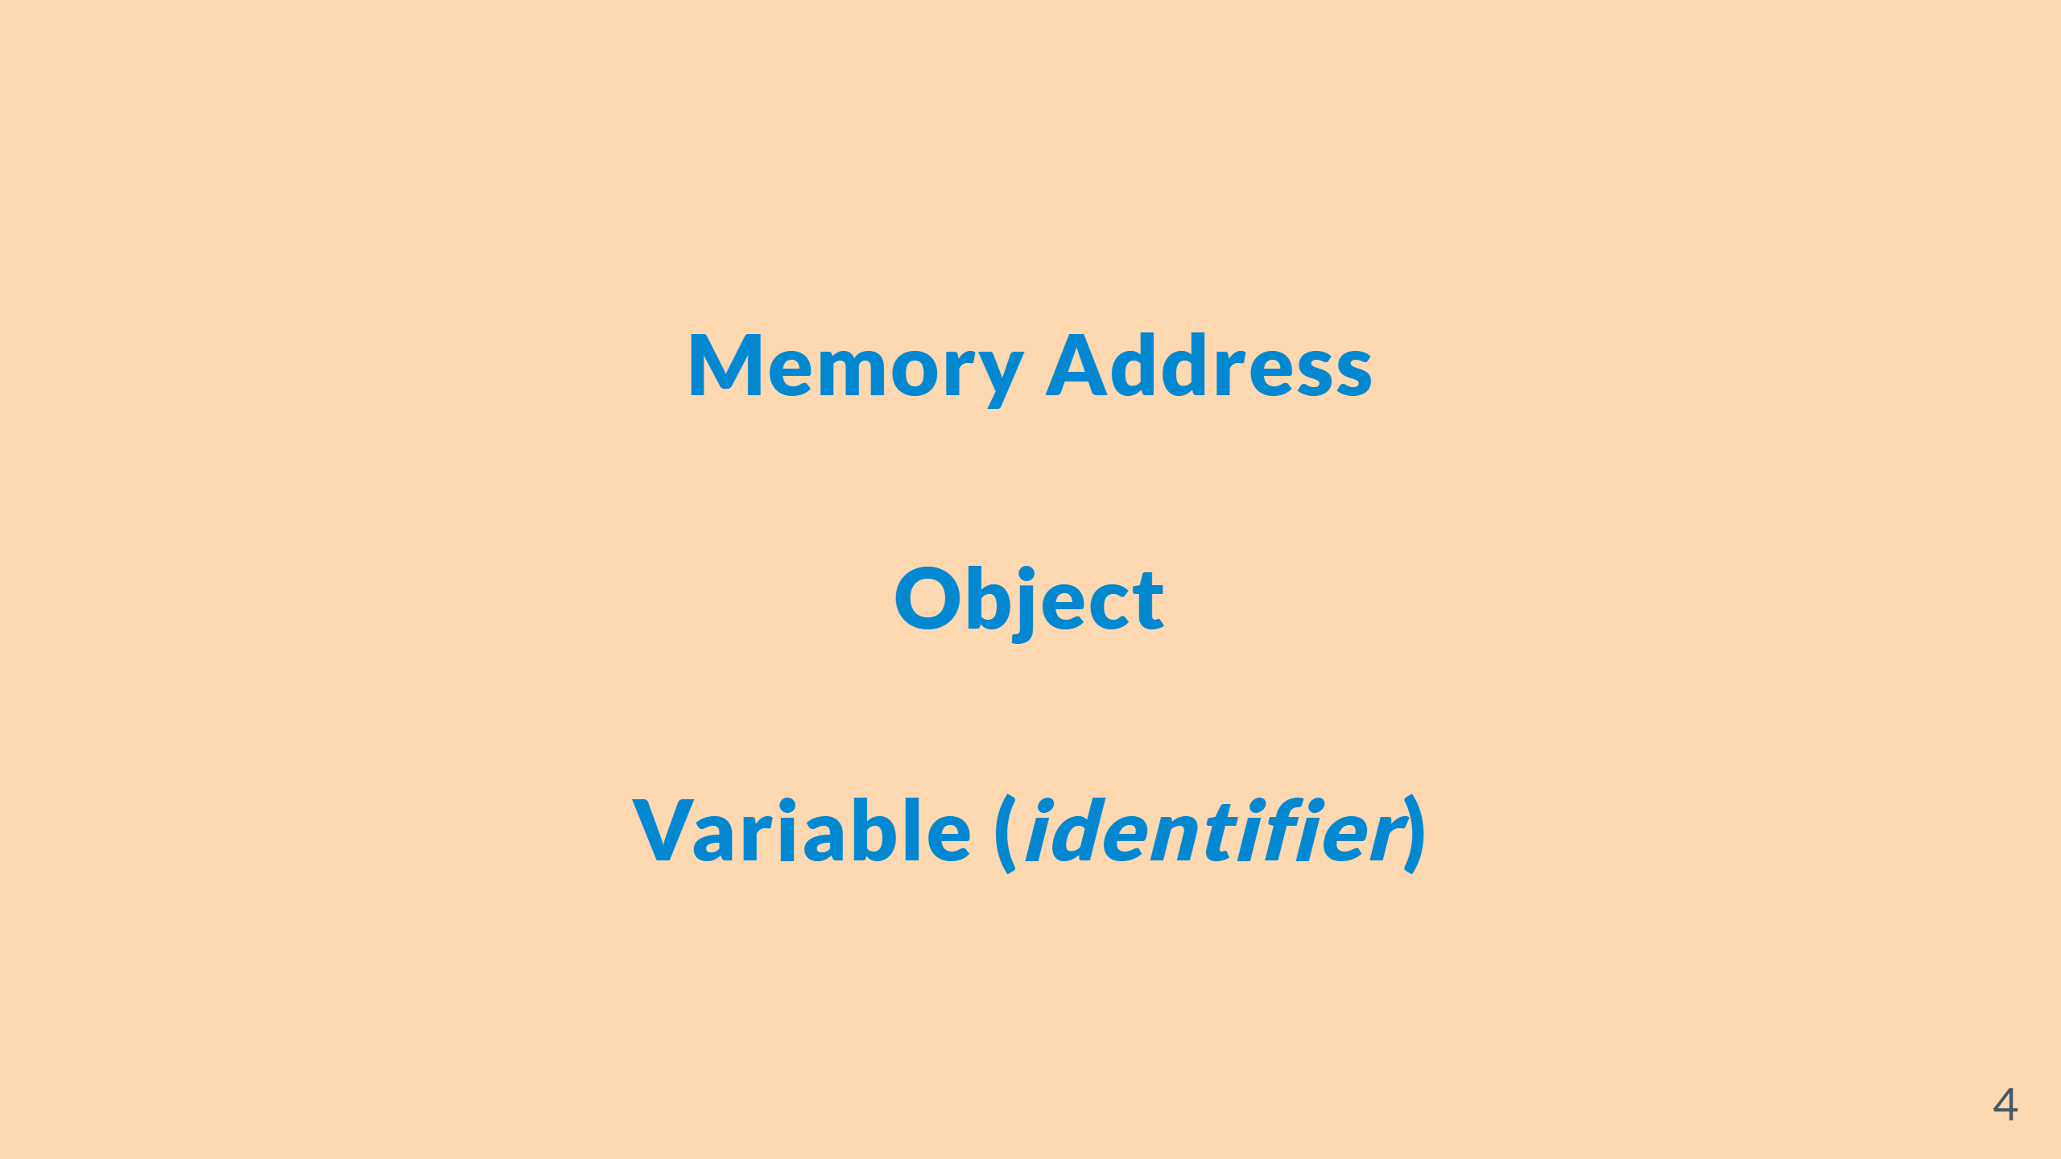

Slide 5
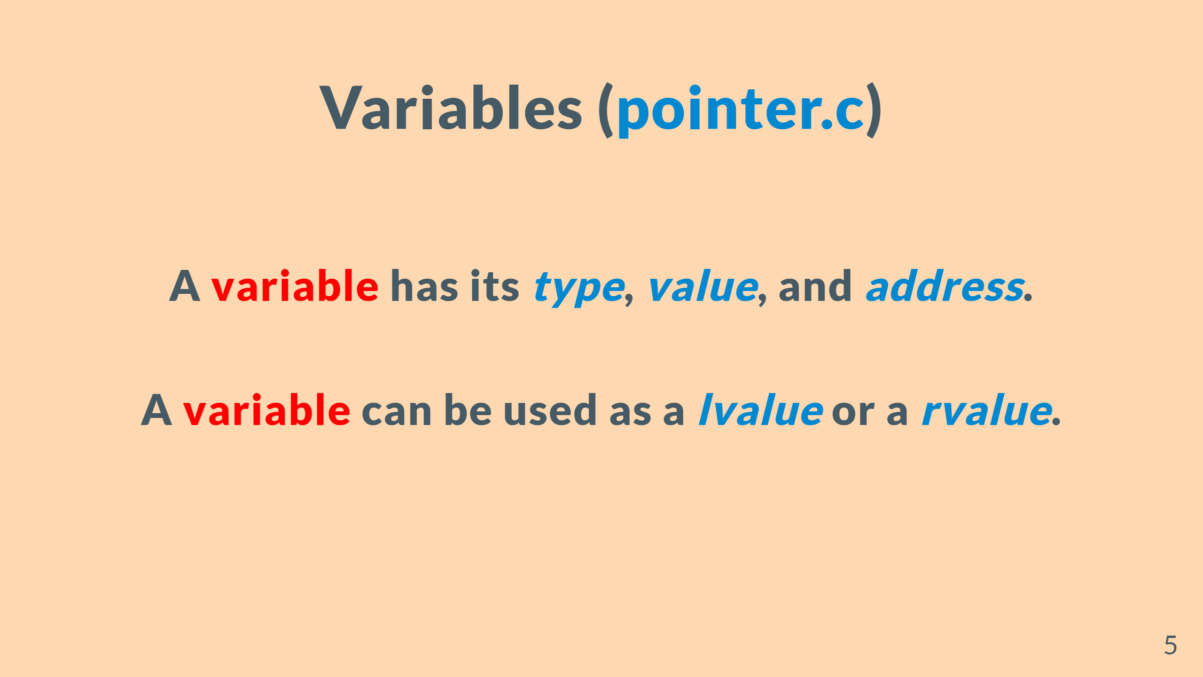

Slide 6
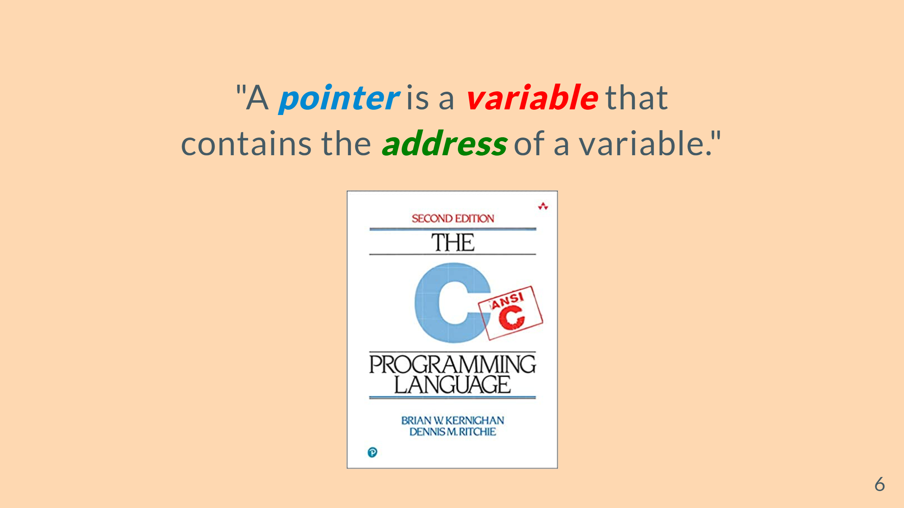

Slide 7
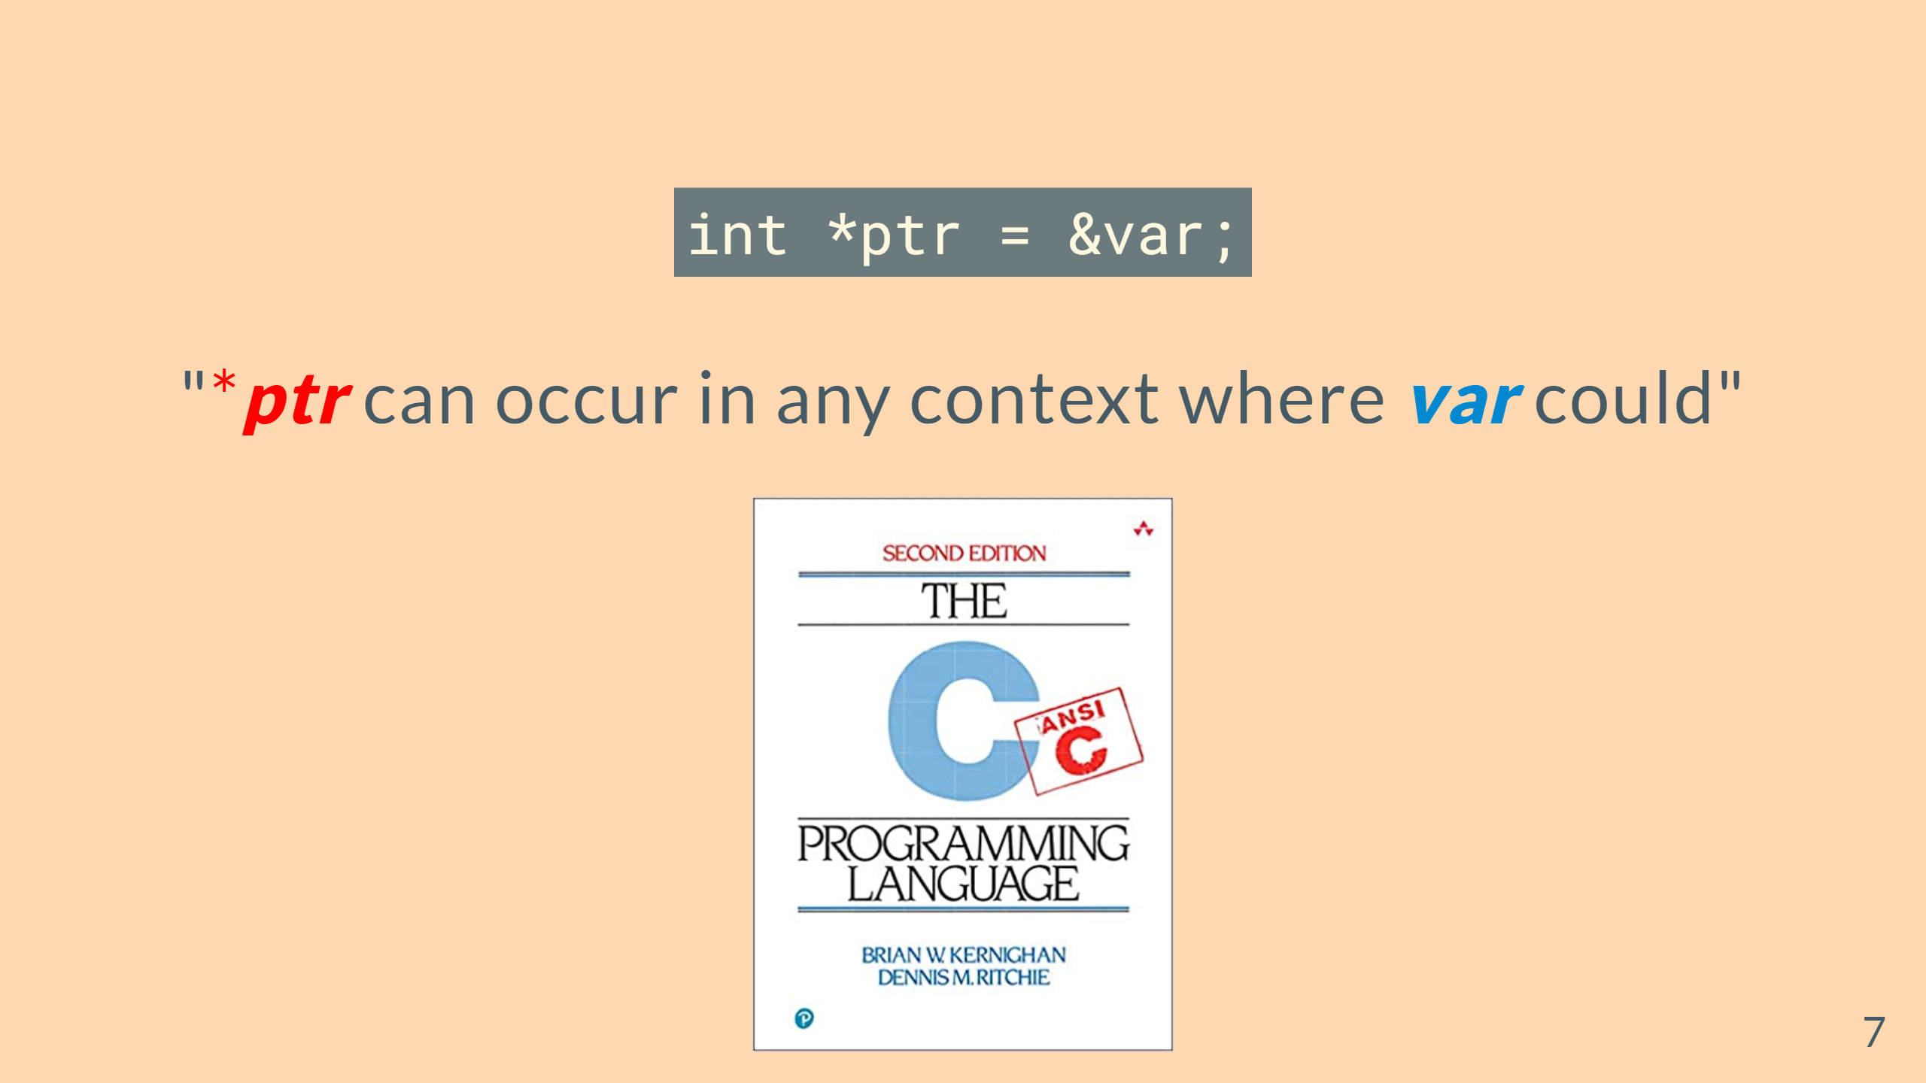

Slide 8
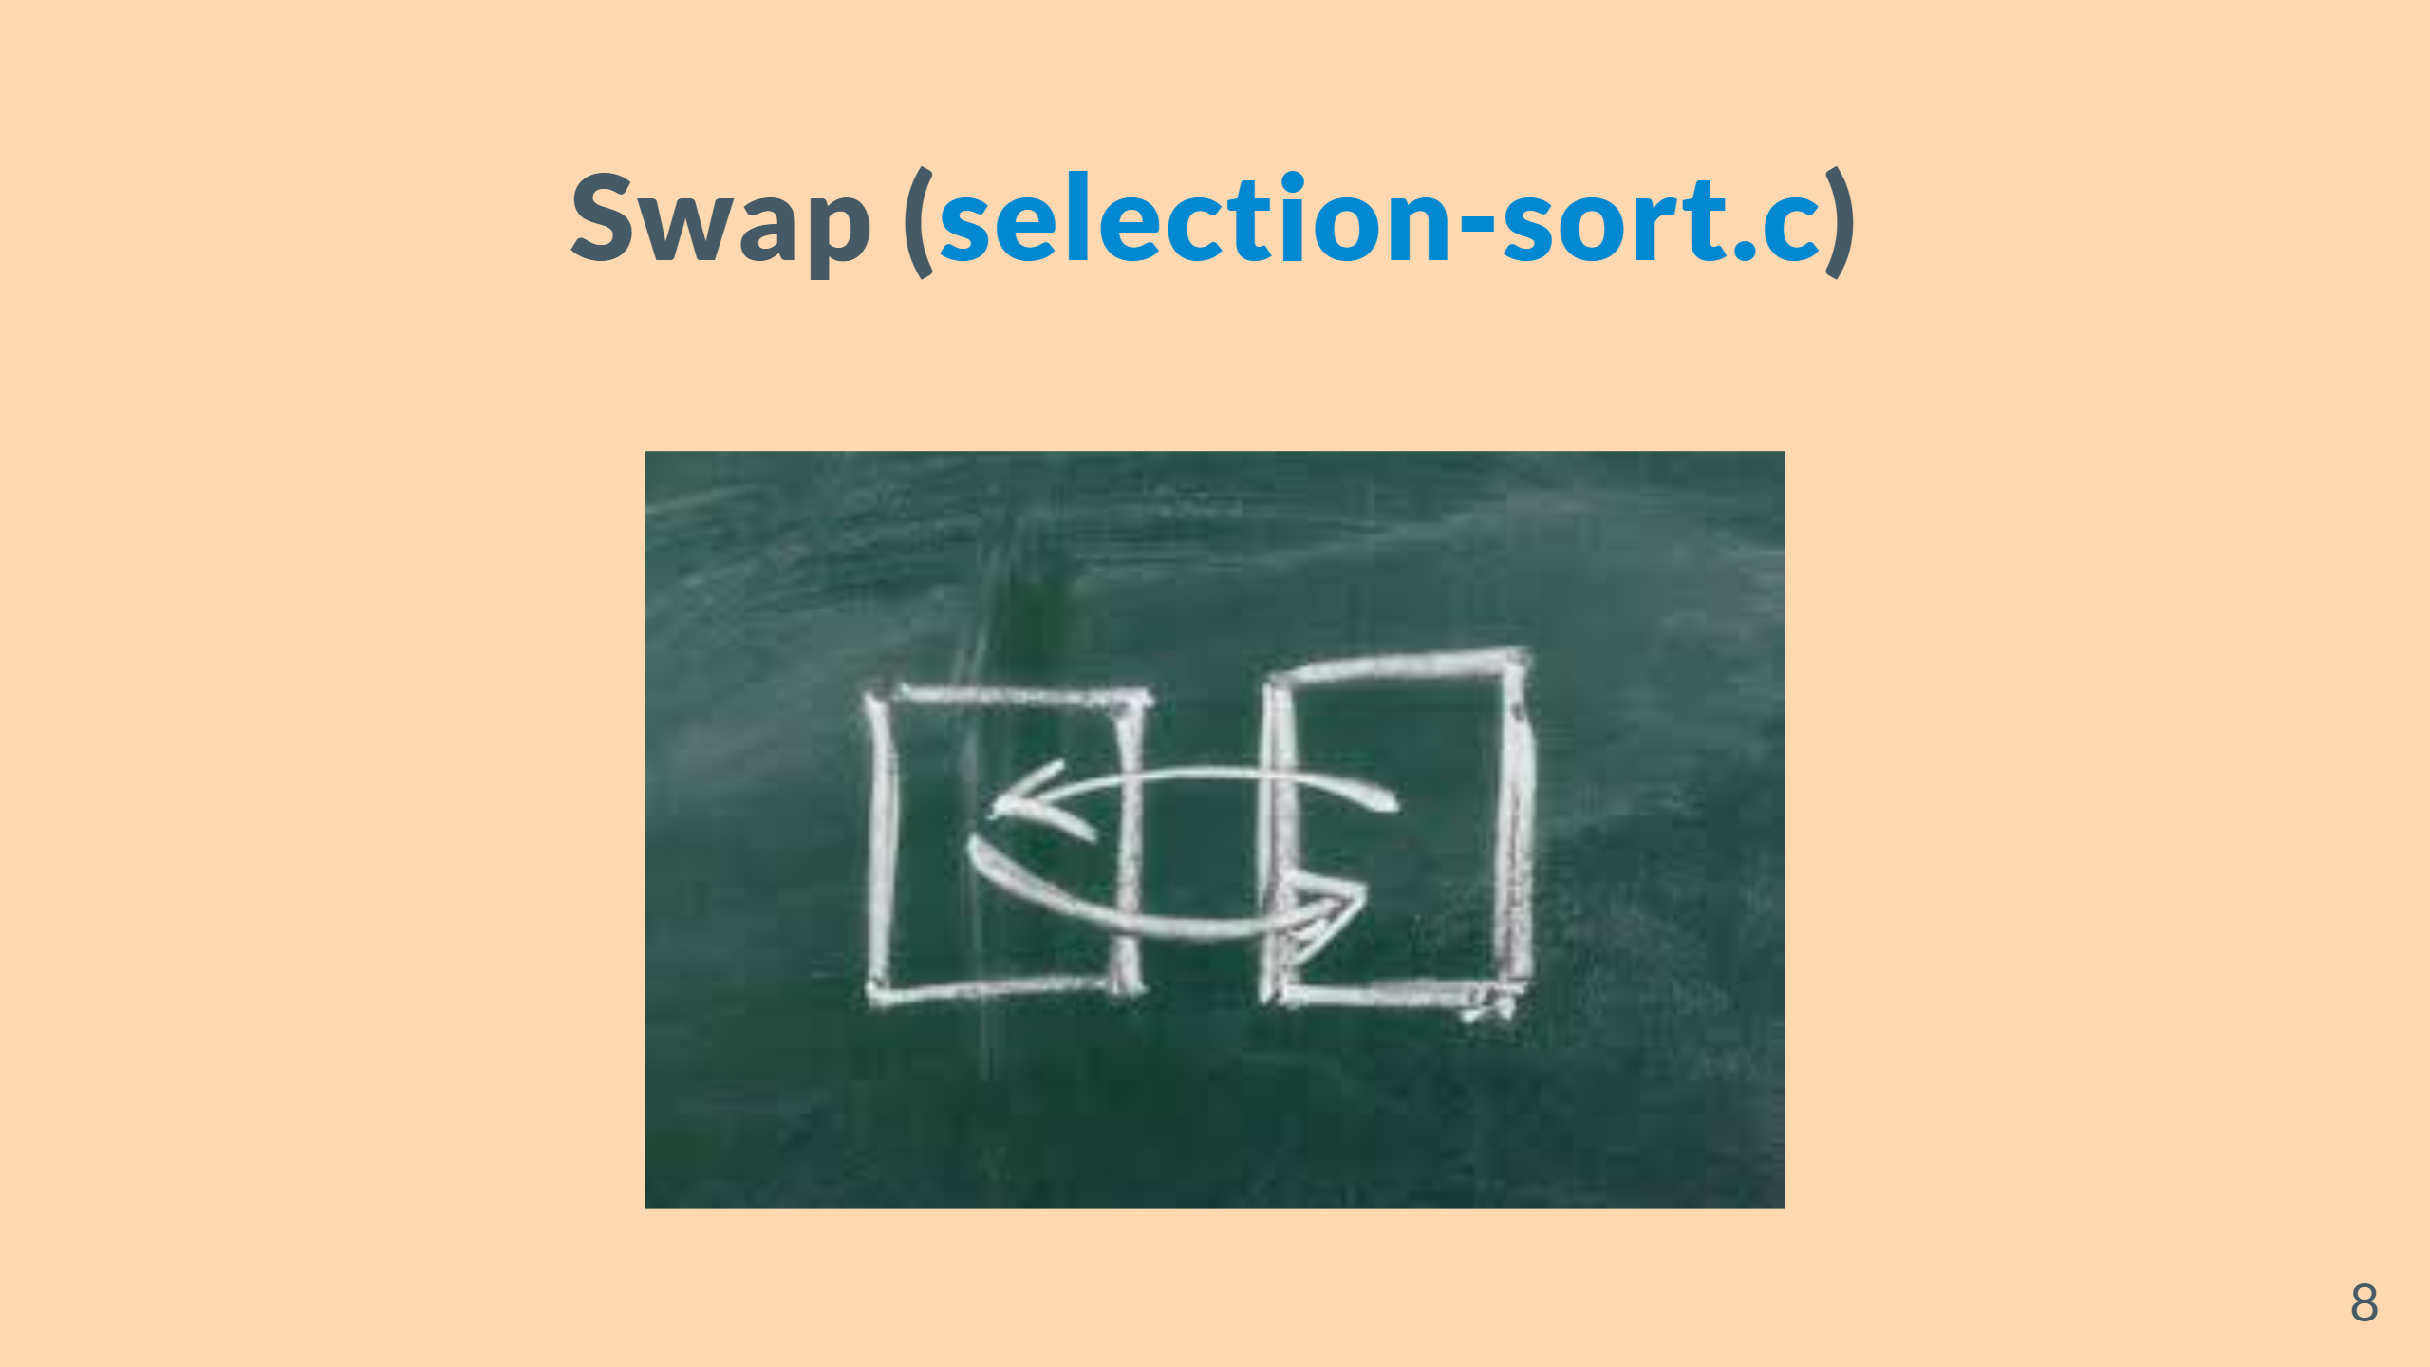

Slide 9
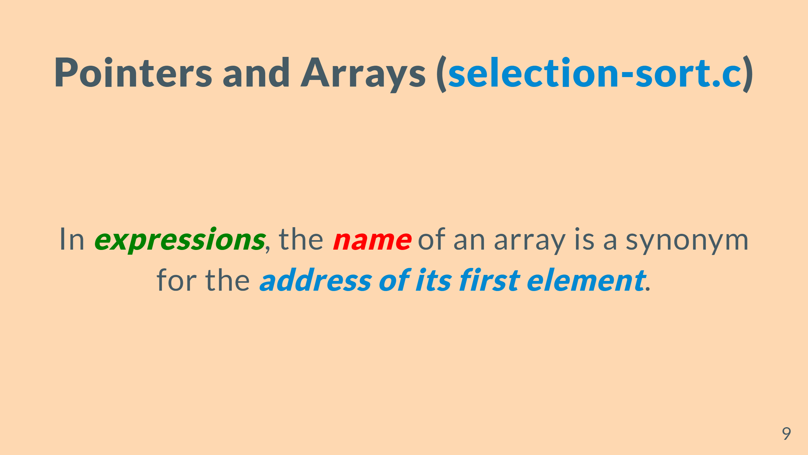

Slide 10
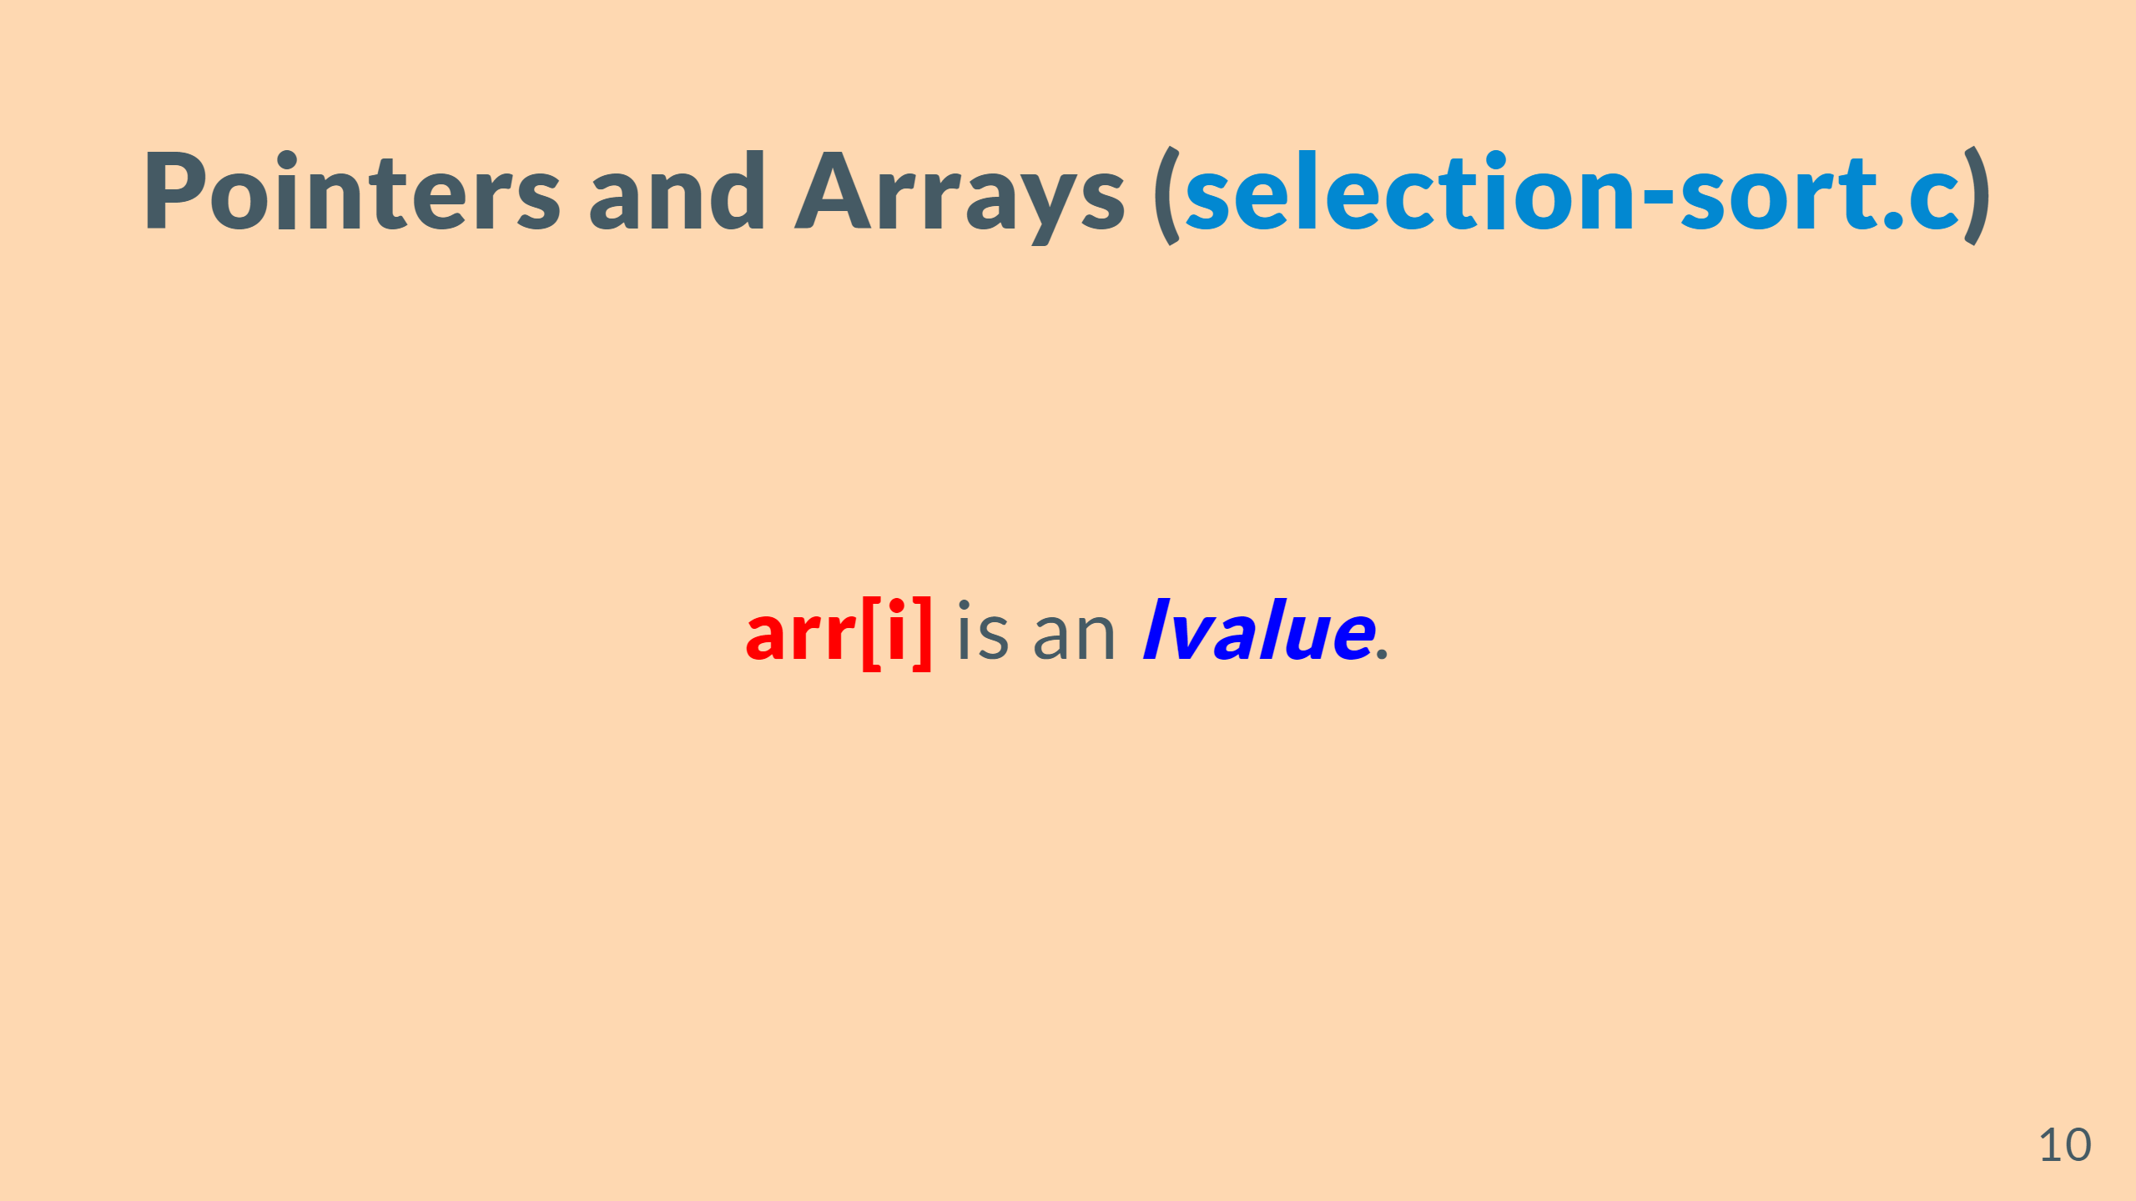

Slide 11
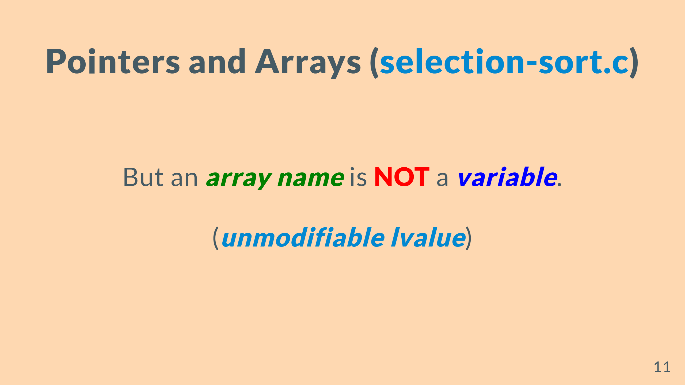

Slide 12
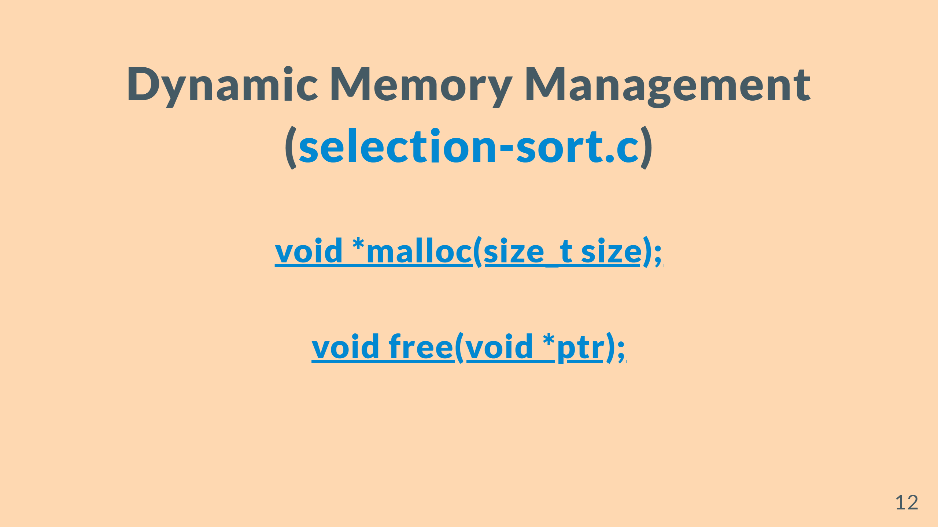
Notes:
--- # Returning Pointers from Functions (<mark>merge.c</mark>) ![w:800](figs/merge-arrays.png) --- # Returning Multiple Values from Functions (<mark>scanf.c</mark>) <br> <br> <br> ### <mark>while (<font color = red>scanf</font>("%d", \&numbers[++len]) != EOF); </mark>

Slide 13


