Slide 1
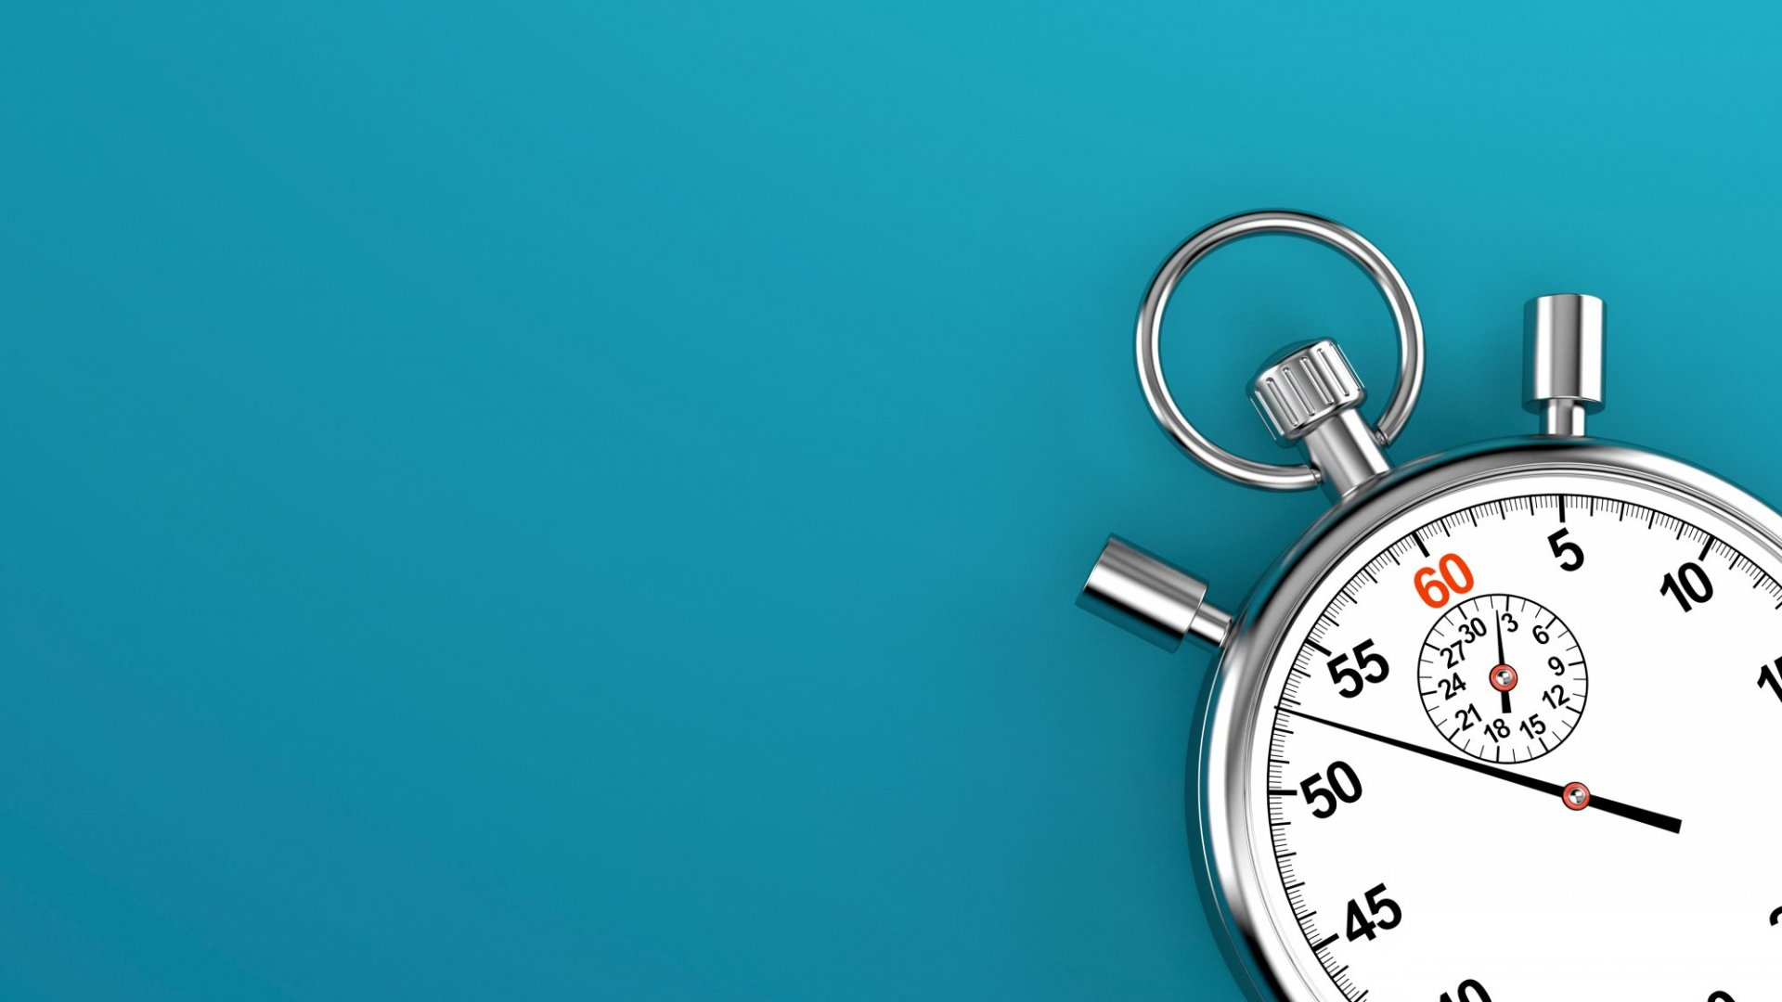

Slide 2
How to time a C program?

Slide 3
How to time your coding activities?

