Slide 1
Drone Data Acquisition | Processing | Analysis Using Open Source Tools
4-8 Nov’ 2019
Course Logistics
PS Singh, Scientist-SE
ss.puyam@nesac.gov.in

Slide 2

Course at a Glance
Lectures – 7 Hrs Core Concepts of Drone Data Acquisition, Processing and Analysis of the drone data
Hands-On - 4 Hrs
Guided Walkthrough to teach you on the important Open Source tools & Libraries for Drone Data Processing
Open Practical - 15 Hrs
Use the Hand-Outs for Processing of UAV data for generation of Orthomosaic, DSM DTMs, Dense Point Clouds, 3D Texture Models on Different Drone Datasets
Demonstrations on UAVs, Mission/Flight Planning for Data Acquisition

Slide 3
Lectures
L01: Overview of UAV Remote Sensing
L02: UAV Principles & Components / Operation and Flight Planning
L03: UAV Photogrammetry, Data Acquisition & Processing methods - Geometric corrections, extraction, accuracy and level of information.
L04: Real time UAV Image and video data processing
L05: Deep Learning for Computer Vision and its applications using UAV data
L06: LiDAR remote sensing applications using UAV
L07: Computer Vision for 3D Scene Reconstruction: Feature Detection, Matching and Generation of Sparse/Dense Point Cloud Using SfM & MVS techniques

Slide 4
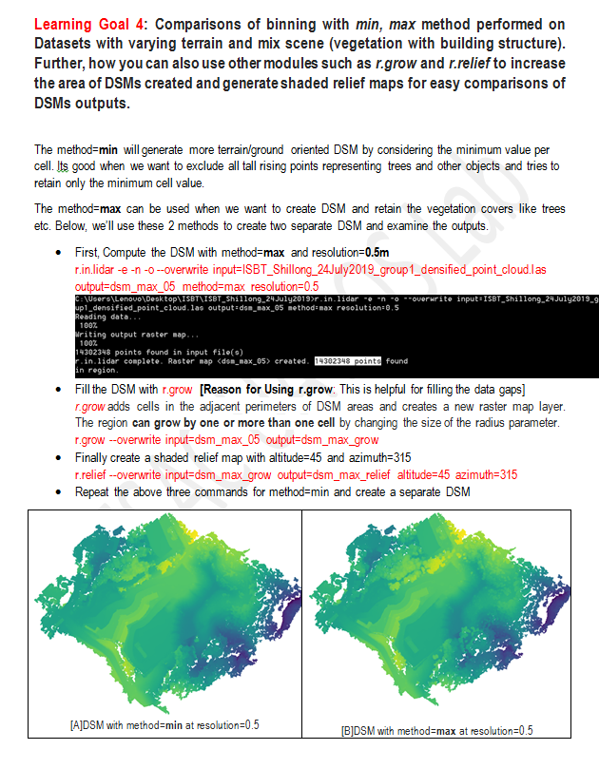
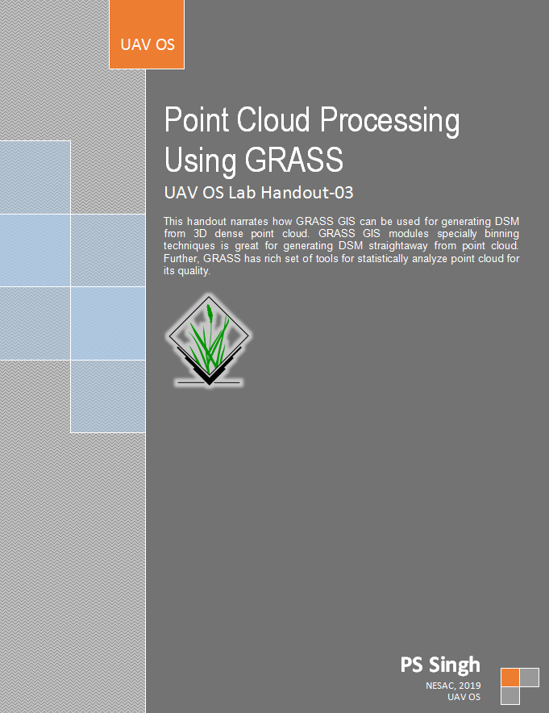
Hands-On Walkthrough
Practically learn about the Open Source Tools for Drone Data Processing
Detail Walkthrough has been prepared for applying these tools on our real UAV Datasets
Picked-Up Most Common Useful and Must-Know Tools & Libraries
Most of the Hand-Out will have Learning Goals defined to make you aware of what you’ll be doing & learning.
Quiz will be made based on these learning goals at on the last day to assess your understandings.

Slide 5
Hands-On Walkthrough
Hands-On #01
Hands-On #02/05
Hands-On #03
Hands-On #04
2D Drone Images
3D Dense Point Cloud
3D Dense Point Cloud
ENTWINE/
Potree/PDAL
VSfM
Filtering/Segmentation/ Translation/Classification
PDAL/PCL
Point Cloud Quality Analysis/Statistics/DSM/DTMs/Other Analysis Module
GRASS
CMPMVS
3D Dense Point Cloud
Classified Point Clouds
Filtered/Corrected Point Clouds
Statistics, DSM, DTM
Indexing and serving of large Scale Point cloud
Potree for Visualisation/Analysis
PDAL for information extraction
Orthophoto, DEM,
3D Mesh, Videos etc
Meshlab
Classified Point Clouds
Filtered/Corrected Point Clouds
Statistics, DSM, DTM
3D Textured Surface Model
(Visualization and Analysis)
Hands-On #06
3D Textured Models
Georeferenced Products – DSM, DTM, Orthomosaic
Contours,
Inbuilt 2D/3D Data Visualization
Sparse/Dense 3D Point Cloud
Geo-referencing, DEM Processing,
Orthomosaic Processing
2D Images
3D Meshing/
Texturing
OpenDroneMap

Slide 6
Open Practical Sessions
Flight Planning for UAV Data Acquisition with 1 practical flight Session
Drone Data Analysis with ML/DL
Follow the Hand-Out and carry out Drone Data Processing
Try on different UAV data scenes
Mixed Scenes (Building + Vegetation)
Building Structures
Terrain with less vegetation etc
Observe & Analyze the output.
Between different datasets/Methods/Platforms
Labs (114/110)
All the lecture materials relevant to the course will be made available on
Github page at https://github.com/courseuav/uavos/
Sat 09 : (Optional) Study Trip To Cherrapunji

